Slide 1
Presented by: Daniel Mondragon
Instagram: @embracingnonviolence
embracingnonviolence@gmail.com

Slide 2
Agreements for Critical Conversation
We will ensure each person is respected as fellow participants in the conversation.
We will listen fully to each other.
We will each speak/write in chat from our own experience and knowledge, being cautious about not sharing an unverified story or an opinion not based in fact.
We will touch on matters that are political, but not partisan.
We will refrain from “othering” anyone with whom we disagree or see as “opposition.”
We will hold our thoughts quietly when something is expressed that causes a negative internal reaction.
Now is not the time for debate. Allow each other to be.

Slide 3
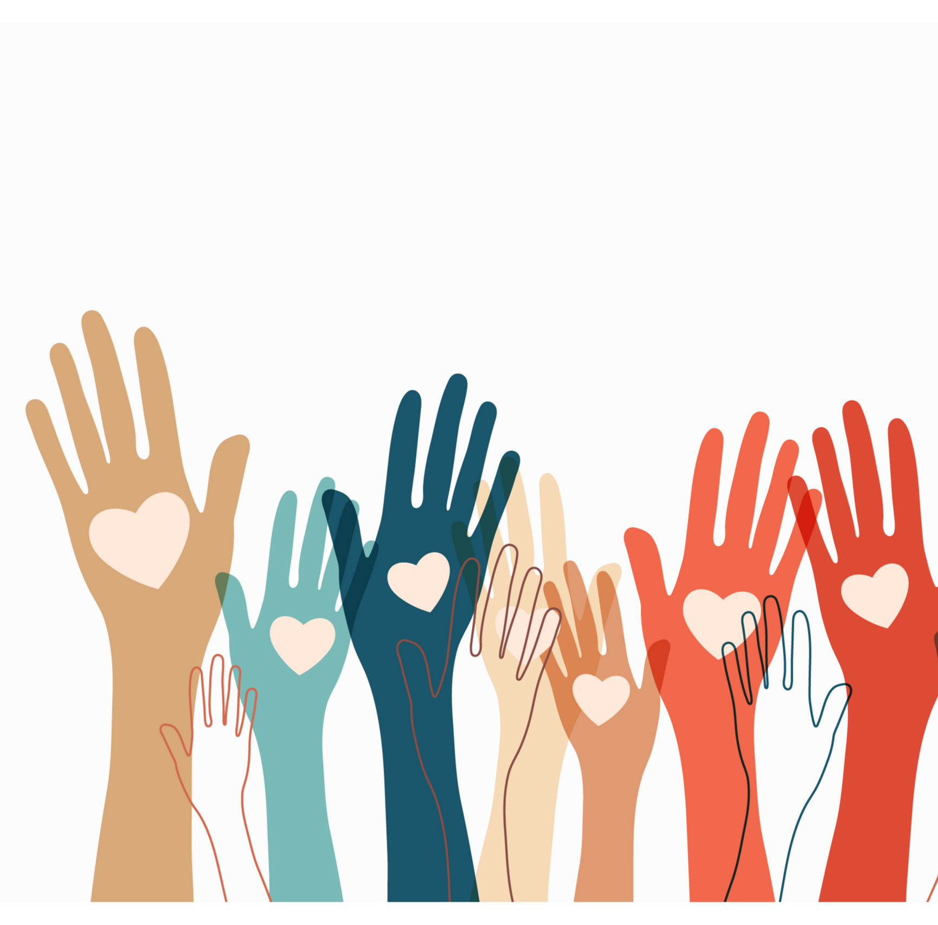
Beloved Community
“The aftermath of nonviolence is the creation of the beloved community, while the aftermath of violence is tragic bitterness.” It connotes a realty where all are welcome, respected as equals, live free of violence, and can contribute to and benefit from society. It is a loving way of life. A commitment to nonviolence and each other. It's a place where racism and poverty are ended, and people share a spirit of compassion.

Slide 4
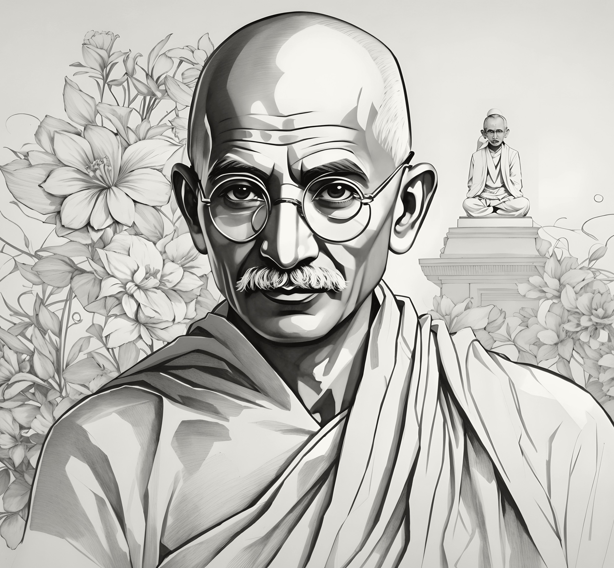
Mahatma Gandhi’s Teachings
Ahimsa: “Lacking any desire to kill. It implies a state in which no violence – of thought, or action – exists. In such a state, there is only love. It is a choice, an attitude to not harm, to not kill.”
Satyagraha: “It is a force of intense love…. It is an active seeking of the truth, devoid of hostility, anger, and violence….”
Satya (truth): “an expression of love.” Truth=Love!!!
Agraha (firmness): a commitment to “the denial of self-interest” - this was Gandhi’s solution to the subjectivity of truth.

Slide 5
Outcomes and Lessons Learned from the Montgomery story
Segregation and mistreatment on the buses, stemming from…..
System of “Jim Crow” laws and “ southern customs” from……
Discrimination and hatred of black people
Superiority belief system
FOCUS
IMPACT
Self-esteem & Agency
BELOVED
COMMUNITY INDICATORS
Respect & Civil Rights

Slide 6
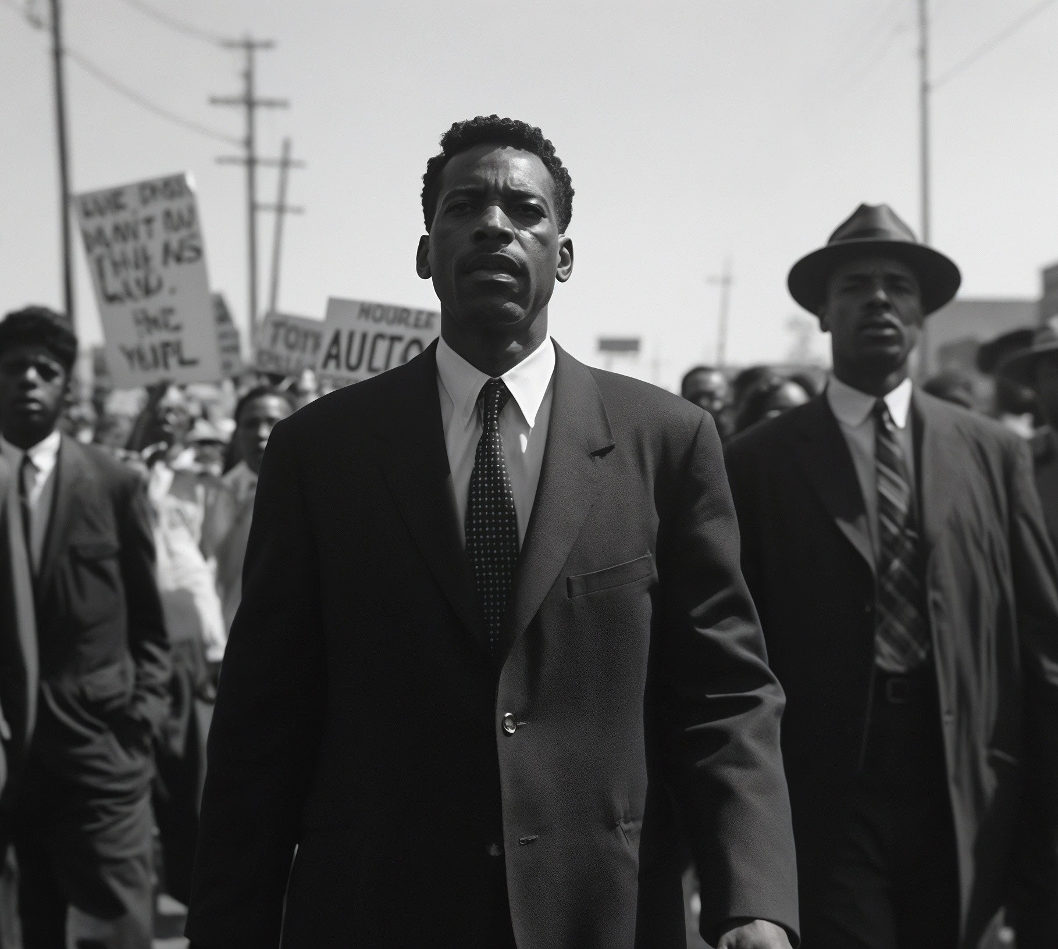
REV. DR. MARTIN LUTHER KING’S
SIX STEPS FOR NONVIOLENT SOCIAL CHANGE
The Six Steps for Nonviolent Social Change are based on Dr. King’s nonviolent campaigns and teachings that emphasize love in action. From Martin Luther King, Jr.’s “Letter from Birmingham Jail” in Why We Can’t Wait, Penguin Books, 1963.
INFORMATION GATHERING
EDUCATION
PERSONAL COMMITMENT
DISCUSSION / NEGOTIATION
DIRECT ACTION
A STEP TOWARDS THE BELOVED COMMUNITY

Slide 7
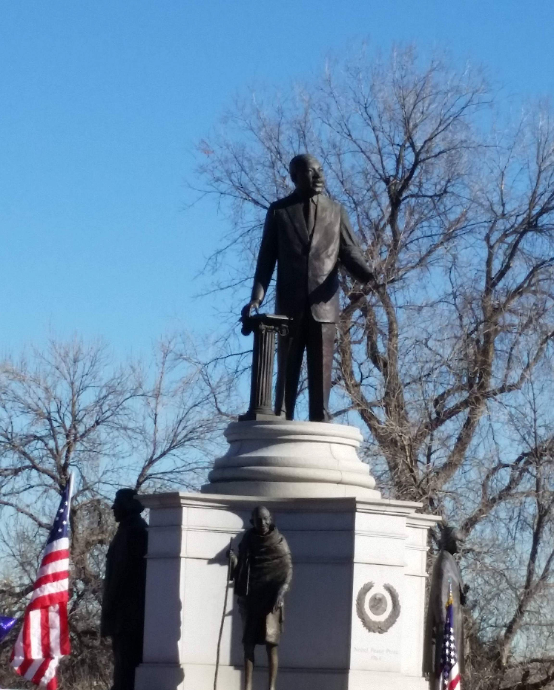
REV. DR. MARTIN LUTHER KING’S
SIX CHARACTERISTICS OF NONVIOLENCE
Stride Toward Freedom, p.90
Nonviolent resistance is not a method for cowards. It is a way of life for courageous people
It does not seek to defeat or humiliate the opponent, but to win friendship and understanding
It is directed to defeat injustices, not people
Nonviolence enables people to willingly accept suffering without retaliation
It chooses love over hate (Agape / Aloha)
Nonviolence is based on the conviction that the universe is on the side of justice

Slide 8

Connection to our Episcopal faith
Baptismal covenant
Will you seek and serve Christ in all persons, loving your neighbor as yourself?
Will you strive for justice and peace among all people and respect the dignity of every human being?
Gospel mandate
“Love as I have loved you”
Peacemakers – willing to suffer

Slide 9
Thank You
Power at its best is love implementing the demands of justice, and justice at its best is love correcting everything that stands against love.
Embracing Nonviolence
Daniel Mondragon, Project Director
Instagram: @embracingnonviolence embracingnonviolence@gmail.com
- Rev. Martin Luther King, Jr.

