Slide 1
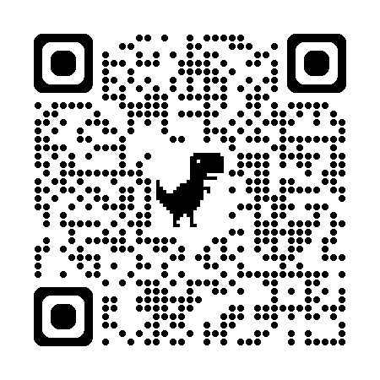
Blessed to Become
Beloved Community
Download the Becoming Beloved Community Where You Are booklet – latest update!

Slide 2
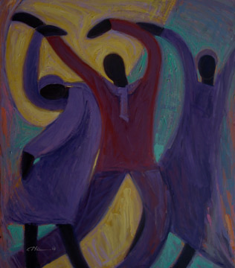
The Kingdom of God is justice and peace
And joy in the Holy Spirit
Come, Lord, and open in us
The gates of your kingdom

Slide 3
Litany of Repentance
We respond to “In your compassion”
by saying, “Have mercy on us.”
Drawn from Service of Repentance and Reconciliation offered at St. Paul's Episcopal Church, Delray Beach, FL, in the Diocese of Southeast Florida
Shared by Ellen Kentner: ellenjanekentner@gmail.com

Slide 4
Absolution & Forgiveness

Slide 5
Leviticus 19:33-34
When a stranger sojourns with you in your land, you shall not do him wrong. You shall treat the
stranger who sojourns with you as the native among you, and you shall love him as yourself, for you were strangers in the land of Egypt:
I am the Lord your God.
Hear what the Spirit is saying to God’s people.
Thanks be to God.

Slide 6
Psalm 36:5-11
Your love, O Lord, reaches to the heavens,
and your faithfulness to the clouds.
Your righteousness is like the strong mountains,
your justice like the great deep;
you save both human and beast, O Lord.
How priceless is your love, O God!
your people take refuge under the shadow of your wings.
They feast upon the abundance of your house;
you give them drink from the river of your delights.
For with you is the well of life,
and in your light we see light.
Continue your loving-kindness to those who know you,
and your favor to those who are true of heart.
Let not the foot of the proud come near me,
nor the hand of the wicked push me aside.

Slide 7
John 13 (31-35)
When Judas had gone out, Jesus said, “Now the Son of Man has been glorified, and God has been glorified in him. If God has been glorified in him, God will also glorify him in himself and will glorify him at once. Little children, I am with you only a little longer. You will look for me; and as I said to the Jews so now I say to you, ‘Where I am going, you cannot come.’ I give you a new commandment, that you love one another. Just as I have loved you, you also should love one another. By this everyone will know that you are my disciples, if you have love for one another.”
Hear what the Spirit is saying to God’s people.
Thanks be to God.

Slide 8
Reflections on the Day

Slide 9
How are you already becoming Beloved Community?
Where is God calling you to go next?
Learn more about the Episcopal Church’s commitment to Beloved Community at www.episcopalchurch.org/beloved-community

Slide 10
Our Prayers (attributed to Martin Luther King Jr.)
When our eyes do not see the gravity of racial injustice, Shake us from our slumber and open our eyes, O Lord.
When out of fear we are frozen into inaction, Give us a spirit of bravery, O Lord.
When we try our best but say the wrong things, Give us a spirit of humility, O Lord.
When the chaos dies down
and we are tempted to normalcy, Give us a spirit of steadfast solidarity, O Lord.
When it becomes easier to point fingers outward, Help us to examine our own hearts, O Lord. …

Slide 11
God of truth, in your wisdom
Enlighten Us.
God of love, in your mercy
Forgive Us.
God of hope in your kindness
Heal Us.
Creator of All People, in your generosity
Guide Us.
Racism breaks your heart break our hearts for what breaks yours, O Lord.

Slide 12
Baptismal Reaffirmation
We respond to each promise with a robust,
WE WILL, WITH GOD’S HELP!
Will you continue in the apostles’ teaching and fellowship, in the breaking of bread, and in the prayers?
Will you persevere in resisting evil, and, whenever you fall into sin, repent and return to the Lord?
Will you proclaim by word and example the Good News of God in Christ?
Will you seek and serve Christ in all persons, loving your neighbor as yourself?
Will you strive for justice and peace among all people, and respect the dignity of every human being?

Slide 13
Ain’t gonna let nobody turn me around,
turn me around
Ain’t gonna let nobody turn me around,
I’m gonna keep on walkin’,
Keep on talkin’,
Marching up to Freedom Land
Ain’t gonna let no hatred …
Ain’t gonna let racism …
Ain’t gonna let injustice …

Slide 14
O God, you made us in your own image
and redeemed us through Jesus your Son:
Look with compassion on the whole human family;
take away the arrogance and hatred which infect our hearts; break down the walls that separate us; unite us in bonds of love; and work through our struggle and confusion to accomplish your purposes on earth; that, in your good time,
all nations and races may serve you
in harmony around your heavenly throne;
through Jesus Christ our Lord. Amen.
- Prayer for the Human Family

Slide 15
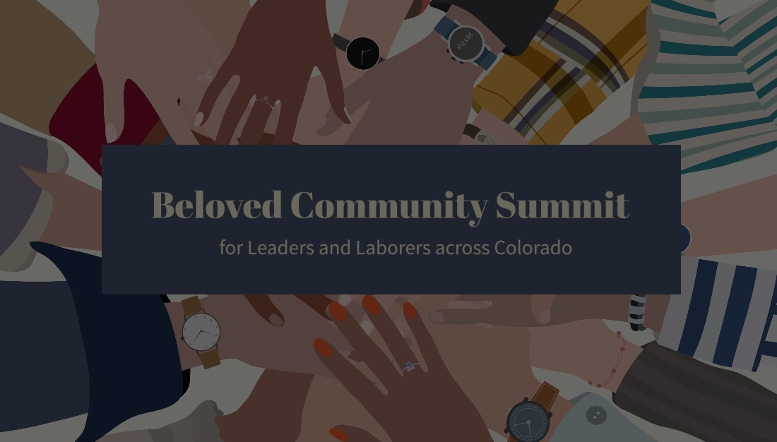
Keep Singing and
Keep Becoming GOD’S
Beloved Community!
Ain’t gonna let nobody turn me around,
turn me around …

