Slide 1
Gospel Values
for a Beloved Community
Talk 2: Thursday Mid-Morning Conversation
between The Rev. Canon Stephanie Spellers
and Bishop Kym Lucas

Slide 2
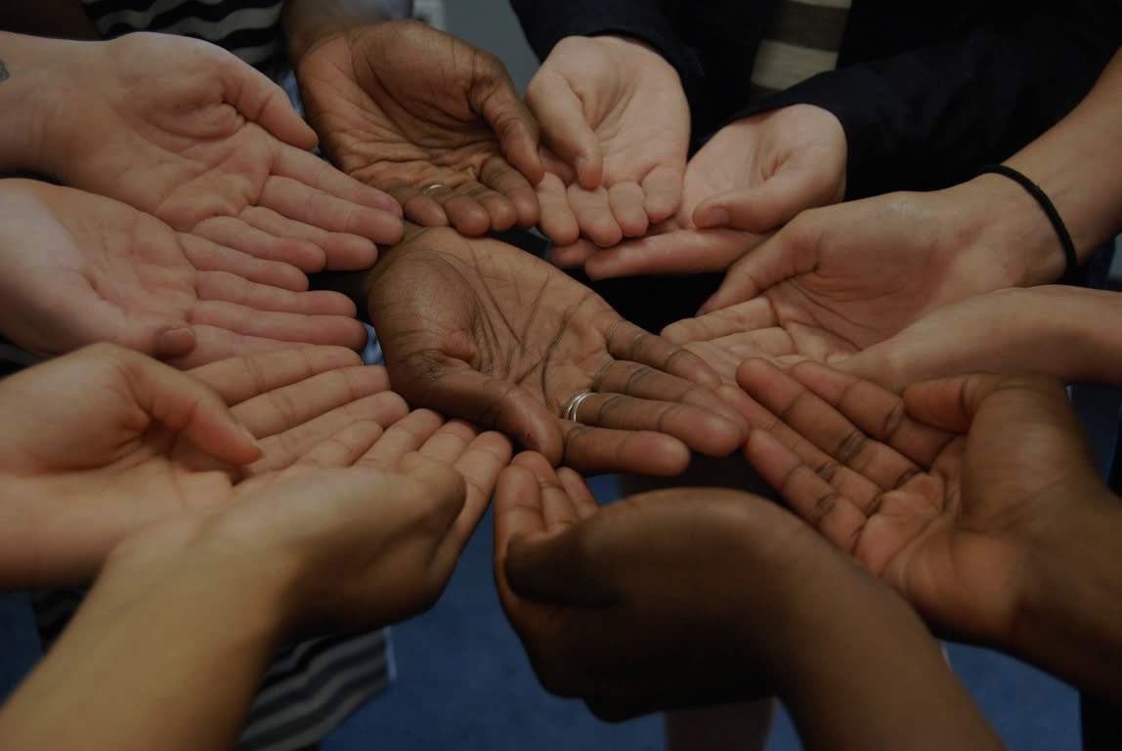
I have decided to follow Jesus (3x)
No turning back, no turning back
I have decided to love my neighbor …
I have decided to stand for justice …
I have decided to cry for mercy …

Slide 3
Gospel Values
for a Beloved Community

Slide 4
“Love the Lord your God with all your heart, and with all your soul, and with all your mind, and with all your strength”
- Mark 12:29-30
“Love your neighbor as yourself”
- Mark 12:31

Slide 5
“The eye cannot say to the hand,
‘I have no need of you.’ …
If one part suffers, every part suffers with it;
if one part is honored,
every part rejoices with it”
- 1 Corinthians 12:21,26

Slide 6
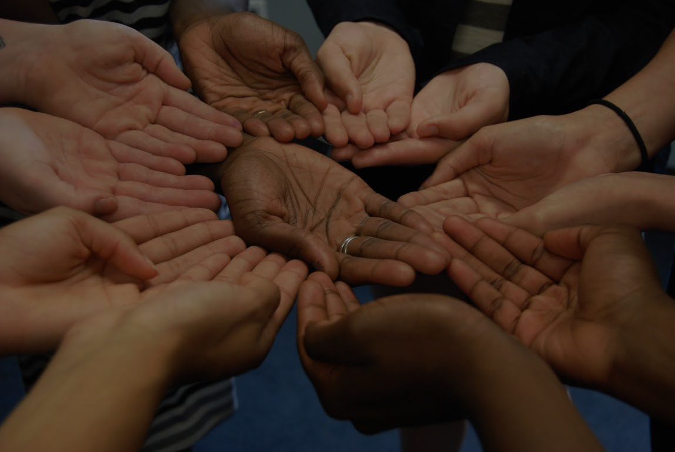
“We are all caught in an inescapable network of mutuality, tied in a single garment of destiny. Whatever affects one directly, affects all indirectly. I can never be what I ought to be until you are what you ought to be, and you can never be what you ought to be until I am what I ought to be.”
- Martin Luther King Jr.

Slide 7
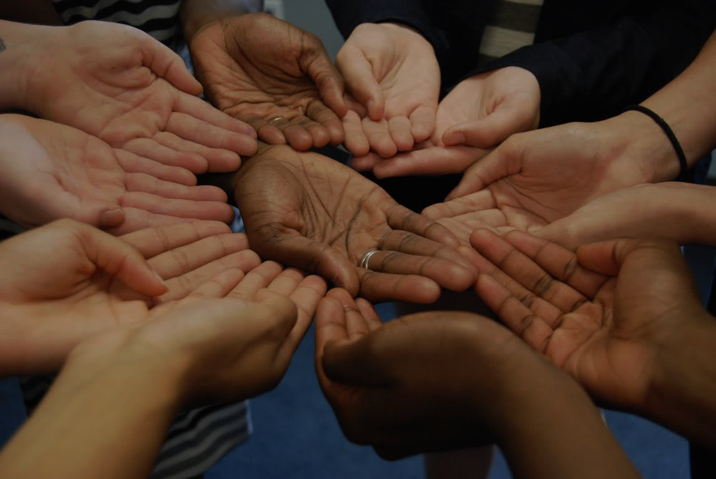
Isaiah 58:5-12: Such fasting as you do today will not make your voice heard on high. Is such the fast that I choose, a day to humble oneself? Is it to bow down the head like a bulrush and to lie in sackcloth and ashes? Will you call this a fast, a day acceptable to the Lord?
Is not this the fast that I choose: to loose the bonds of injustice, to undo the straps of the yoke, to let the oppressed go free, and to break every yoke? Is it not to share your bread with the hungry and bring the homeless poor into your house; when you see the naked, to cover them and not to hide yourself from your own kin?

Slide 8
Then your light shall break forth like the dawn, and your healing shall spring up quickly; your vindicator shall go before you; the glory of the Lord shall be your rear guard. Then you shall call, and the Lord will answer; you shall cry for help, and he will say, “Here I am.”
If you remove the yoke from among you, the pointing of the finger, the speaking of evil, if you offer your food to the hungry and satisfy the needs of the afflicted, then your light shall rise in the darkness and your gloom be like the noonday. The Lord will guide you continually and satisfy your needs in parched places and make your bones strong, and you shall be like a watered garden, like a spring of water whose waters never fail. Your ancient ruins shall be rebuilt; you shall raise up the foundations of many generations; you shall be called the repairer of the breach, the restorer of streets to live in.

Slide 9
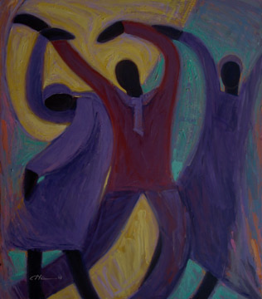
Baptismal Covenant
Will you continue in the apostles’ teaching and fellowship, in the breaking of bread, and in the prayers?
Will you persevere in resisting evil, and, whenever you fall into sin, repent and return to the Lord?
Will you proclaim by word and example the Good News of God in Christ?
Will you seek and serve Christ in all persons, loving your neighbor as yourself?
Will you strive for justice and peace among all people, and respect the dignity of every human being?

Slide 10
Gospel Values
for a Beloved Community

