Slide 1
Becoming Beloved Community:
Now More Than Ever!
Talk 1: Thursday Morning Session
The Rev. Canon Stephanie Spellers
Author of The Church Cracked Open and Church Tomorrow? (out in Nov.)
Assisting Priest at St. Bartholomew’s-NYC
Learn more about the Episcopal Church’s vision for Beloved Community
at www.episcopalchurch.org/beloved-community

Slide 2
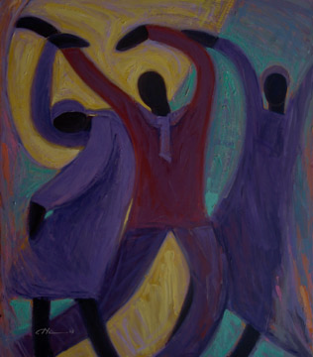
Arise and shine
for your light has come.
And the glory of the Lord
has dawned upon you!

Slide 3
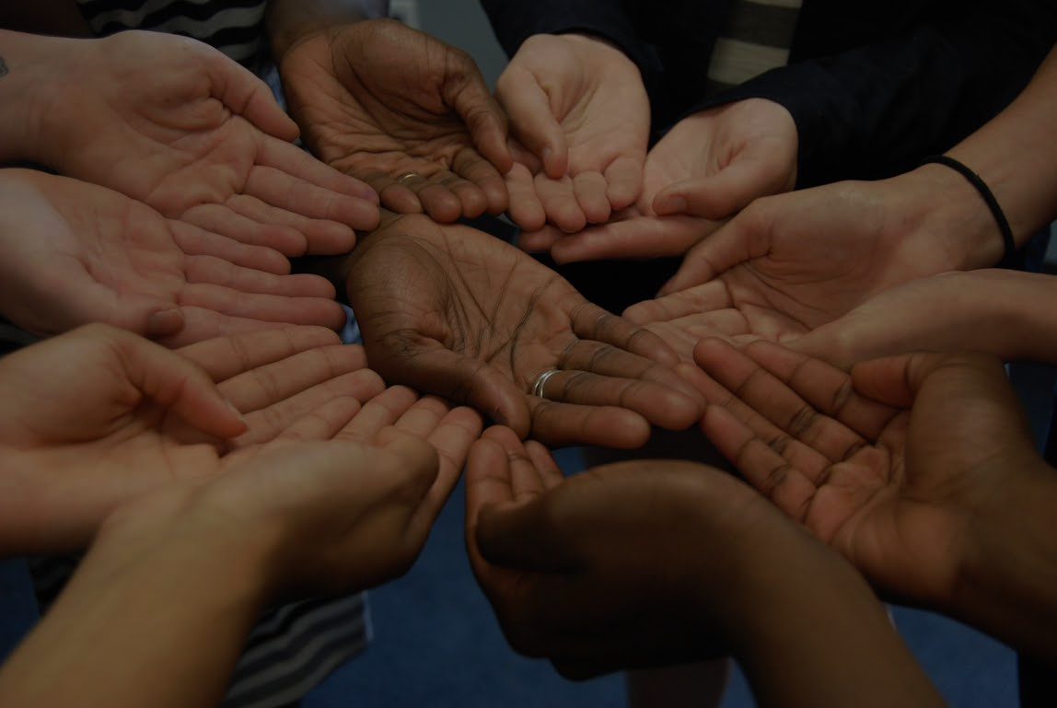
O God, you made us in your own image
and redeemed us through Jesus your Son:
Look with compassion on the whole human family;
take away the arrogance and hatred which infect our hearts; break down the walls that separate us; unite us in bonds of love; and work through our struggle and confusion to accomplish your purposes on earth; that, in your good time,
all nations and races may serve you
in harmony around your heavenly throne;
through Jesus Christ our Lord. Amen.
- Prayer for the Human Family

Slide 4
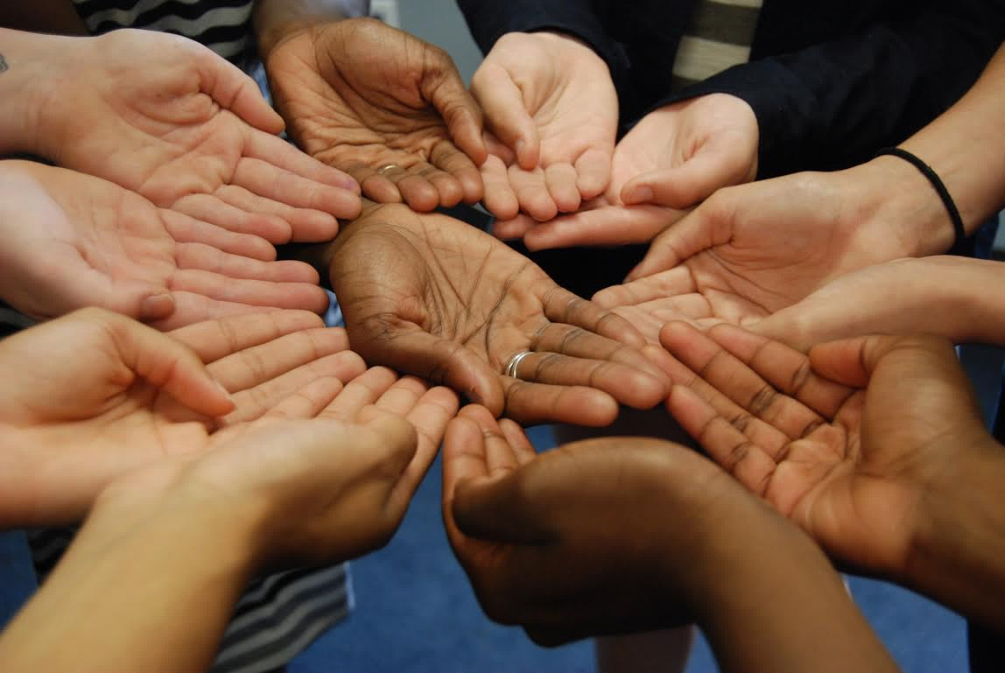

Slide 5
Learn more www.episcopalchurch.org/beloved-community

Slide 6
O God, you made us in your own image
and redeemed us through Jesus your Son:
Look with compassion on the whole human family;
take away the arrogance and hatred which infect our hearts; break down the walls that separate us; unite us in bonds of love; and work through our struggle and confusion to accomplish your purposes on earth; that, in your good time,
all nations and races may serve you
in harmony around your heavenly throne;
through Jesus Christ our Lord. Amen.
- Prayer for the Human Family

Slide 7
Beloved Community:
The community united in bonds of love
where your suffering pains me,
your hope becomes my hope,
and your flourishing makes my heart sing.
The community where I am willing to take risks
to give up some preference or comfort,
and to dismantle any system that wounds you,
until we all finally become whole and free.
From The Church Cracked Open: Disruption, Decline and New Hope for Beloved Community

Slide 8
Learn more www.episcopalchurch.org/beloved-community

Slide 9
Telling the Truth about Our Churches and Race
– TRUTH-TELLING
What racial, cultural and ethnic groups are in our church?
Who is around us?
What groups shape our common life, leadership and worship?
How has our church excluded or embraced different racial, cultural and ethnic groups over time?
Will you persevere in resisting evil, and whenever you fall into sin,
repent and return to the Lord?

Slide 10
Telling the Truth about
Our Churches and Race
Identify a moment when you saw racial hierarchy and domination
in your/our church.

Slide 11
Proclaiming the Dream of Beloved Community – PROCLAMATION
What does Beloved Community look like for you and your neighbors?
How could you preach, pray, and engage in public witness around Beloved Community?
How could that vision shape your corporate worship and prayer?
Will you proclaim by word and example the Good News of God in Christ?

Slide 12
Practicing the Way of Jesus –
FORMATION
How will we grow as reconcilers
and healers?
What activities, practices, learning
and experiences would (trans)form us?
How will we share and receive stories,
grow relationship across dividing walls
and seek Christ in each other?
Will you seek and serve Christ in all persons, loving your neighbor as yourself?

Slide 13
Practicing the Way of Jesus –
FORMATION
Share with your partner about a moment when you felt excluded from a group or community.

Slide 14
Repairing the Breach in Society and Institutions – JUSTICE
What social institutions and systems most clearly bear the signs of racial injustice and brokenness?
How could we participate in the repair, restoration, and healing of people, institutions, and systems?
Will you strive for justice and peace among all people,
and respect the dignity of every human being?

Slide 15
How are you already becoming Beloved Community?
Where is God calling you to go next?
Learn more www.episcopalchurch.org/beloved-community

Slide 16
Arise and shine
for your light has come.
And the glory of the Lord
has dawned upon you!

Slide 17
Becoming Beloved Community:
Now More Than Ever!
Talk 1: Thursday Morning Session
The Rev. Canon Stephanie Spellers
Author of The Church Cracked Open and Church Tomorrow? (out in Nov.)
Assisting Priest at St. Bartholomew’s-NYC
Learn more about the Episcopal Church’s vision for Beloved Community
at www.episcopalchurch.org/beloved-community

