Slide 1

Discernment Team
Orientation Training
GF

Slide 2
A Prayer for Discernment
Lord I know that you love me and that your desire is for me to live my life fully alive and attuned to your ways. But sometimes I am overwhelmed by the thought of my future.
Show me how to walk forward one day at a time. As I explore the options that lie before me, help me to listen openly to others and to pay attention to what is in the depth of my own heart.
In this way, may I hear your call to a way of life which will allow me to love as only I can, and allow me to serve others with the special gifts You have given me. Amen.
TM

Slide 3
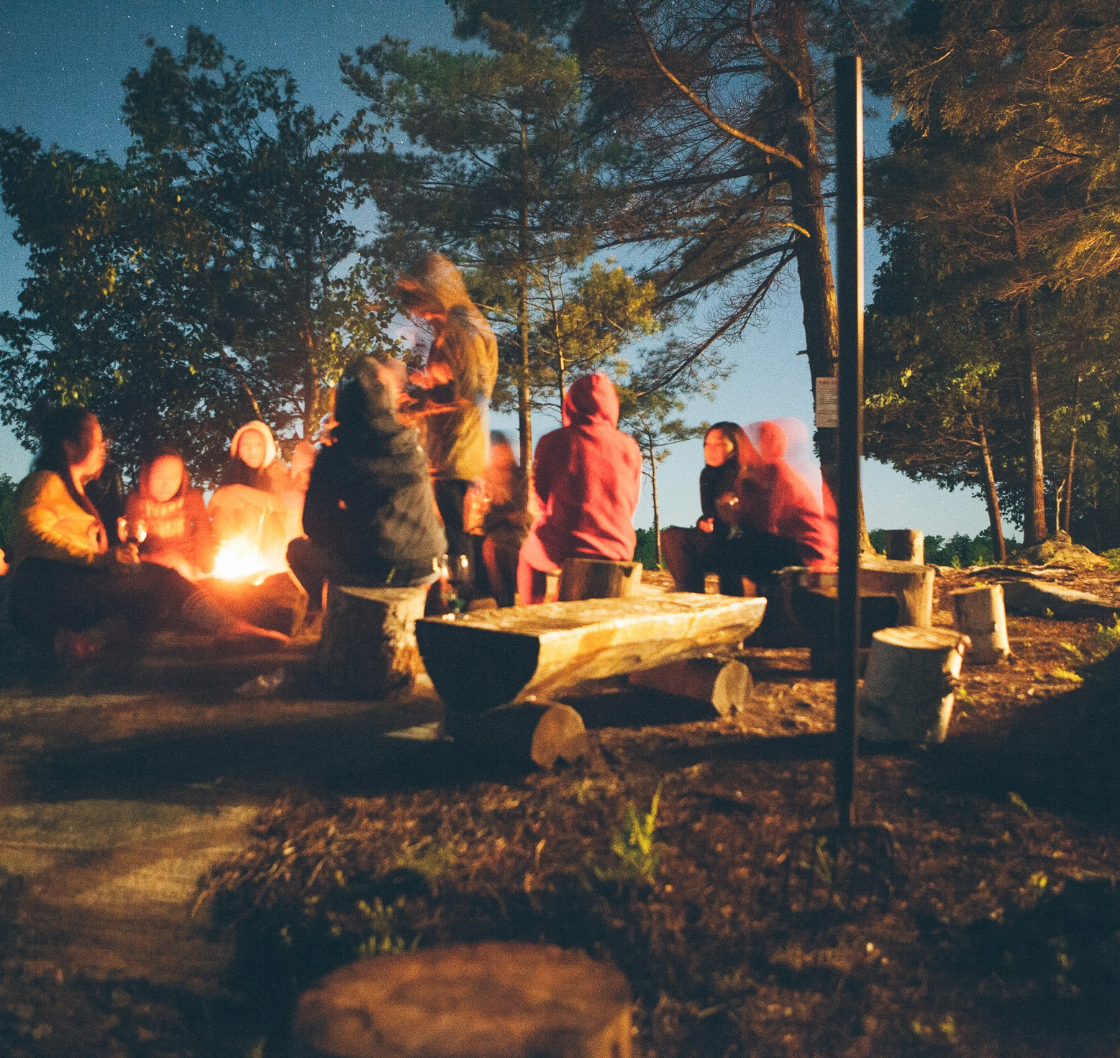
Introductions Using Mutual Invitation
DD

Slide 4

Discernment Process Overview
Seeker begins to discern their faith, gifts, and possible call
Seeker meets with their priest (3-12 months)
  Spiritual direction is strongly encouraged
Priest calls a congregational discernment team
Priest requests an orientation/training for the congregational discernment team
  A team of trainers has been trained by the Office of the Bishop
Seeker meets monthly with congregational discernment team 7-12 months
Congregational discernment team writes summary for rector or priest
Priest and seeker take next steps
Notes:
Bullet 2: The timeframe will vary from person to person based on their gifts and possible call. A longer timeframe of meetings is indicated if seeker seems to be sensing a call to ordained ministry.
Bullet 3: Priest determines timing of calling a discernment team.

Slide 5

Why Are We Here?
“Don’t ask what the world needs.
Ask what makes you come alive,
and go do it.
Because what the world needs
is people who have come alive.”
~ Howard Thurman
GF

Slide 6

What Is Discernment?
A definition
What are people discerning?
Models of discernment
Parker Palmer video
  https://www.youtube.com/watch?v=t_J6RE5_5R4
TM

Slide 7
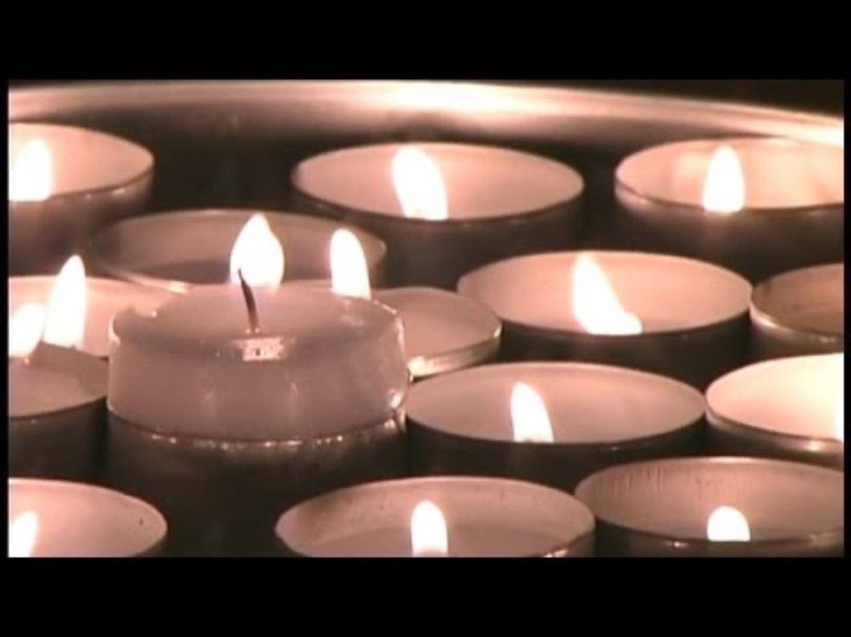

Slide 8

What Are People Discerning?
TM
Notes:
People and communities are discerning around many things

Slide 9


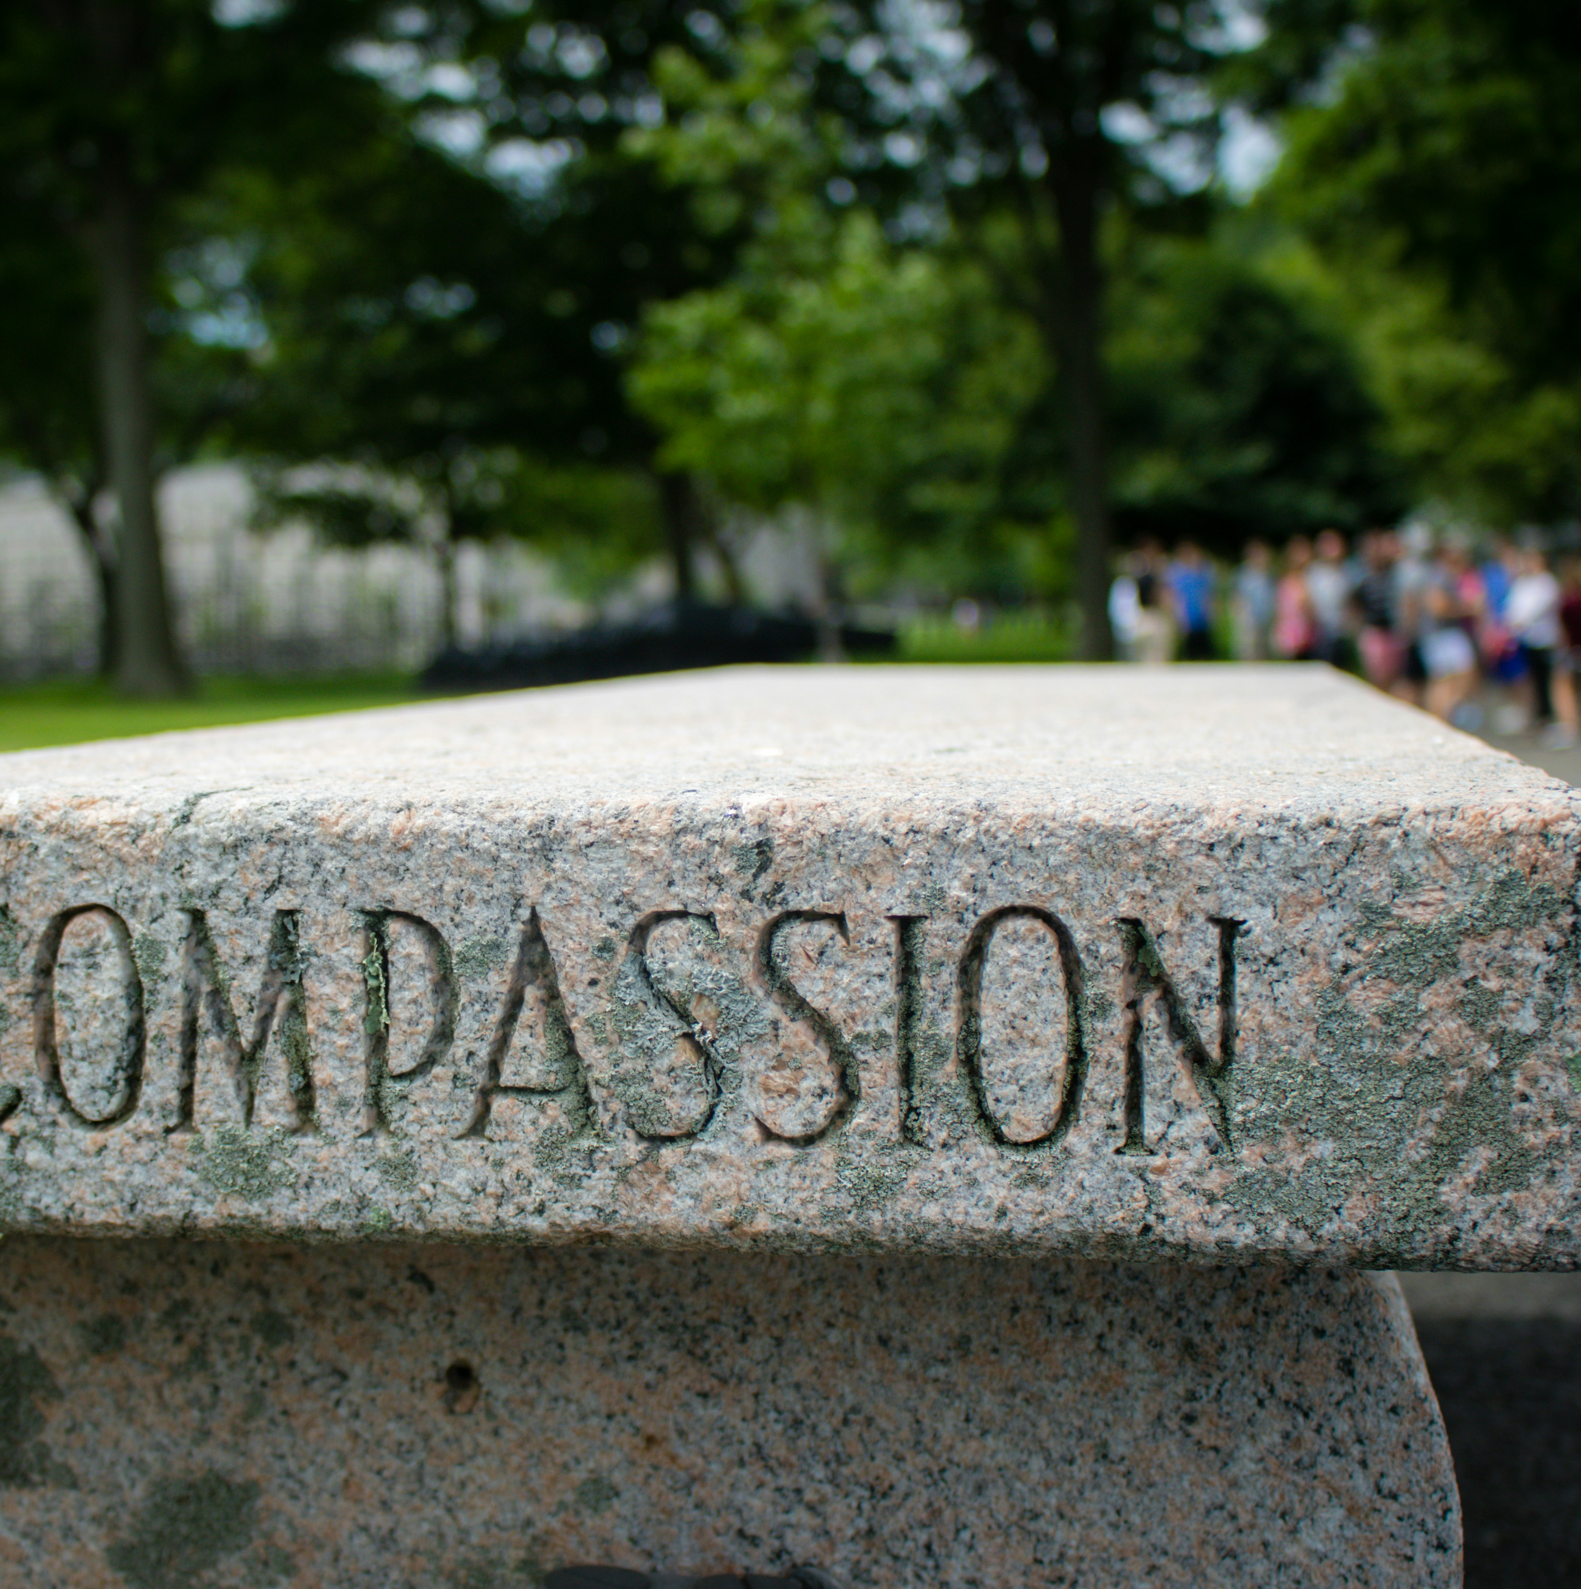

Lay Leaders
Types of ministry
  Licensed
  Congregational ministries
Qualities of lay leaders
Web page: https://episcopalcolorado.org/lay-ordained-ministry/licensed-lay-ministry/
TM

Slide 10

Vowed Religious
Life
Religious orders
Religious communities
Qualities of people living a vowed religious life
Explore: https://episcopalcolorado.org/lay-ordained-ministry/vowed-religious-life/
GF

Slide 11
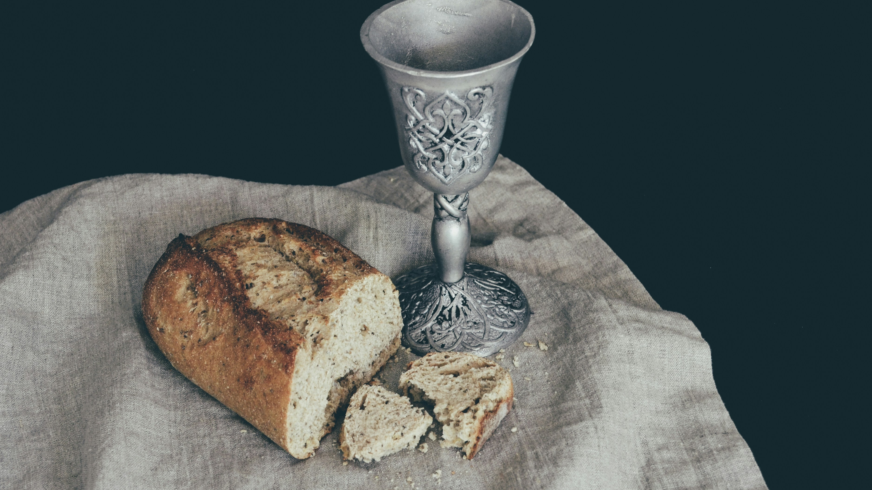
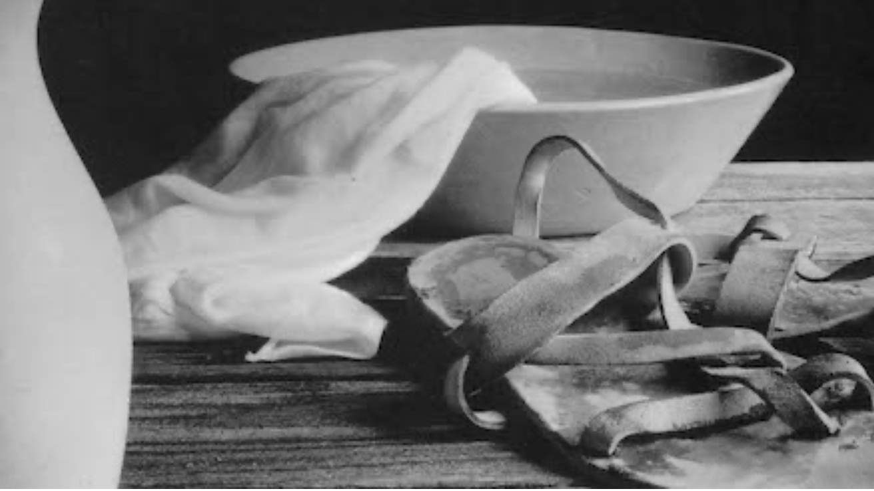
Ordained Leaders
What are qualities of ordained leaders?
Deacons
Priests
GF

Slide 12

What Does Discernment in Community Look Like?
A sacred container for listening to the Holy Spirit
A gift and a mutual blessing
A compassionate listening and gentle exploring process, loving and attentive to the seeker
Completely confidential: no commenting outside the team; however, congregation may be invited to pray for the seeker and the discernment team (if the seeker is ready for this)
Spirit-led
Shared leadership
Open-ended
Comfortable with silence, allowing the team and seeker to notice the movement of the Holy Spirit
Comfortable with whatever unfolds during the discernment process
Able to speak the truth in love
“We can never achieve wholeness simply by ourselves but only together with others. Consequently as we involve the community in discerning call, God enlivens and strengthens both us and the community.”
~ Susan Farnham
DD

Slide 13
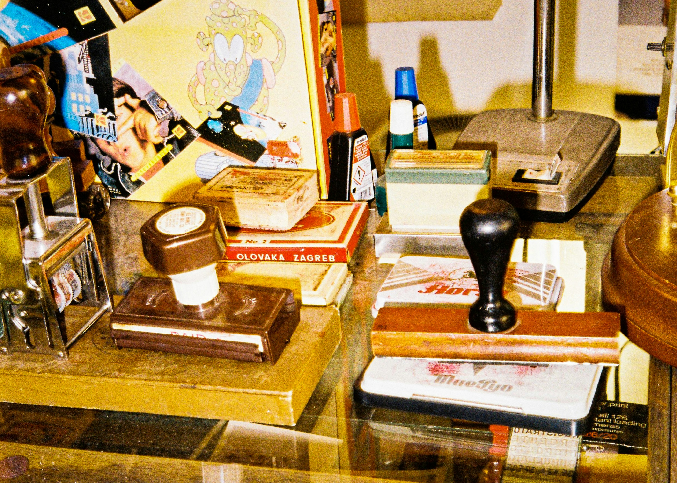
What Discernment in Community Is Not
Having preconceived notions of outcomes
Guided by rules and regulations
Informational
An interrogation
A support group (You are not a cheerleader for the seeker)
Driven by deadlines
A mutual sharing group
  90:10 guideline
GF

Slide 14

What Is the Team Listening for?
Does the seeker know what they are getting into and why they are doing this?
Is the seeker able to articulate who and what they are?
Is there a level of transparency apparent in their personhood?
Does the seeker understand they are discerning for the Episcopal Church, not a specific congregation, diocese, or another Christian tradition?
TM

Slide 15

When Does Discernment End?
It is okay to stop the process at any time if it becomes clear to the seeker that this is not what they want to do with their life—at least at this time.
If this happens, the seeker should continue meeting with their priest and spiritual director.
DD

Slide 16

What Happens at the First Meeting?
Begin with a prayer experience offered by one of the discernment team members (15-20 minutes).
  Intentionally invite the Holy Spirit.
Confirm that everyone on team has read the book Listening Hearts by Suzanne Farnham.
  Priest should provide discernment team members with a copy of the book.
  It is recommended the seeker read Let Your Life Speak by Parker Palmer.
Share spiritual autobiographies.
  10 minutes each (have timekeeper).
  Each person shares their spiritual journey (no more than 10 minutes).
  Option to use template provided by formation team.
Seeker gives an expanded version of their spiritual journey (up to 20 minutes).
Close with prayer.
DD

Slide 17

Future Sessions
Begin each meeting with a 15-20 minute prayer experience offered by a discernment team member (all members take turns).
Following each meeting, the discernment team members, not including the seeker, should briefly discuss what they would like to explore next with the seeker. This should be based on observations, reflections, and discussions from previous meetings.
TM

Slide 18

Logistical Considerations
Discernment teams meet with the seeker a minimum of seven months.
Meetings should last no more than 90 minutes.
Meetings occur every 4-6 weeks.
Meetings can take place via Zoom or in person.
Leadership is shared: in addition to different team members leading opening and closing prayers, they take turns facilitating individual sessions.
The team should select a scheduler who can communicate with the team, schedule meetings, and create the prayer schedule.
DD

Slide 19

Support for Discernment Teams
If the Discernment Team has questions or needs direction, reach out to your orientation trainer(s).
DD

Slide 20

What Happens When Discernment Is Complete?
Discernment team summary
  Choose team member to write summary.
  Should include:
      Team’s level of comfort with the seeker as someone who continues to feel called to lay or ordained ministry.
      Team’s support for moving the seeker forward in the process with enthusiasm
      Any indications the seeker is appropriate for a specific path: ordained ministry (deacon/priest), vowed religious life, lay ministry
Summary should be reviewed and signed by all discernment team members.
The discernment team summary is sent to the rector or sponsoring priest.
DD

Slide 21

Scenarios
You’ve progressed through the minimum seven months. Some people on the team think you’re finished. Others think you’re not. How do you decide if you should continue with the discernment process?
In session two, the seeker says they are discerning for the priesthood. How do you respond?
Your team is talking about the movement of the Holy Spirit, and one team member says they don’t know what it means to listen for the Holy Spirit. What might you say?
GF

Slide 22
Scenarios
The person who is supposed to lead the opening prayer experience forgot to prepare. What do you do?
After session five, the seeker feels they are being called to the diaconate. What suggestions might you offer them for exploring this path more deeply?
The team is sensing a lack of transparency from the seeker. It feels like they may be telling the discernment team what they want to hear. What do you do?
TM

Slide 23
Scenarios
A discernment team member expresses discomfort with allowing space for silence. How do you handle this?
The seeker shares that they are in recovery. How does the team receive this?
DD

Slide 24

Wrap-Up
Twice-annual trainings
Dianne will reach out to you as requests are received
Take time to explore discernment web pages: https://episcopalcolorado.org/lay-ordained-ministry/discerning-gods-call/
Is there anything else you need to prepare for your trainings?
Final thoughts and questions
Thank you for your willingness to be part of this work training discernment teams.
GF

