Slide 1
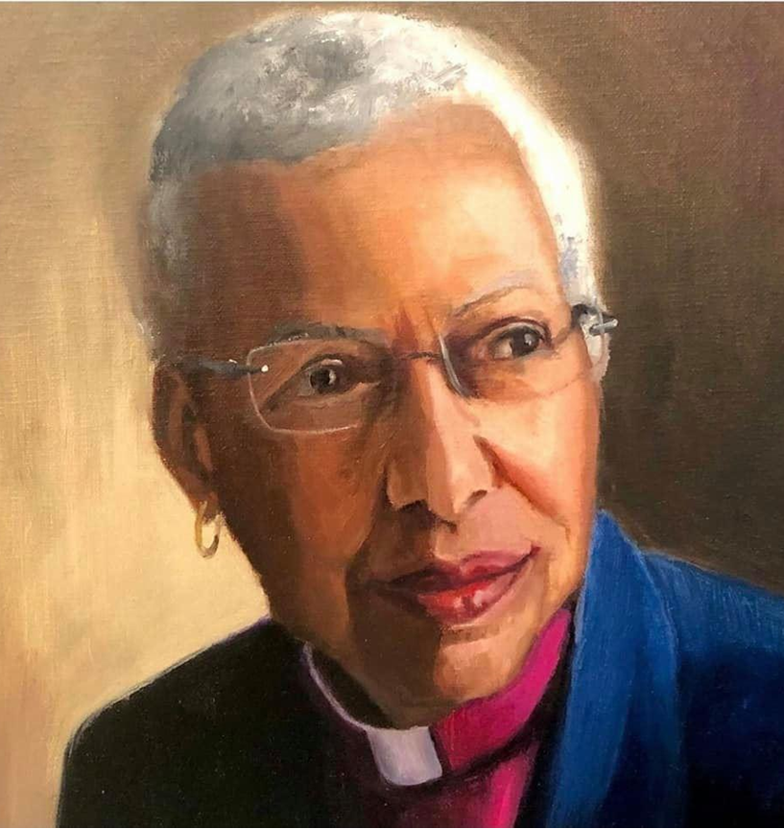
Full Screen Image Slide
O God, the light of the minds that know you,
the joy of the hearts that love you,
the strength of the wills that try to serve you.
Grant us to so know you as to love you,
so love you as to serve you –
in whose service is perfect freedom.
And since you have called all of us
to your service,
make us worthy of that calling
and empower us for that service,
through Jesus Christ our Lord. Amen.
- The Right Rev. Barbara C. Harris

Slide 2

Vocation
is a tapestry that gathers up the disparate threads of a life.
Professor Ellen Davis

Slide 3

Emotional Labor
The management of emotions in the course of observing the practices, rules and expectations of the practice of ministry.

Slide 4

Emotional Labor
Surface acting:
Conscious display of emotions that is appropriate for the moment but not aligned with the emotions we are feeling.
Deep acting:
An effortful process through which employees change their internal feelings to align with the circumstance, producing more natural and genuine emotional displays.

Slide 5
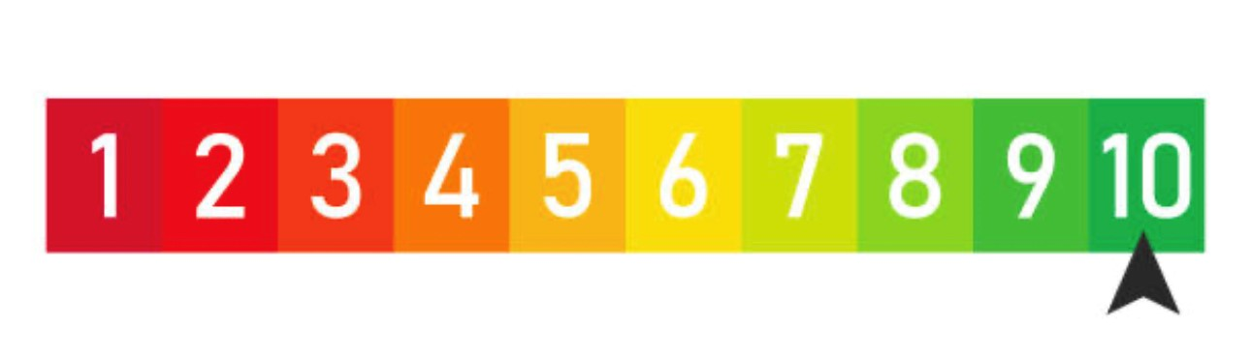
Vocational Balance Inventory
Ministry Vocation
Auxiliary Vocations
Family and Friendships
Serving Others
Growth and Learning
Personal Wellness/Caretaking
Other
What parts are you honoring?
What parts are you neglecting?
What parts of yourself are screaming for attention?
What’s the right next step in the journey to abundance and balance?

Slide 6


If you’re going to be in the newspaper Monday morning, call the bishop on Sunday night.

Slide 7
What’s the real job description for the Vestry?
Pray
Give
Collaborate
Stay connected
Build relationships
Envision mission

Slide 8
Build a Strong Leadership Team with your Wardens
Take counsel regularly with your Wardens
Develop Vestry agendas
Identify and nurture leaders
Focus: the good, the godly and the grace-ful

Slide 9
Build a Strong Vestry
Pray and study together
Get to know one another
Share responsibility
Solicit ideas and viewpoints

Slide 10

Mutual Invitation
Rules for Respect
Confidentiality and Solidarity
Image: Municipal World

Slide 11

Mutual Invitation
Image: Dreamstime

Slide 12
      1. Leader clarifies the topic of conversation
      2. Set time parameters
      3. Share first or invite another to speak
      4. Don’t necessarily speak in seating order
      5. Listen respectfully – no crosstalk or interruptions
      6. After you speak, invite another
      7. OK to “pass”
      8. Everyone speaks once before anyone speaks twice
      9. Go back to those who passed

Slide 13

Don’t be a
voltage regulator
Practice
respectful
communication
Image: ClassicMovieHub.com

Slide 14

10 Rules for
From The Right Rev. Greg Rickel, Bishop of Olympia
Drawn from an article by Charles Christian, a pastor in the Church of the Nazarene
1. If you have a problem with me, come to me (privately).
2. If I have a problem with you, I will come to you (privately).
3. If someone has a problem with me and comes to you, send them to me. (I’ll do the same for you)

Slide 15
4. If someone consistently will not come to me, say, “Let’s go to _____ together. I am sure _____ will see us about this.” (I will do the same for you.)
5. Be careful how you interpret me; I’d rather do that. On matters that are unclear, do not feel pressured to interpret my feelings or thoughts. It is easy to misinterpret intentions.
6. I will be careful how I interpret you.
7. If it’s confidential, don’t tell. If you or anyone comes to me in confidence, I won’t tell unless a) the person is going to harm himself/herself, b) the person is going to physically harm someone else, c) a child has been physically or sexually abused. I expect the same from you.

Slide 16
8. I do not read unsigned letters or notes.
9. I do not manipulate; I will not be manipulated; do not let others manipulate you. Do not let others manipulate me through you. I will not preach “at you.” I will leave conviction to the Holy Spirit (she does it better anyway!)
10. When in doubt, just say it. The only dumb questions are those that don’t get asked. Our relationships with one another, at the end of the day, are the most important things so if you have a concern, pray, and then (if led) speak up. If I can answer it without misrepresenting something, someone, or breaking a confidence, I will.

Slide 17

Confidentiality
and Solidarity
The Chatham House Rule
Chatham House, the Royal Institute of International Affairs, is an independent and world-leading policy institute whose mission is to help governments and societies build a sustainably secure, prosperous and just world by fostering dialogue, sponsoring research, and training the next generation of leaders. www.chathamhouse.org

Slide 18
When a meeting, or part thereof, is held under the Chatham House Rule, participants are free to use the information received, but neither the identity nor the affiliation of the speaker(s), nor that of any other participant, may be revealed.

