Slide 1



Healthy Boundaries
Notes:
Let’s discuss the Healthy Boundaries course in the Safe Church, Safe Communities series. This course is offered on Praesidium Academy.
Facilitator Note:
Introduce learners to the Safe Church, Safe Communities series if needed.

Slide 2

Notes:
Welcome to the Safe Church, Safe Communities Series course on Healthy Boundaries. This course is designed with many roles in mind and will walk you through the types of boundaries, best practices for forming and maintaining healthy boundaries, and how to recognize and best respond to boundary violations.
Facilitator Note:
N/A

Slide 3
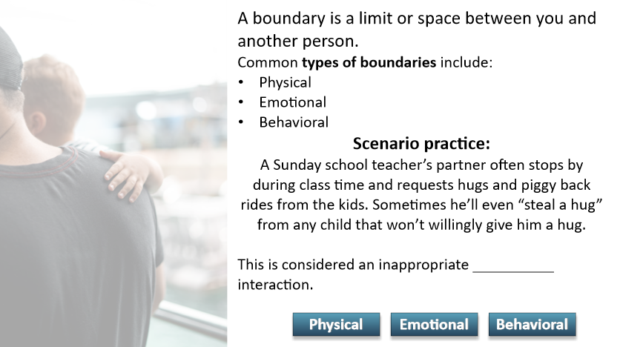
Notes:
A boundary is a limit or space between you and another person, a clear place where you begin and the other person ends. The purpose of setting healthy boundaries is to protect and take good care of yourself and others. Healthy boundaries start with an awareness of the types of boundaries people have. These include physical, emotional and behavioral boundaries. Before learning more about each, let’s test your knowledge. After reading the following scenario, determine which type of boundary interaction occurred.
Let’s review the scenario: A Sunday school teacher’s partner often stops by during class time and requests hugs and piggyback rides from the kids. Sometimes he’ll even “steal a hug” from any child that won’t willingly give him a hug. This would be considered what type of inappropriate interaction?
Facilitator Notes:
Read the scenario and give the class 5 minutes to select their answer.

Slide 4

Notes:
Physical Boundary is the correct answer. By forcing a child to hug him or by hugging a child that does not want one, this person is violating a physical boundary. If you selected Emotional or Behavioral boundaries as an answer, we’ll learn more about each of these in the course.
Facilitator Notes:
Discuss with the learners what answers they selected. Then give the answer.

Slide 5
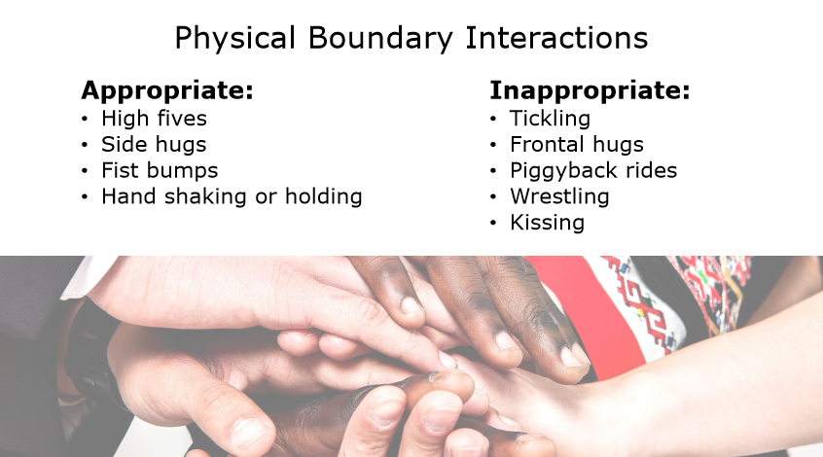
Physical Boundary Interactions
Notes:
Physical boundaries relate to a person’s body, physical space, and/or privacy. Appropriate physical interaction include:
High fives, side hugs, fist bumps and hand shaking or hand holding, like when guiding a small child or during prayer
Inappropriate physical interaction includes things like:
Tickling, frontal hugs, piggyback rides, wresting, or kissing
These types of interactions should raise a red-flag!
Facilitator Notes:
N/A

Slide 6
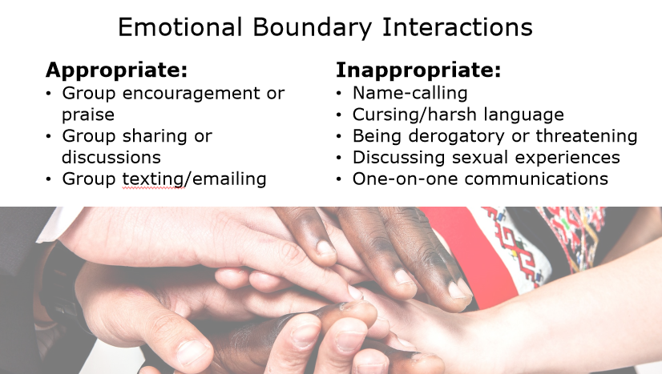
Emotional Boundary Interactions
Notes:
Emotional boundaries cover several types of interactions such as verbal interaction and/or electronic communications.
Appropriate emotional interactions are often held during group discussions, like giving encouragement or praise, or sharing personal experiences. Electronic communications are only appropriate if addressed to a group and should include parents, guardians, or caretakers.
Emotional boundaries maybe be crossed during inappropriate verbal interactions such as name-calling, cursing or using harsh language, saying derogatory or threatening things, or sharing or asking about sexual experiences. Inappropriate communication such as texting one-on-one, connecting and communicating through social media, or any one-on-one communication that does not involve another adult and/or is not applicable to a church or ministry program/event.
Facilitator Notes:
N/A

Slide 7
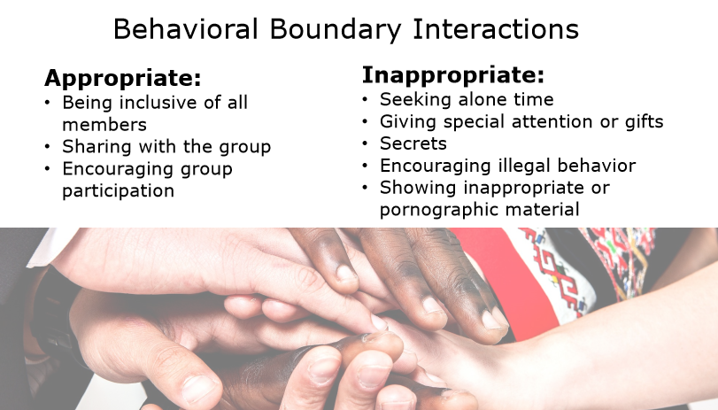
Behavioral Boundary Interactions
Notes:
Finally, let’s discuss behavioral boundaries, which relate to how an individual acts toward others.
Some healthy examples of behavioral boundaries are being inclusive of all members, bring a snack to a group meeting to share, or encouraging group participation from all members.
If a person seeks time alone with or gives special attention or gifts to one person or child, or if they share secrets, encourage illegal behavior, or share inappropriate or pornographic material to someone, then they are demonstrating inappropriate behavioral interactions.
Facilitator Notes:
N/A

Slide 8
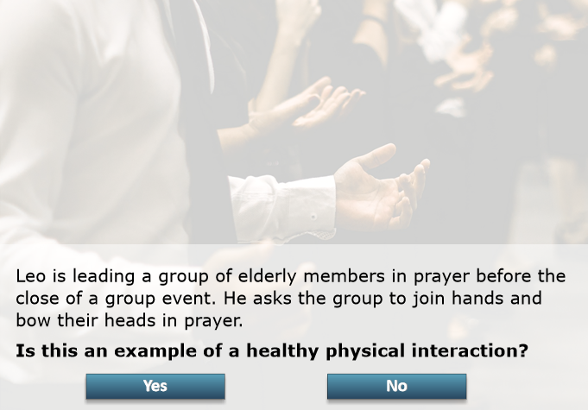
Notes:
Let’s look at a scenario. Leo is leading a group of elderly members in prayer before the close of a group event. He asks the group to join hands and bow their heads in prayer.
Facilitator Note:
Read the scenario and pose the question to the group: “Is this an example of a healthy physical interaction?”

Slide 9
It is appropriate for the group to join hands in prayer. Even though there is hand holding, it involves the whole group and is only during prayer, which is an appropriate interaction among adults.
Notes:
Yes, it is appropriate for the group to join hands in prayer. Even though there is hand holding, it involves the whole group and is only during prayer, which is an appropriate interaction among adults.
Facilitator Notes:
Share the answer.

Slide 10
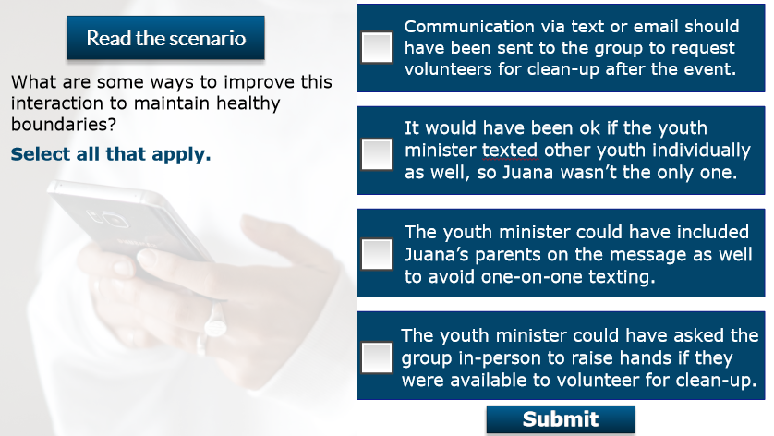
Notes:
Let’s take a moment to consider another scenario and decide what are some ways to improve this interaction to maintain healthy boundaries.
Facilitator Note:

Slide 11
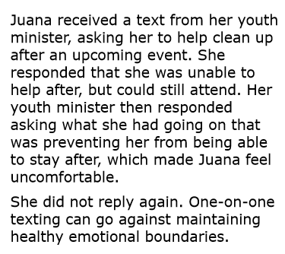
Notes:
Here’s the scenario. Juana received a text from her youth minister, asking her to help clean up after an upcoming event. She responded that she was unable to help after, but could still attend. Her youth minister then responded asking what she had going on that was preventing her from being able to stay after, which made Juana feel uncomfortable. She did not reply again. One-on-one texting can go against maintaining healthy emotional boundaries.
Facilitator Note:
Read the scenario and then move to the next slide (to show the choices again).

Slide 12
Notes:
What are some ways to improve this interaction to maintain healthy boundaries? Our options include:
Communication via text or email should have been sent to the group to request volunteers for clean-up after the event.
It would have been ok if the youth minister texted other youth individually as well, so Juana wasn’t the only one.
The youth minister could have included Juana’s parents on the message as well to avoid one-on-one texting.
The youth minister could have asked the group in-person to raise hands if they were available to volunteer for clean-up.
Facilitator Note:
Give the class a few moments to select their choice. On the next slide discuss the answers.

Slide 13
Remember that one-on-one communication is an inappropriate interaction. It’s always best to communicate with the whole group or include parents or guardians on communications.
Notes:
Remember that one-on-one communication is an inappropriate interaction. It’s always best to communicate with the whole group or include parents or guardians on communications.
Facilitator Notes:
Show the correct answers and discuss with the group.

Slide 14
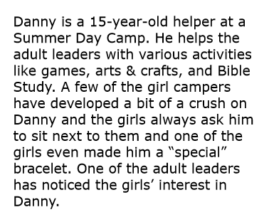
Notes:
Let’s look at another scenario and think about some suggestions for the adult leader on what she could do to ensure healthy boundaries between Danny and the campers.
Danny is a 15-year-old helper at a Summer Day Camp. He helps the adult leaders with various activities like games, arts & crafts, and Bible Study. A few of the girl campers have developed a bit of a crush on Danny and the girls always ask him to sit next to them and one of the girls even made him a “special” bracelet. One of the adult leaders has noticed the girls’ interest in Danny.
Facilitator Note:
Read the scenario and give the group 5 minutes to think of some suggestions.

Slide 15
You may have said something like:
The leader could have a conversation with the girls to let them know that their actions are inappropriate.
The leader could speak to Danny to let him know that he should not reciprocate the special attention and to remind him to let an adult leader know if the girls continue the behavior.
Adult leaders could lead a discussion or make an announcement on the importance of healthy boundaries and what is appropriate camp behavior.
The leader could ensure proper supervision is in place during all camp activities to monitor all behaviors and interactions between campers and staff/volunteers.
Notes:
You may have said something like:
The leader could have a conversation with the girls to let them know that their actions are inappropriate.
The leader could speak to Danny to let him know that he should not reciprocate the special attention and to remind him to let an adult leader know if the girls continue the behavior.
Adult leaders could lead a discussion or make an announcement on the importance of healthy boundaries and what is appropriate camp behavior.
The leader could ensure proper supervision is in place during all camp activities to monitor all behaviors and interactions between campers and staff/volunteers.
Facilitator Note:
Discuss the learners’ suggestions with the class, and then share the suggestions noted on the slide.

Slide 16
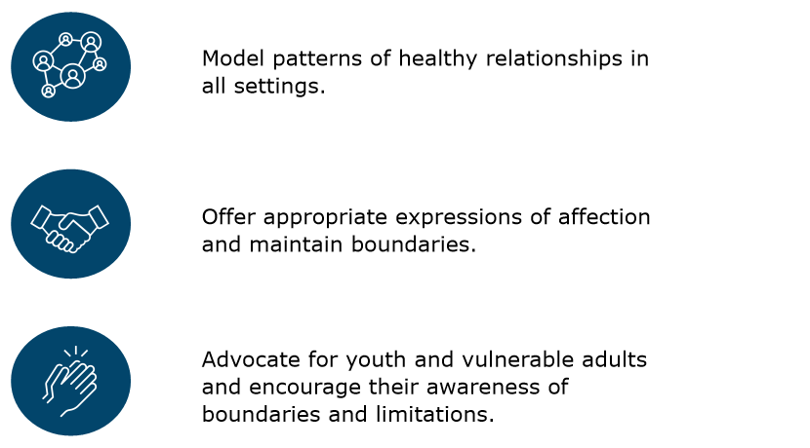
Notes:
The expectation is for everyone to model patterns of healthy relationships in all settings.
Adults are required to offer appropriate expressions of affection and to maintain boundaries when sharing personal information.
By modeling appropriate boundaries, adults can advocate for youth and vulnerable adults and encourage their awareness of boundaries and limitations.
Facilitator Note:
N/A

Slide 17
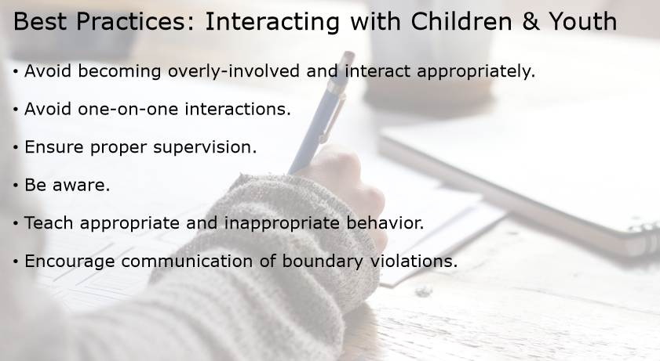
Notes:
Children and youth have the same rights to healthy boundaries as everyone else.
What are some best practices for healthy boundaries with and among children and youth?
Avoid becoming overly-involved with youth and ensure you are only interacting appropriately
Avoid inappropriate one-on-one interactions with children and youth
Ensure proper supervision of children and youth
Be aware of others’ behaviors. For example, have you noticed an adult paying special attention to one child in particular? Have you seen that one kid has been bullied by some of the older kids lately?
Ensure children and youth know what is appropriate and inappropriate behavior. Be clear and transparent about rules on boundaries.
Encourage children to speak up to a trusted adult if they feel any of their boundaries have been violated.
Facilitator Note:
N/A

Slide 18
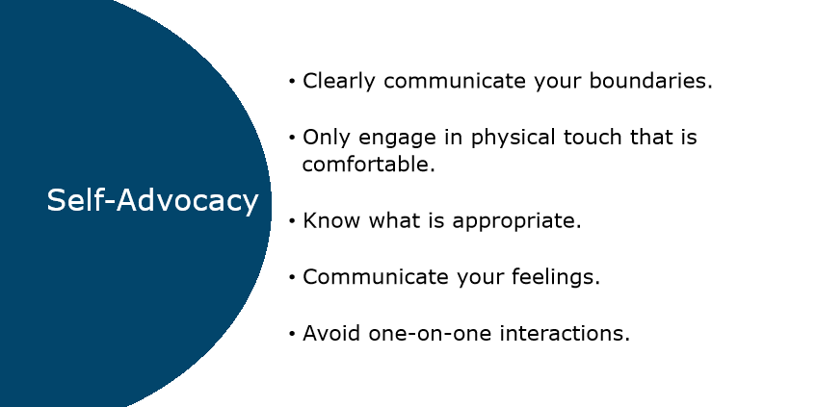
Notes:
It’s important to be your own advocate when it comes to boundaries and to empower others to do the same.
Be clear about your own boundaries and limitations.
If you are uncomfortable with a quick hello hug, request a high five or hand shake instead.
Know and follow the rules on boundaries and what is appropriate.
Communicate your feelings and avoid one-on-one interactions that may make you or someone else feel uncomfortable.
The following slides outline a couple of scenarios demonstrating self-advocacy and maintaining healthy boundaries.
Facilitator Note:
N/A

Slide 19
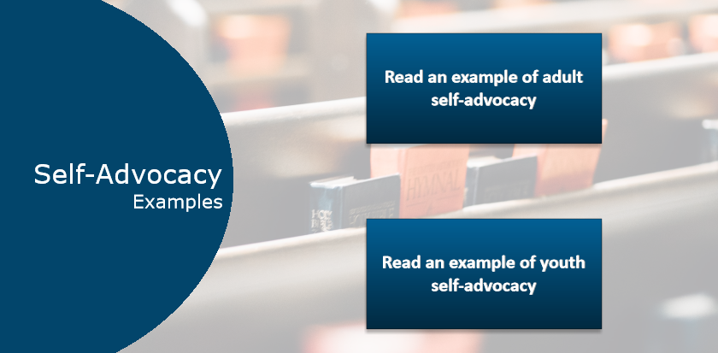
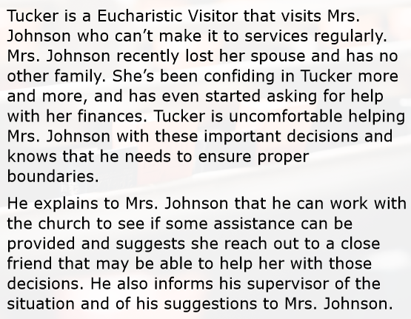
Notes:
Here are a couple of scenarios demonstrating self-advocacy and maintaining healthy boundaries. Let’s review the first example. This is an example of adult self-advocacy.
Tucker is a Eucharistic Visitor that visits Mrs. Johnson who can’t make it to services regularly. Mrs. Johnson recently lost her spouse and has no other family. She’s been confiding in Tucker more and more, and has even started asking for help with her finances. Tucker is uncomfortable helping Mrs. Johnson with these important decisions and knows that he needs to ensure proper boundaries.
He explains to Mrs. Johnson that he can work with the church to see if some assistance can be provided and suggests she reach out to a close friend that may be able to help her with those decisions. He also informs his supervisor of the situation and of his suggestions to Mrs. Johnson.
Facilitator Note:
N/A

Slide 20
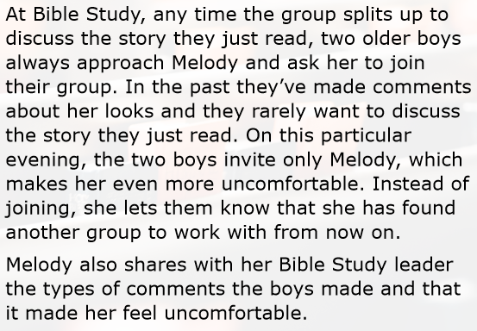
Notes:
Let’s look at this next example of youth self-advocacy.
At Bible Study, any time the group splits up to discuss the story they just read, two older boys always approach Melody and ask her to join their group. In the past they’ve made comments about her looks and they rarely want to discuss the story they just read. On this particular evening, the two boys invite only Melody, which makes her even more uncomfortable. Instead of joining, she lets them know that she has found another group to work with from now on.
Melody also shares with her Bible Study leader the types of comments the boys made and that it made her feel uncomfortable.
Facilitator Note:
N/A

Slide 21
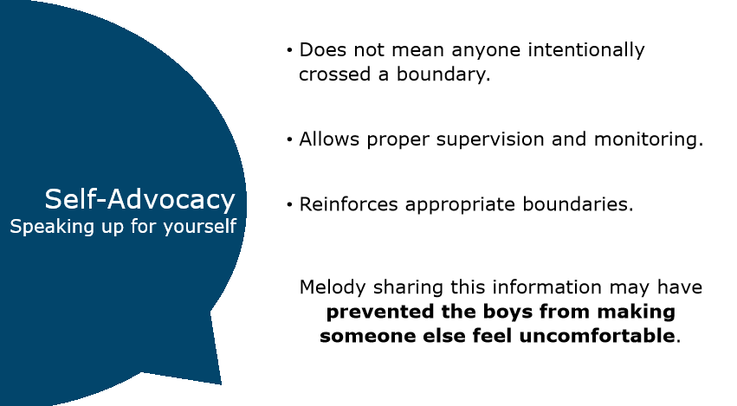
Notes:
Let’s discuss both examples.
Speaking up can be hard to do. The other person may not have been intentionally crossing a boundary, but by letting someone know proper supervision and monitoring can be reinforced and discussions around appropriate boundaries can be reinforced if needed.
In Tucker’s instance, sharing this information with his supervisor may have prevented a false allegation.
In Melody’s instance, sharing this information with the Bible Study leader may have prevented the boys from making someone else feel uncomfortable.
Facilitator Note:
Ask the class to share their thoughts about both self-advocacy examples. Then discuss with the class.

Slide 22
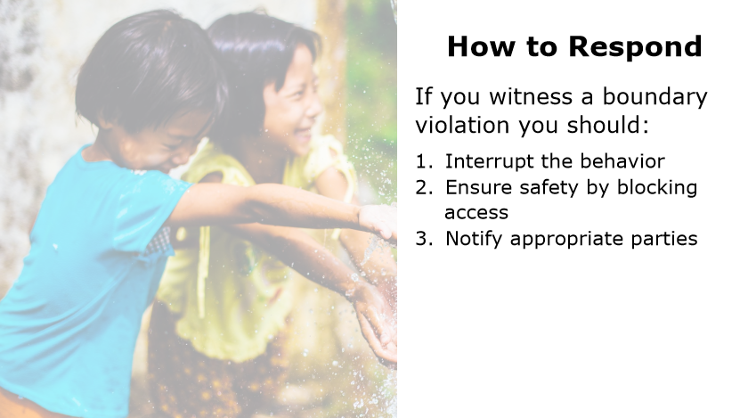
Notes:
Depending on your role, your response may vary, but if you are witness to any boundary violation, your first response should be to immediately, effectively, and safely interrupt the behavior and ensure safety by blocking access. Finally, responding should always involve notifying appropriate parties of the incident. Additionally, if you suspect or hear of boundary violations, you should still do your best to block access and notify the proper individuals, even if you didn’t witness the violation firsthand.
Facilitator Notes:
N/A

Slide 23
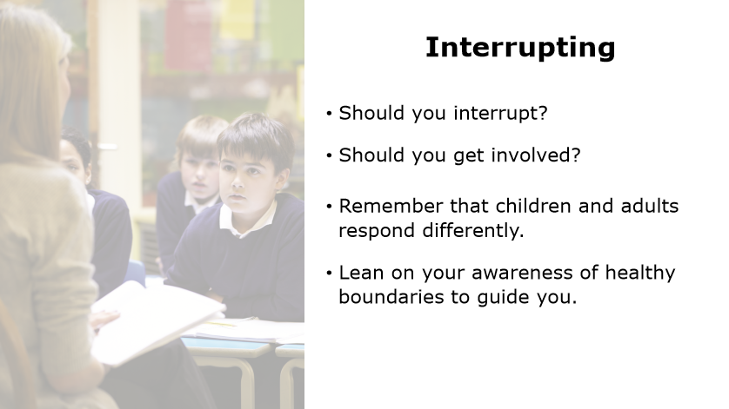
Notes:
It can be hard to determine if you should really interrupt. Maybe you see that a Sunday school teacher just redirected a young child who then immediately started throwing a tantrum. It can be alarming and may have you questioning whether or not you should get involved. Remember what we learned about healthy boundaries and how children and adults may have different experiences. Lean on your awareness of healthy boundaries to guide you
Facilitator Notes:
N/A

Slide 24

Scenario
Notes:
Let’s revisit the same scenario. This time, you hear the Sunday school teacher yelling and using profanity with the young child. The child begins throwing a tantrum. This is an example of where it is appropriate to interrupt, regardless of your role.
Interrupting may be as simple as striking up a conversation with the Sunday School teacher so you can ensure that they don’t continue speaking to the child in that manner. Perhaps you’re a parent to another child in the class and you decide to abruptly call out the Sunday School teacher for her use of harsh language and how she disciplined the child. After all, you wouldn’t want her to treat your child that way. Always assess the situation, but if you feel that a boundary is being violated or that another child or vulnerable adult may be in harm’s way, it’s important to immediately interrupt the behavior.
Facilitator Notes:
Click the play button to play the video and then discuss with the class.

Slide 25
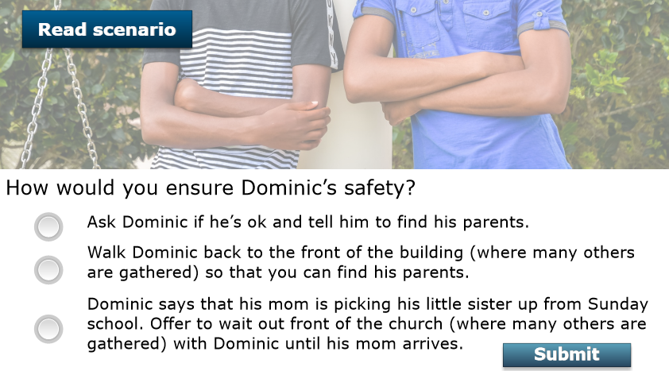
Notes:
Let’s take a moment to consider another scenario and think about how we would ensure Dominic’s safety.
Facilitator Note:

Slide 26
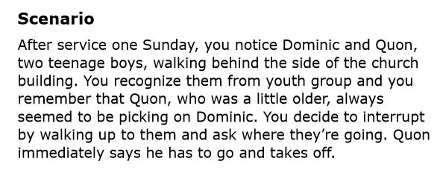
Notes:
Here’s the scenario. After service one Sunday, you notice Dominic and Quon, two teenage boys, walking behind the side of the church building. You recognize them from the youth group and you remember that Quon, who was a little older, always seemed to be picking on Dominic. You decide to interrupt by walking up to them and ask where they’re going. Quon immediately says he has to go and takes off.
Facilitator Note:
Read the scenario and then move to the next slide (to show the choices again).

Slide 27
Notes:
How would we ensure Dominic’s safety? Our options include:
Ask Dominic if he’s ok and tell him to find his parents.
Walk Dominic back to the front of the building (where many others are gathered) so that you can both find his parents.
Dominic says that his mom is picking up his little sister from Sunday school. Offer to wait out front of the church (where many others are gathered) with Dominic until his mom arrives.
Facilitator Note:
Give the class a few moments to select their choice. On the next slide discuss the answers.

Slide 28
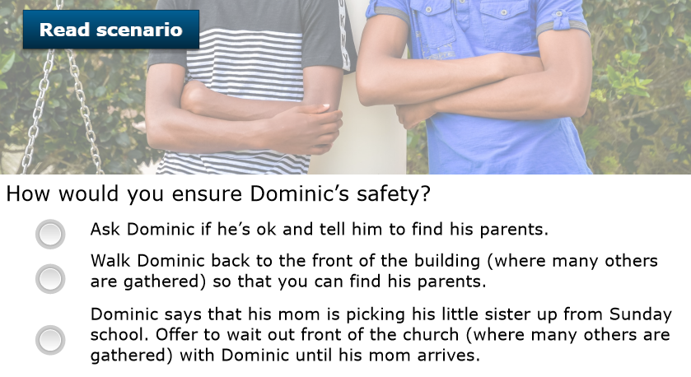
Notes:
The last two options are correct. By staying with Dominic until a parent arrives, you can ensure his safety from Quon. If you left Dominic alone, Quon could have easily approached him again.
Facilitator Notes:
Share with the class the correct answers (B and C).

Slide 29
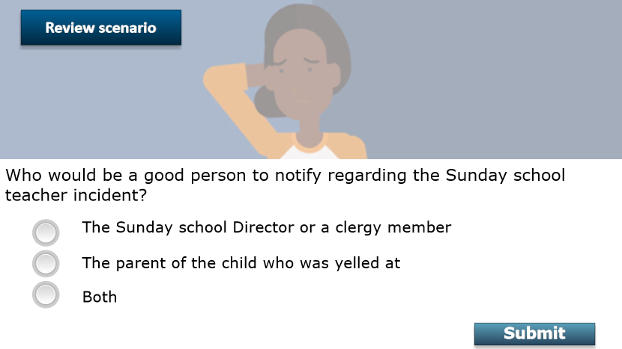
Notes:
Although an isolated instance or one inappropriate behavior doesn’t make someone an offender, you may not be aware of prior inappropriate behaviors they’ve displayed. By notifying a church leader, clergy member, or supervisor of the incident, you can help make others aware so that proper steps can be taken to ensure safety. If you witness or suspect sexual abuse, you should immediately report the incident to law enforcement or appropriate child welfare agency.
Let’s consider the two scenarios we just reviewed. Who would be a good person to notify regarding the Sunday School teacher incident?
Facilitator Notes:

Slide 30
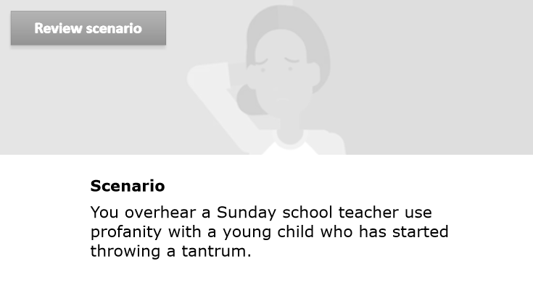
Notes:
Here is the scenario. You overhear a Sunday school teacher use profanity with a young child who has started throwing a tantrum.
Facilitator Notes:
N/A

Slide 31
That way the parent is aware in case they want to remove the child from that class and the teacher’s supervisor is aware so that proper supervision and monitoring can take place.
Notes:
Let’s answer the question: “Who would be a good person to notify regarding the Sunday school teacher incident?”
Here are the options:
The Sunday school Director or a clergy member
The parent of the child who was yelled at
Both
The answer is Both. That way the parent is aware in case they want to remove the child from that class and the teacher’s supervisor is aware so that proper supervision and monitoring can take place.
Facilitator Note:
Give the class a few minutes to think of the answer. Then discuss with the class.

Slide 32
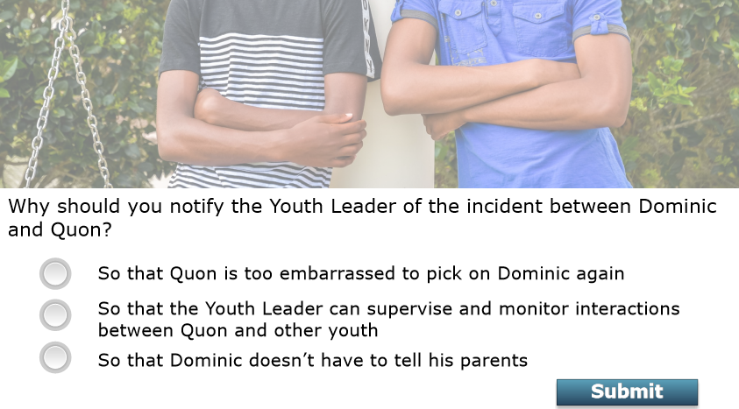
Notes:
Now let’s ask this question: “Why should you notify the Youth Leader of the incident between Dominic and Quon?
Our options include:
So that Quon is too embarrassed to pick on Dominic again
So that the Youth Leader can supervise and monitor interactions between Quon and other youth
So that Dominic doesn’t have to tell his parents
The answer is the 2nd option. So that the Youth Leader can supervise and monitor interactions between Quon and other youth.
Facilitator Notes:
Give the class a few minutes to think of the answer. Then discuss with the class.

Slide 33

Questions and Comments
Let’s take a moment to discuss any questions or comments you may have.
Notes:
Questions and Comments
This will conclude our discussion on this Safe Church, Safe Communities course: Healthy Boundaries.
What questions or comments do you have?
Allow participants to answer the first question fully before moving onto the second question:
What have you learned about heathy boundaries that you maybe did not know before this training?
Facilitator Note:
As you wrap up the discussion, be sure to:
Tell participants who they can reach out to if they have further questions or comments about the content covered in this training.
Conclude by thanking participants for their time and dedication.

