Slide 1




Notes:
The Introduction & Theological Background course is the second course in the Safe Church, Safe Communities series. These courses are offered on Praesidium Academy.
Facilitator Notes:
Introduce learners to the Safe Church, Safe Communities series if necessary. Explain this course is the second course and that several other courses are a part of this Universal Training for the Safe Church, Safe Communities series.

Slide 2

Notes:
Welcome!
Welcome to the Safe Church, Safe Communities Series course on Organizational Rules & Policies! This course will review The Episcopal Church’s Model Policies for the Protection of Children, Youth, and Vulnerable Adults. Updated in 2017, these policies are a statement for the Episcopal Church, setting forth expectations for its leaders in their relationships with children and youth. The purpose of these model policies is to foster the highest standards of behavior in ministry settings.
Facilitator Notes:
If you haven’t already done so, this is a good time to set norms surrounding the training session (location of restroom, electronic device expectations, etc). Then briefly share with the group the names for both model policies and when they were approved for The Episcopal Church.
Share this link as a resource if needed - https://www.episcopalchurch.org/ministries/faith-formation/model-policies/

Slide 3
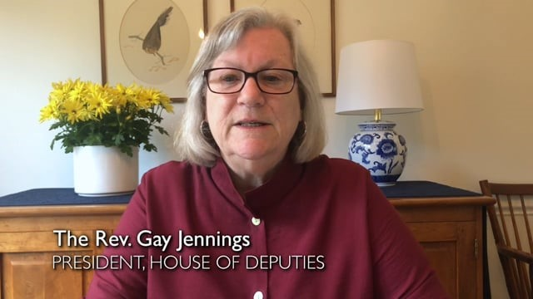
Notes:
Next we’ll hear from The Reverend Gay Jennings, President of the House of Deputies.
Facilitator Notes:
Play the video. After playing the video, ask the group have they taken any of the courses in the Safe Church, Safe Communities series on Praesidium Academy.

Slide 4
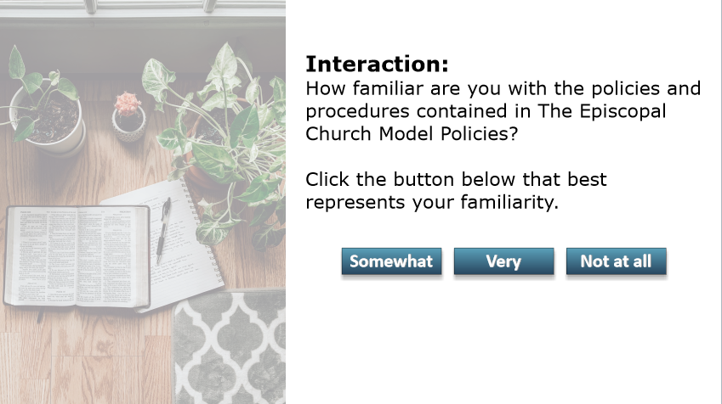
Notes:
How familiar are you with the policies and procedures in The Episcopal Church Model Policies?
Somewhat?
Very?
Not at all?
Facilitator Notes:
Ask the above question, but use some of the following prompts if learners are hesitant to share:
We have some knowledge of the model policies
We know that our model policies are intended to help our organization
Can you recall the last time you read through the model policies?

Slide 5
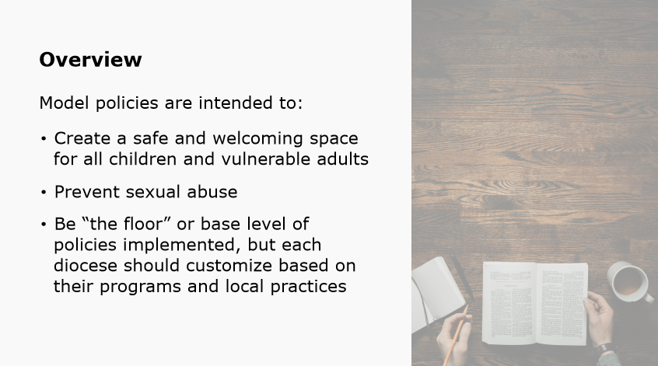
Notes:
The Episcopal Church provides model policies for the protection of children and vulnerable adults. The intent of these policies is not only to create a safe and welcoming space for all children and vulnerable adults and those engaged in ministry with children and vulnerable adults, but also to prevent sexual abuse. These policies are considered, “the floor,” meaning that your diocese has agreed that these policies should be implemented in all ministry settings. However, your diocese should have also adopted supplemental provisions and local practices, which are specific to your diocese and/or your ministry context.
Facilitator Notes:
Guide the discussion towards an understanding of the intent of the model policies as a safe and welcoming space for all those in the Episcopal Church and each diocese.

Slide 6
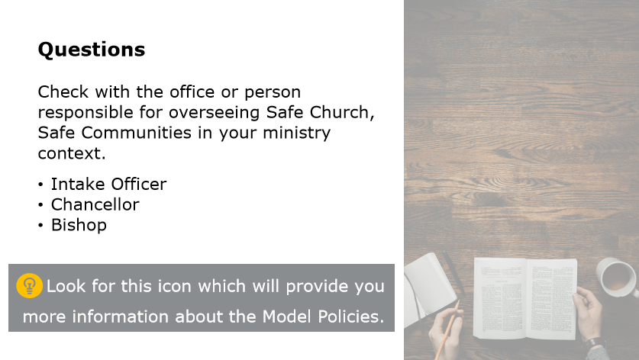
Notes:
For any questions regarding policies and/or to find out if additional training may be required based on your role within your diocese or ministry, you can check with the office or person responsible for overseeing Safe Church, Safe Communities in your ministry context. This may be someone in your diocesan office, for example the Intake Officer, Chancellor or Bishop. Throughout the course, you can verify your understanding of or learn more about definitions or policies . Look for this light bulb icon, which will provide you with more information.
Facilitator Notes:
Ask learners if they have any questions.

Slide 7
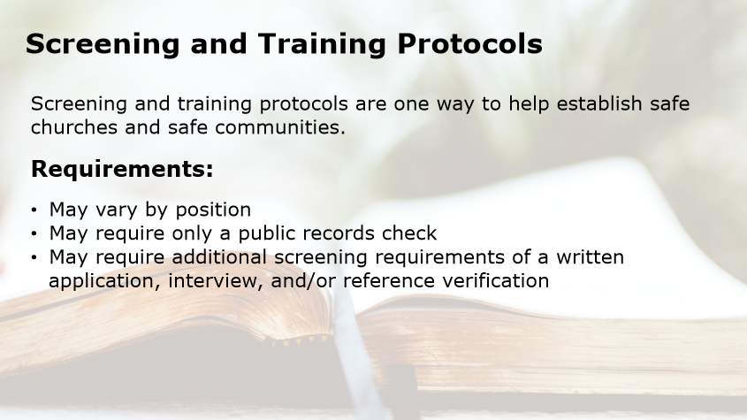
Notes:
Screening and training protocols are one way to help establish safe churches and safe communities. Screening and training protocols may vary by position, some requiring only a public records check, while others require additional screening requirements of a written application, interview, or reference verification.
Can you think of any screening requirements? Let’s discuss a few on the next slides.
Facilitator Notes:
Over the next slides, introduce screening and training protocols.

Slide 8

Notes:
Screening requirements may include:
A Public Records Check
A Department of Motor Vehicles (DMV)
A Credit Check or
Additional screening.
Let’s discuss each screen requirement now.
Facilitator Note:
Review each screening requirement on the next slides.

Slide 9
Public Records Check
An approved provider should conduct a criminal public records check, including sex offender registries, before a prospective employee or volunteer begins interacting with youth or vulnerable adults.
Notes:
An approved provider should conduct a criminal public records check, including sex offender registries, before a prospective employee or volunteer begins interacting with youth or vulnerable adults.
Facilitator Notes:
N/A

Slide 10
Department of Motor Vehicles (DMV)
If a volunteer or employee will be required to provide transportation, a DMV records check is required.
Notes:
If a volunteer or employee will be required to provide transportation, a DMV records check is required.
Facilitator Notes:
N/A

Slide 11
Credit Check
A credit check is required if the individual has check signing authority.
Notes:
A credit check is required if the individual has check signing authority.
Facilitator Notes:
N/A

Slide 12
Additional Screening
A completed written application, personal interview, verification of Driver’s license and automobile insurance, and reference checks are required for some roles.
Notes:
A completed written application, personal interview, verification of Driver’s license and automobile insurance, and reference checks are required for some roles.
Facilitator Notes:
N/A

Slide 13
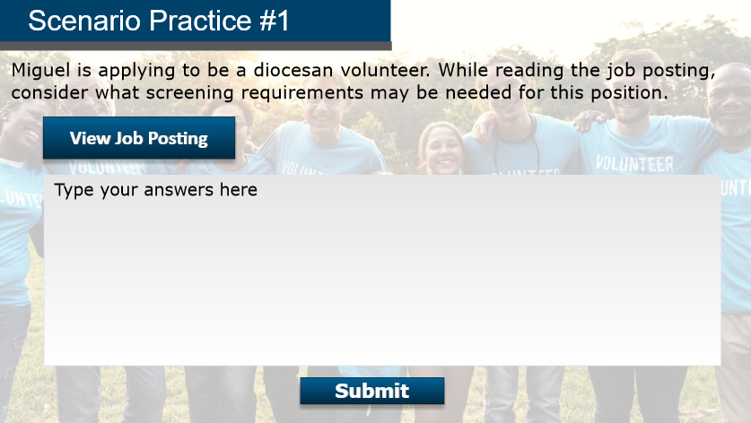
Notes:
Now let’s review a scenario. Miguel is applying to be a diocesan volunteer. While reading the job posting, consider what screening requirements may be needed for this position. Let’s look at the posting on the next slide.
Facilitator Notes:
Have participants break off into groups of three. Give the groups five minutes to brainstorm an answer and select a group representative to explain the group’s answer to the rest of the class. Be sure to set a timer.
Go to the next slides to show the Job Posting, and then the answer for this scenario.

Slide 14
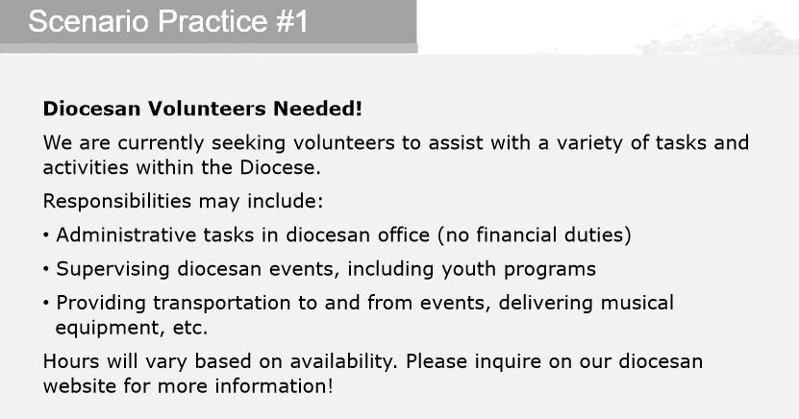
Notes:
Here is the Job Posting.
Diocesan Volunteers Needed!
We are currently seeking volunteers to assist with a variety of tasks and activities within the Diocese.
Responsibilities may include:
Administrative tasks in diocesan office (no financial duties)
Supervising diocesan events, including youth programs
Providing transportation to and from events, delivering musical equipment, etc.
Hours will vary based on availability. Please inquire on our diocesan website for more information!
Take a few moments to write down your answers.
Facilitator Note:
Read the job posting and ask the groups to write down their answers.

Slide 15
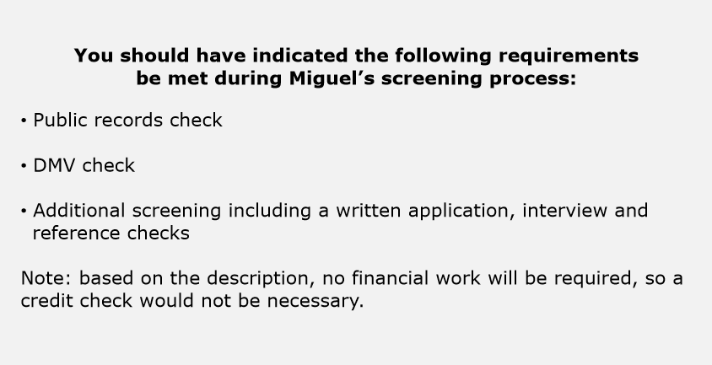
Notes:
You should have indicated the following requirements be met during Miguel’s screening process:
Public records check
DMV check
Additional screening including a written application, interview and reference checks
Note: based on the description, no financial work will be required, so a credit check would not be necessary.
Facilitator Note:
When the timer goes off, ask the representative from each group to share out their answer. Then share the answer on the slide.

Slide 16
Training Levels
Universal
Introduction and Theological Background
Organizational Rules & Policies
Healthy Boundaries and
Inclusion
Specialized
Power and Relationships
Abuse & Neglect
Pastoral Relationships
Bullying
Anti-Harassment (In Progress)
Notes:
Training Levels:
The Episcopal Church offers two levels of training: Universal and Specialized.
Universal Training was designed to foster a culture of safety and inclusion for all people and to equip all members to live out their Baptismal Covenant. Universal Training is available to all members of the Episcopal Church. Universal/Core training covers a variety of topics such as:
Introduction and Theological Background
Organizational Rules & Policies
Healthy Boundaries and
Inclusion
Specialized training is also required for supervisors and those with oversight of and, or engaged in ministry with children, youth, or vulnerable adults. Specialized training covers a variety of topics like:
Power and Relationships
Abuse & Neglect
Pastoral Relationships
Bullying
Anti-Harassment
Facilitator Notes:
N/A

Slide 17
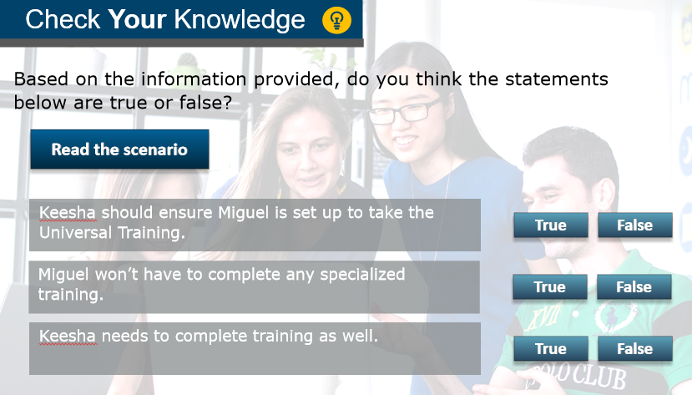
Notes:
Check Your Knowledge:
Based on the Training Levels slide we just discussed, let’s check our knowledge. Keesha was recently promoted to supervisor, and she just completed her third year as a Diocesan Employee. She was the one who posted the flyer and invited Miguel to volunteer with youth ministries and events. Let’s review each statement and decide if it’s true or false.
Facilitator Note:
Read the scenario. Then read each statement and ask the class if it is true or false. On the next slides, give the answer for each statement.

Slide 18
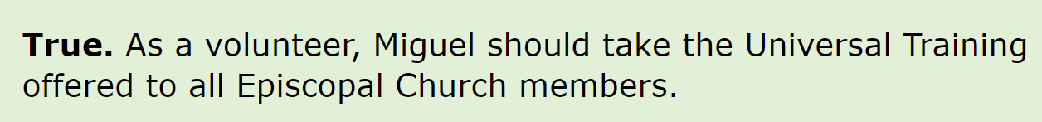
Check Your Knowledge
Keesha should ensure Miguel is set up to take the Universal Training.
True or False?
Notes:
Keesha should ensure Miguel is set up to take the Universal Training.
True or False?
True. As a volunteer, Miguel should take the Universal Training offered to all Episcopal Church members.
Facilitator Note:
Take a few moments to ask the learners how many thought the statement was true, and then false. Discuss with the group and then give the answer to the statement.

Slide 19
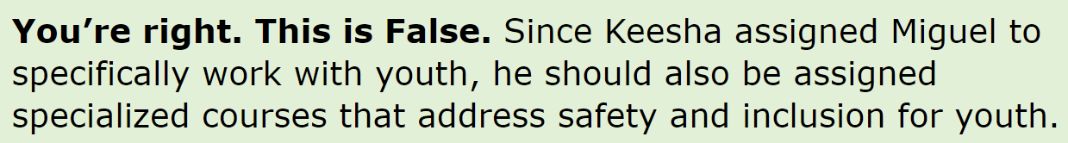
Check Your Knowledge
Miguel won’t have to complete any specialized training.
True or False?
Notes:
Keesha should ensure Miguel is set up to take the Universal Training.
True or False?
This statement is False. Since Keesha assigned Miguel to specifically work with youth, he should also be assigned specialized courses that address safety and inclusion for youth.
Facilitator Note:
Give the answer to the statement.

Slide 20
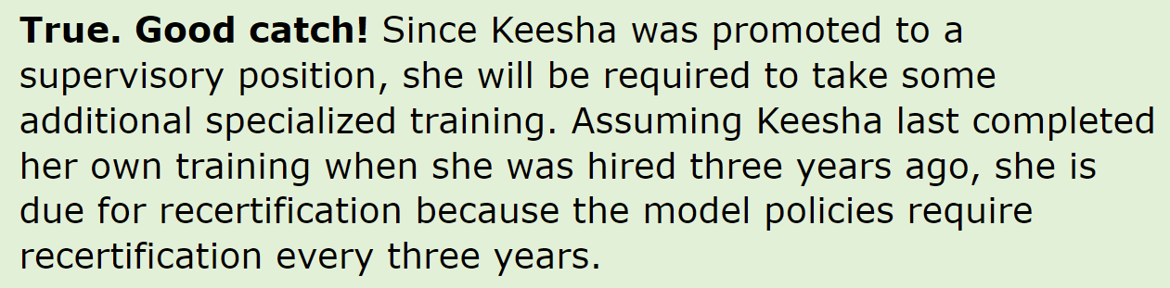
Check Your Knowledge
Keesha needs to complete training as well.
True or False?
Notes:
Keesha should ensure Miguel is set up to take the Universal Training.
True or False?
True. Since Keesha was prompted to a supervisory position, she will be required to take some additional specialized training. Assuming Keesha last completed her own training when she was hired three years ago, she is due for recertification because the model policies require recertification every three years.
Facilitator Note:
Give the answer to the statement.

Slide 21
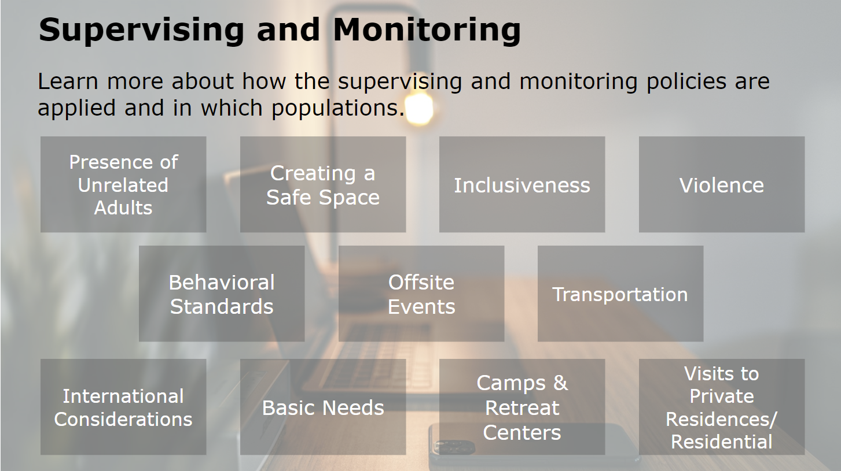
Notes:
Limiting unsupervised access and opportunity for one-on-one interactions is critical in preventing sexual abuse. Dioceses, congregations, and organizations maintain up-to-date lists of persons with contact information who are approved to monitor and supervise children, youth, and vulnerable adults. On the next slides, we’ll learn more about how the supervising and monitoring policies are applied and in which populations.
We will cover the following areas:
Presence of Unrelated Adults
Creating a Safe Space, Inclusiveness
Violence
Behavioral Standards
Offsite Events
Transportation
International Considerations
Basic Needs
Camps and Retreat Centers
and Visits to Private Residences and Residential Facilities.
Facilitator Note:
N/A

Slide 22
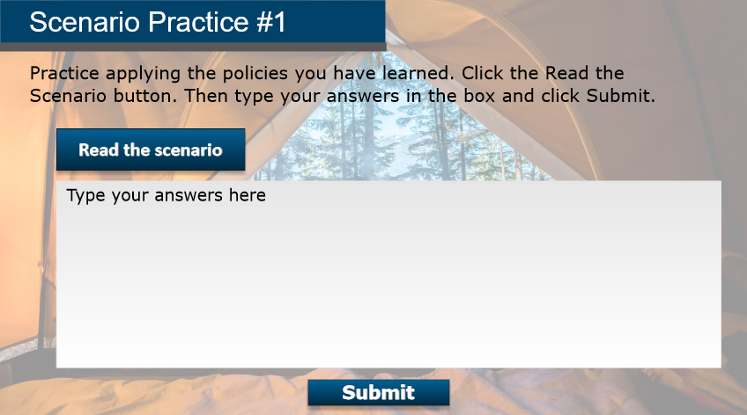
Notes:
Let’s review a scenario. A few camp counselors are finalizing plans in preparation for a youth camp that is starting in a few weeks. They are working on some best practices for the other counselors and volunteers that will be supervising the event. Let’s read the statements on the slide and decide which policy each statement relates to.
Facilitator Note:
Go to the next slide to show the class the full scenario.

Slide 23
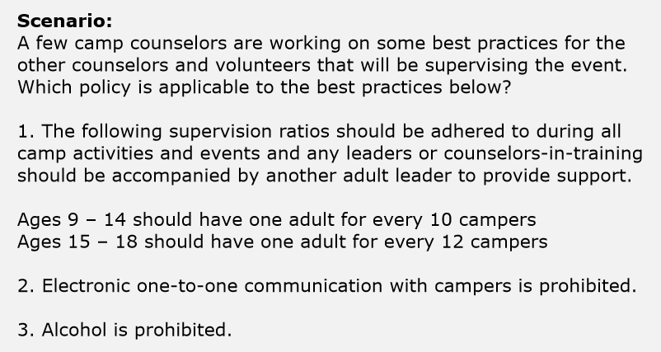
Notes:
Scenario:
A few camp counselors are working on some best practices for the other counselors and volunteers that will be supervising the event. Which policy is applicable to the best practices below?
1. The following supervision ratios should be adhered to during all camp activities and events and any leaders or counselors-in-training should be accompanied by another adult leader to provide support.
Ages 9 – 14 should have one adult for every 10 campers
Ages 15 – 18 should have one adult for every 12 campers
2. Electronic one-to-one communication with campers is prohibited.
3. Alcohol is prohibited.
Facilitator Note:
Give the groups five minutes to brainstorm an answer and select a group representative to explain the group’s answer to the rest of the class. Be sure to set a timer.

Slide 24
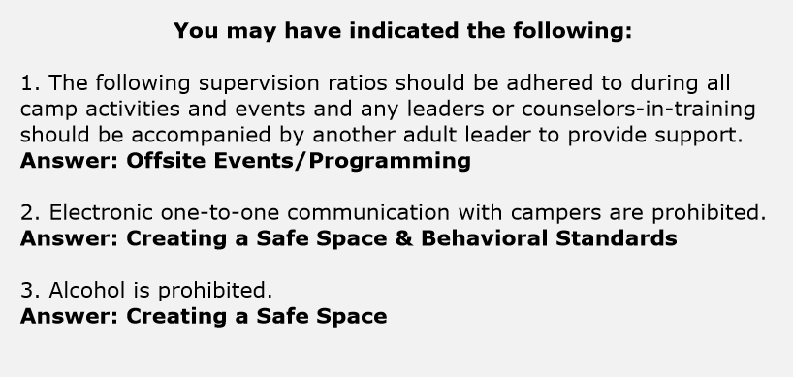
Notes:
Now let’s review the statements again with the answers.
1. The following supervision ratios should be adhered to during all camp activities and events and any leaders or counselors-in-training should be accompanied by another adult leader to provide support.
Answer: Offsite Events/Programming
2. Electronic one-to-one communication with campers are prohibited.
Answer: Creating a Safe Space & Behavioral Standards
3. Alcohol is prohibited.
Answer: Creating a Safe Space
Facilitator Notes:
When the timer goes off, ask the representative from each group to share out their answer. Then share the answers.

Slide 25
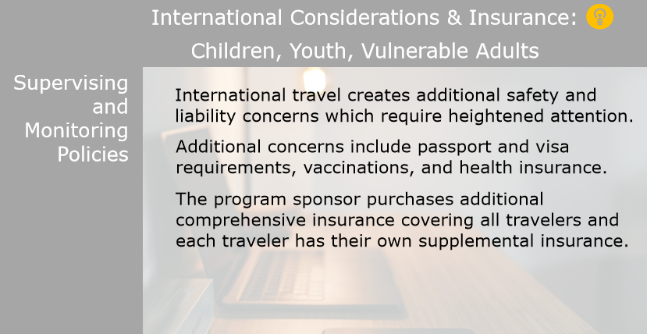
Notes:
International travel creates additional safety and liability concerns which require heightened attention. Additional concerns include passport and visa requirements, vaccinations, and health insurance. The program sponsor purchases additional comprehensive insurance covering all travelers and each traveler has their own supplemental insurance.
Facilitator Notes:
Share with the class that more information can be found in Section VI, J of the Model Policies.

Slide 26
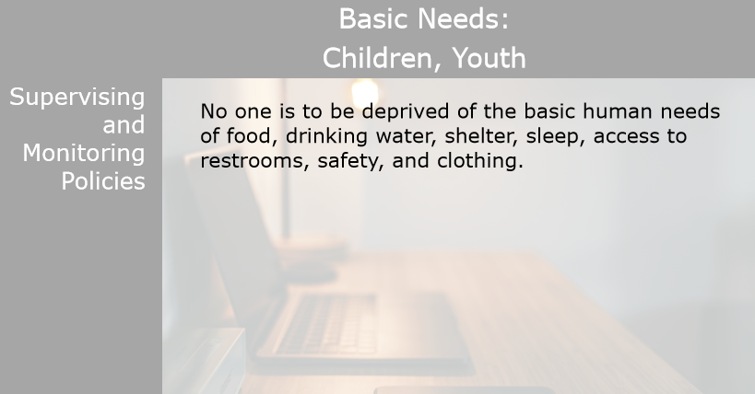
Notes:
No one is to be deprived of the basic human needs of food, drinking water, shelter, sleep, access to restrooms, safety, and clothing.
Facilitator Notes:
Share with the class that more information can be found in Section VI, J of the Model Policies.

Slide 27
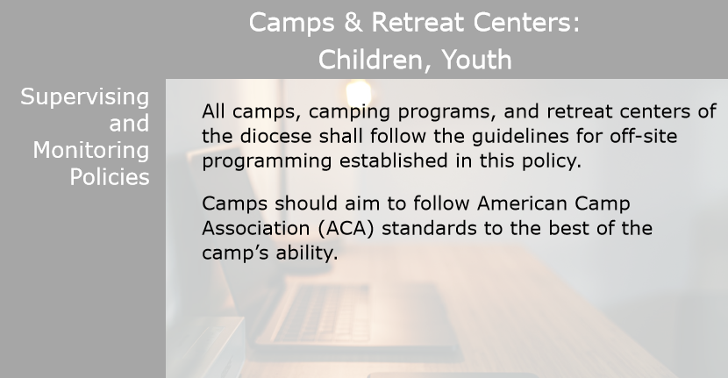
Notes:
All camps, camping programs, and retreat centers of the diocese shall follow the guidelines for off-site programming established in this policy. Camps should aim to follow American Camp Association (ACA) standards to the best of the camp’s ability.
Facilitator Notes:
Share with the class that more information can be found in Section VI, J of the Model Policies.

Slide 28
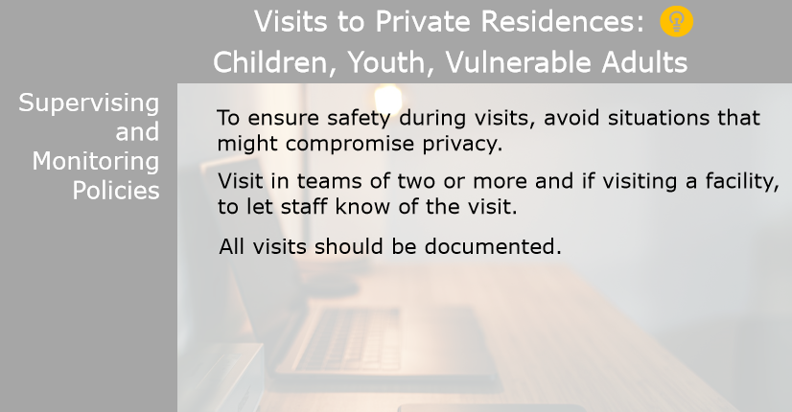
Notes:
To ensure safety during visits, avoid situations that might compromise privacy. Visit in teams of two or more and if visiting a facility, to let staff know of the visit. All visits should be documented.
Facilitator Notes:
Share with the class that more information can be found in Section VI, G of the Model Policies.

Slide 29
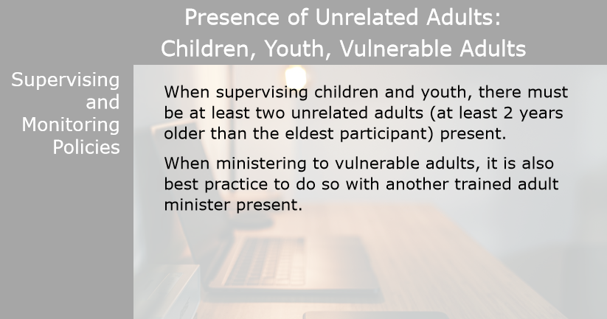
Notes:
When supervising children and youth, there must be at least two unrelated adults (at least 2 years older than the eldest participant) present. When ministering to vulnerable adults, it is also best practice to do so with another trained adult minister present.
Facilitator Notes:
Share with the class that more information can be found in Section VI, J of the Model Policies.

Slide 30
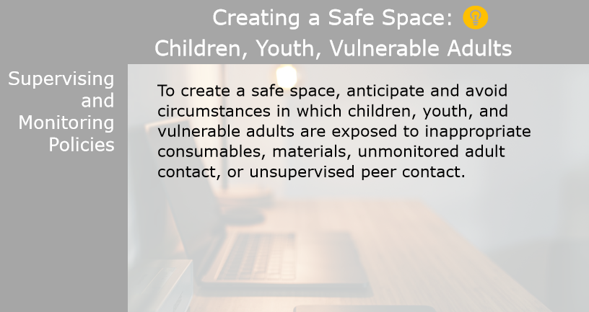
Notes:
To create a safe space, anticipate and avoid circumstances in which children, youth, and vulnerable adults are exposed to inappropriate consumables, materials, unmonitored adult contact, or unsupervised peer contact.
Facilitator Notes:
Share with the class that more information can be found in Section VI of the Model Policies.

Slide 31
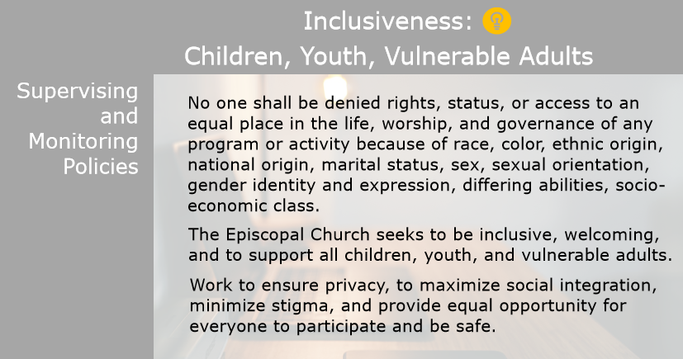
Notes:
No one shall be denied rights, status, or access to an equal place in the life, worship, and governance of any program or activity because of race, color, ethnic origin, national origin, marital status, sex, sexual orientation, gender identity and expression, differing abilities, socio-economic class. The Episcopal Church seeks to be inclusive, welcoming, and to support all children, youth, and vulnerable adults. Work to ensure privacy, to maximize social integration, minimize stigma, and provide equal opportunity for everyone to participate and be safe.
Facilitator Notes:
Share with the class that more information can be found in Section VI, E, Episcopal Church Constitution and Canons Title I.17 & Title III.1 of the Model Policies as well as Section VI for additional guidelines and best practices for overnight programs.

Slide 32
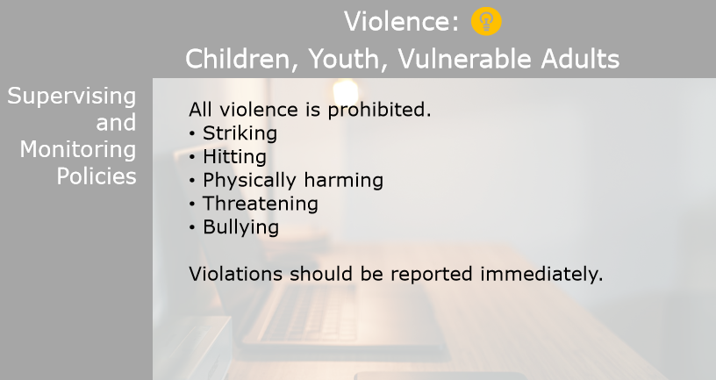
Notes:
All violence is prohibited.
Striking
Hitting
Physically harming
Threatening
Bullying
Violations should be reported immediately.
Facilitator Notes:
Share with the class that more information can be found in Section VII, B of the Model Policies.

Slide 33
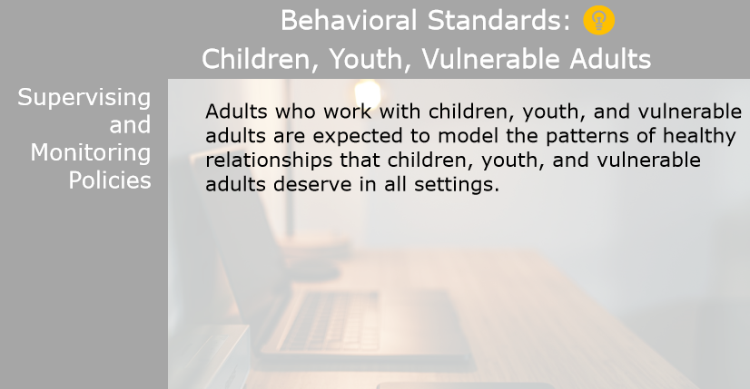
Notes:
Adults who work with children, youth, and vulnerable adults are expected to model the patterns of healthy relationships that children, youth, and vulnerable adults deserve in all settings.
Facilitator Notes:
Share with the class that more information can be found in Section VI, G of the Model Policies.

Slide 34
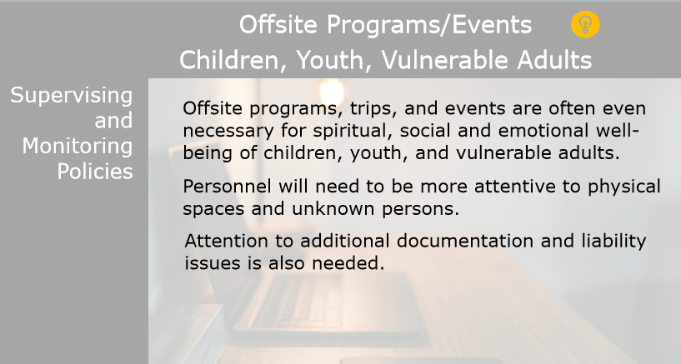
Notes:
Offsite programs, trips, and events are often even necessary for spiritual, social and emotional well-being of children, youth, and vulnerable adults. Personnel will need to be more attentive to physical spaces and unknown persons. Attention to additional documentation and liability issues is also needed.
Facilitator Notes:
Share with the class that more information can be found in Section VI, H of the Model Policies.

Slide 35
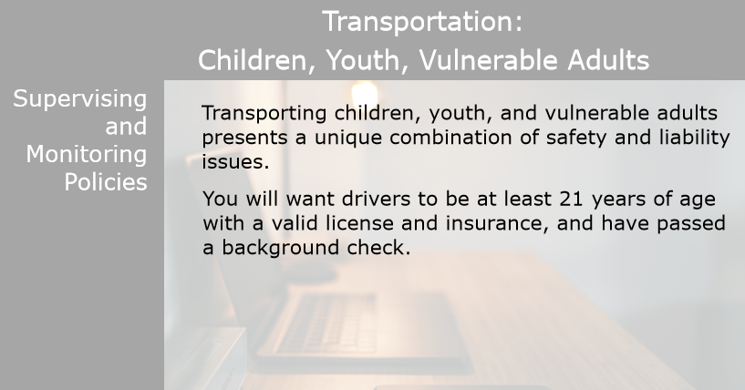
Notes:
Transporting children, youth, and vulnerable adults presents a unique combination of safety and liability issues. You will want drivers to be at least 21 years of age with a valid license and insurance, and have passed a background check.
Facilitator Notes:
Share with the class that more information can be found in Section VI, J of the Model Policies.

Slide 36
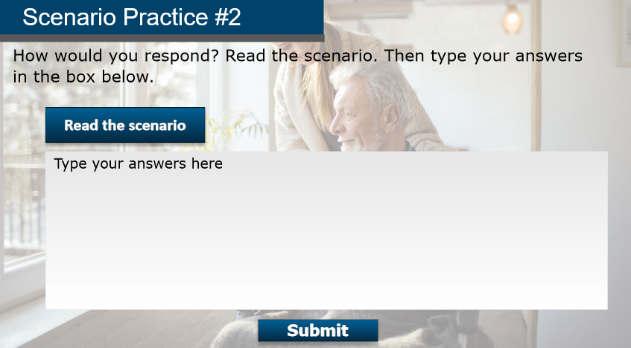
Notes:
Let’s review another scenario. A group of volunteers are planning a visit to a nursing home. Let’s read the statements on the slide and decide which policy each statement relates to.
Facilitator Note:
Go to the next slide to show the class the full scenario.

Slide 37
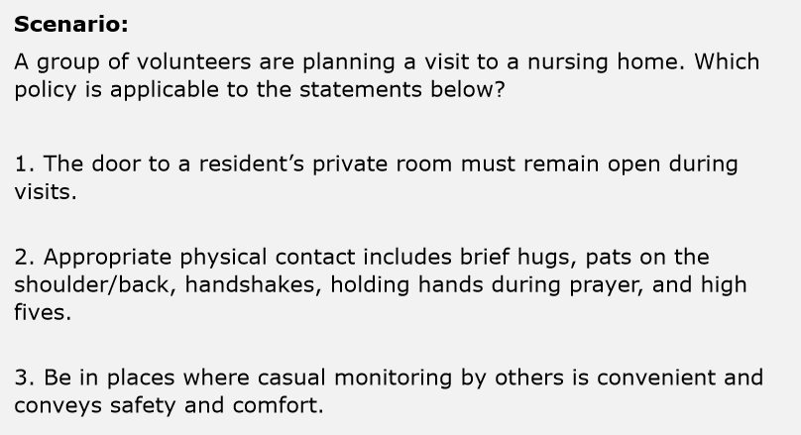
Notes:
Scenario:
A group of volunteers are planning a visit to a nursing home. Which policy is applicable to the statements below?
1. The door to a resident’s private room must remain open during visits.
2. Appropriate physical contact includes brief hugs, pats on the shoulder/back, handshakes, holding hands during prayer, and high fives.
3. Be in places where casual monitoring by others is convenient and conveys safety and comfort.
Facilitator Note:
Give the groups five minutes to brainstorm an answer and select a group representative to explain the group’s answer to the rest of the class. Be sure to set a timer.

Slide 38
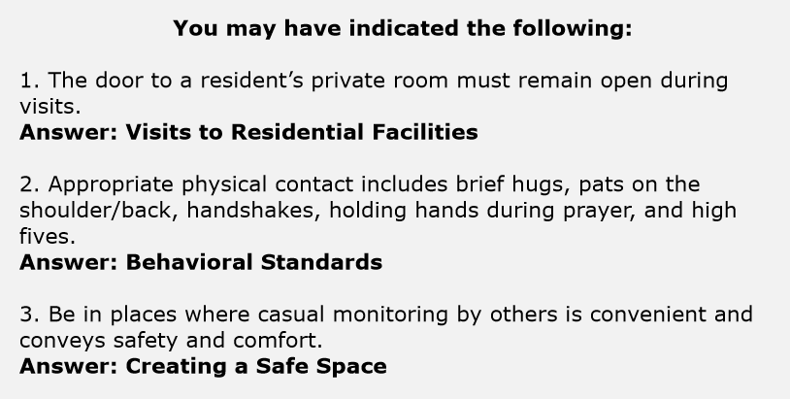
Notes:
Now let’s review the statements again with the answers.
1. The door to a resident’s private room must remain open during visits.
Answer: Visits to Residential Facilities
2. Appropriate physical contact includes brief hugs, pats on the shoulder/back, handshakes, holding hands during prayer, and high fives.
Answer: Behavioral Standards
3. Be in places where casual monitoring by others is convenient and conveys safety and comfort.
Answer: Creating a Safe Space
Facilitator Notes:
When the timer goes off, ask the representative from each group to share out their answer. Then share the answers.

Slide 39
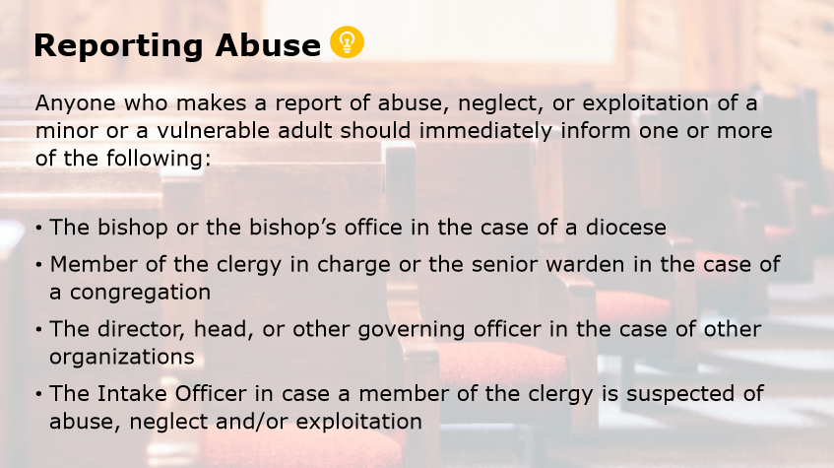
Notes:
Reporting Abuse
Any adult who has reason to suspect that abuse, neglect, or exploitation of a minor or a vulnerable adult has taken place, is strongly encouraged, and all mandated reporters are legally required to contact the state’s appropriate Protective Services.
In most cases, anyone who makes a report of abuse, neglect, or exploitation of a minor or a vulnerable adult should immediately inform one or more of the following:
The bishop or the bishop’s office in the case of a diocese
Member of the clergy in charge or the senior warden in the case of a congregation
The director, head, or other governing officer in the case of other organizations
The Intake Officer in case a member of the clergy is suspected of abuse, neglect and/or exploitation
A list of local resources and contact information should be provided by each diocese, congregation, and organization, including:
Responsible persons, clergy in charge, wardens, bishop, intake officers, and Child & Adult Protective Services. Click the light bulb icon for more information.
Facilitator Notes:
Share with the class that more information can be found in Section VII of the Model Policies.

Slide 40
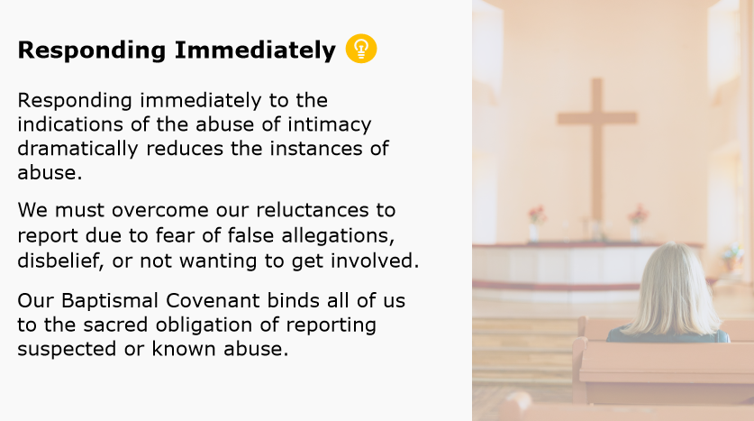
Notes:
Responding Immediately
Ministry always involves a tension between a Gospel-based integrity and a Gospel-based intimacy as modeled by the life of Christ. Because vulnerability is necessary, responding immediately to the indications of the abuse of intimacy dramatically reduces the instances of abuse. Because it is so important to our well-being as a community, we must overcome our reluctances to report due to fear of false allegations, disbelief, or not wanting to get involved.
Our Baptismal Covenant binds all of us to the sacred obligation of reporting suspected or known abuse. Those subject to the Model Policies are required to report policy violations. Click the light bulb icon for more information.
Facilitator Notes:
Share with the class that more information can be found in Section VII of the Model Policies.

Slide 41
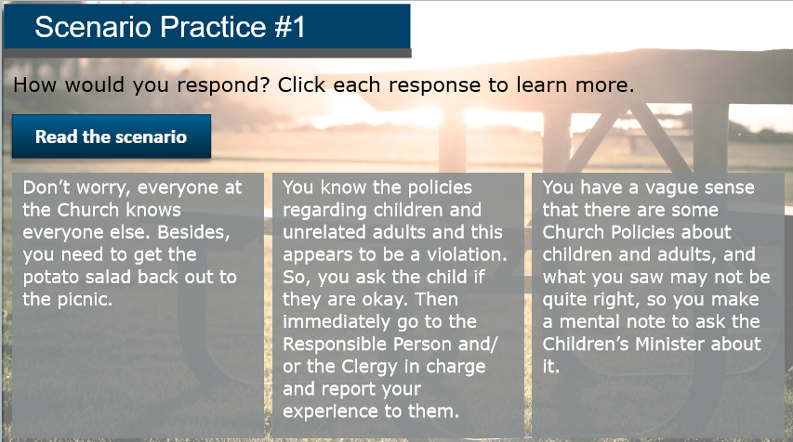
Notes:
Now let’s review a scenario. Is this a Policy Violation? You are attending a Church picnic held outside on the church grounds. You go inside to the kitchen to refill the potato salad. As you walk down the hall, you see a 6-year-old child and an adult who is not their parent leave the restroom together. How would you respond?
Facilitator Notes:
Have participants break off into groups of three. Give the groups five minutes to brainstorm an answer and select a group representative to explain the group’s answer to the rest of the class. Be sure to set a timer.
Go to the next slide to discuss the learners’ responses. Then give the answer for this scenario.

Slide 42
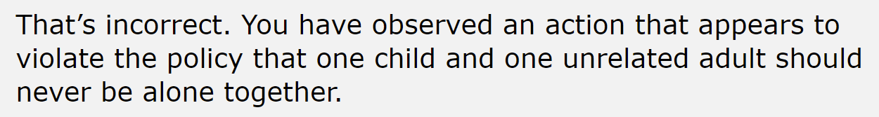
Scenario Practice
Is this a Policy Violation?
Don’t worry, everyone at the Church knows everyone else. Besides, you need to get the potato salad back out to the picnic.
Notes:
Our first response is, “Don’t worry, everyone at the Church knows everyone else. Besides, you need to get the potato salad back out to the picnic.”
That’s incorrect. You have observed an action that appears to violate the policy that one child and one unrelated adult should never be alone together.
Facilitator Note:
Discuss the incorrect answer with the group.

Slide 43
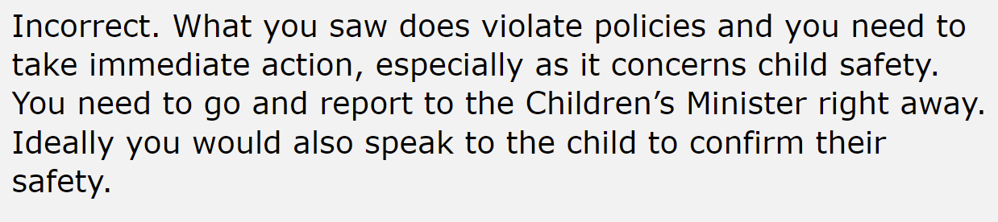
Scenario Practice
Is this a Policy Violation?
You have a vague sense that there are some Church Policies about children and adults, and what you saw may not be quite right, so you make a mental note to ask the Children’s Minister about it.
Notes:
Let’s look at the third response now. It is “You have a vague sense that there are some Church Policies about children and adults, and what you saw may not be quite right, so you make a mental note to ask the Children’s Minister about it.”
This statement is also incorrect. What you saw does violate policies and you need to take immediate action, especially as it concerns child safety. You need to go and report to the Children’s Minister right away. Ideally you would also speak to the child to confirm their safety.
Facilitator Note:
Discuss the incorrect answer with the group.

Slide 44
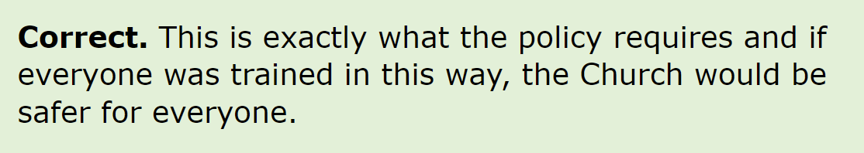
Scenario Practice
Is this a Policy Violation?
You know the policies regarding children and unrelated adults, and this appears to be a violation. So, you ask the child if they are okay. Then immediately go to the Responsible Person and/or the Clergy in charge and report your experience to them.
Notes:
Our second response is the correct response. “You know the policies regarding children and unrelated adults, and this appears to be a violation. So, you ask the child if they are okay. Then immediately go to the Responsible Person and/or the Clergy in charge and report your experience to them.”
This is exactly what the policy requires and if everyone was trained in this way, the Church would be safer for everyone.
Facilitator Note:
Give the correct answer and discuss with the class.

Slide 45
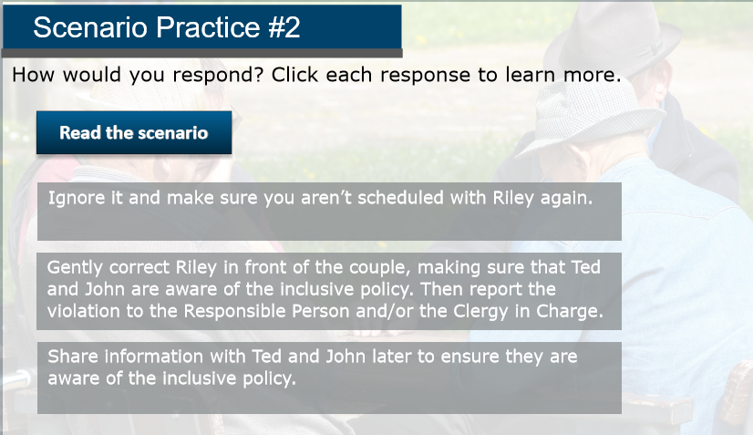
Notes:
Let’s review another scenario. You and Riley are scheduled to take Communion to parishioners who have just moved into an assisted living facility. As you are traveling to the facility, Riley tells you that they are disappointed that you couldn’t find someone to take their spot visiting this particular couple as they are uncomfortable with them. During the visit to Ted and John, you realize that Riley is uncomfortable with their sexuality and refuses to acknowledge that they are married. At one point Riley asks “How long have you been roommates?” How would you respond? Click each statement below to learn more.
Facilitator Notes:
Give the groups another five minutes to brainstorm an answer and designate the group representative to explain the group’s answer to the rest of the class. Be sure to set a timer.
Go to the next slide to discuss the learners’ responses. Then give the answer for this scenario.

Slide 46
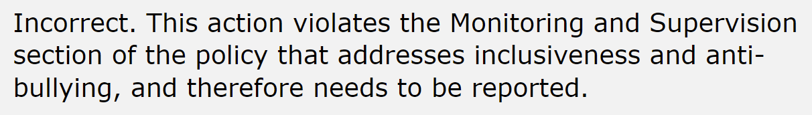
Scenario Practice #2
How would you respond?
Ignore it and make sure you aren’t scheduled with Riley again.
Notes:
Our first response is, “Ignore it and make sure you aren’t scheduled with Riley again.”
That’s incorrect. This action violates the monitoring and supervision section of the policy that addresses inclusiveness and anti-bullying, and therefore needs to be reported.
Facilitator Note:
Share the incorrect answer with the class.

Slide 47
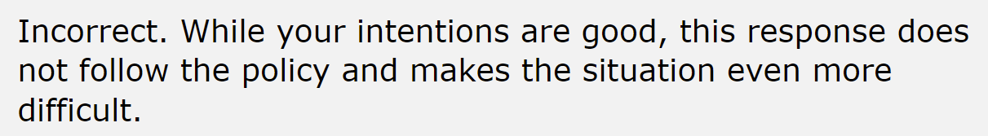
Scenario Practice #2
How would you respond?
Share information with Ted and John later to ensure they are aware of the inclusive policy.
Notes:
Let’s jump ahead to the third response now. It is “Share information with Ted and John later to ensure they are aware of the inclusive policy.”
This answer is incorrect as well. While your intensions are good, this response does not follow the policy and makes the situation even more difficult.
Facilitator Note:
Share the incorrect answer with the class.

Slide 48
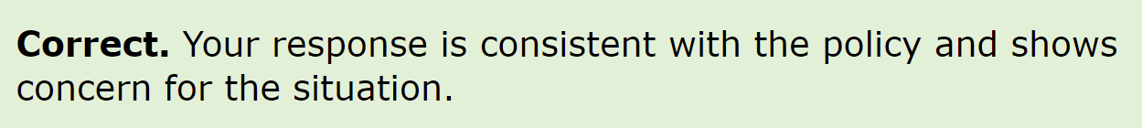
Scenario Practice #2
How would you respond?
Gently correct Riley in front of the couple, making sure that Ted and John are aware of the inclusive policy. Then report the violation to the Responsible Person and/or the Clergy in Charge.
Notes:
Our second response is the correct response. “Gently correct Riley in front of the couple, making sure that Ted and John are aware of the inclusive policy. Then report the violation to the Responsible Person and/or the Clergy in Charge.”
This answer is correct. Your response is consistent with the policy and shows concern for the situation.
Facilitator Note:
Share the correct answer with the class. Take a few moments to discuss both scenarios with the class if anyone has further questions.

Slide 49

This concludes our discussion on the Organizational Rules & Policies course in The Safe Church, Safe Communities series.
Notes:
This will conclude our discussion on the Organizational Rules & Policies course in The Safe Church, Safe Communities Series. Now let’s take a few questions.
Facilitator Note:
Take time for questions and discussions.

