Slide 1



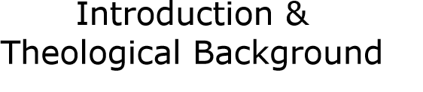
Notes:
The Introduction & Theological Background course is the first course in the Safe Church, Safe Communities series. These courses are offered on Praesidium Academy.
Facilitator Notes:
Introduce learners to the Safe Church, Safe Communities series. Explain this course is the introduction course and that several other courses are a part of this series.

Slide 2

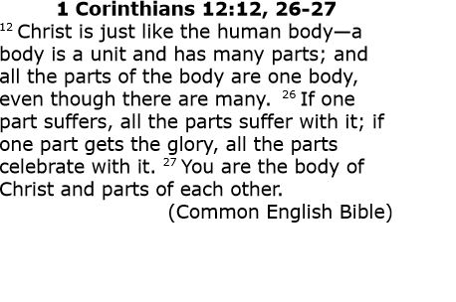
Notes:
1 Corinthians 12:12, 26-27
¹² Christ is just like the human body—a body is a unit and has many parts; and all the parts of the body are one body, even though there are many. ²⁶ If one part suffers, all the parts suffer with it; if one part gets the glory, all the parts celebrate with it. ²⁷ You are the body of Christ and parts of each other. (Common English Bible)
Facilitator Note:
Briefly discuss with the group what this verse means to them.

Slide 3
Each of us has a unique part to play in the life of the church:
Many parts, one body, all important
We all have gifts we bring
Abuse damages those gifts. The damage affects the individual, the families, and the community.
As a community, we are stewards of each other’s well-being and safety.
Notes:
Each of us has a unique part to play in the life of the church:
Many parts, one body, all important
We all have gifts we bring
When abuse or harassment is happening in our communities, those gifts are damaged. The damage affects the individual, the families, and the community.
We, as a community of faith (and as individuals), have a responsibility to see that we are all loved and protected. Learning about ways to make the church safe for all people and practicing safe church is something we all must do. As a community, we are stewards of each other’s well-being and safety.

Slide 4
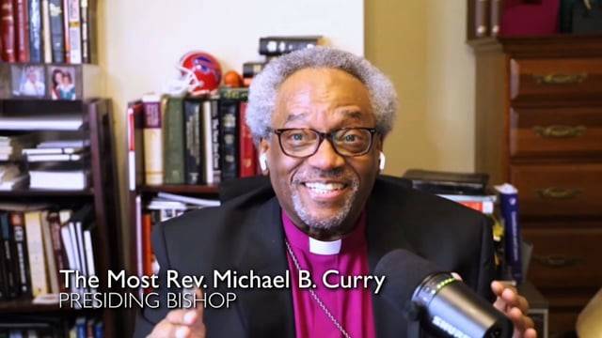
Notes:
Let’s hear Presiding Bishop Michael Curry’s invitation to Safe Church and why it is important.
Facilitator Note:
The next slide will give you prompts to use for reflecting on this video.

Slide 5


What did you find the most meaningful from the Presiding Bishop’s message?
What is something new you learned?
Notes:
Let’s take some time to reflect on the message we just received from Presiding Bishop Curry.
Would anyone like to share what they found most meaningful or something new they learned?
Facilitator Notes:
Use some of the following prompts if learners are slow to share:
We have a covenant to care for all
To guide conduct, awareness, resources
So that we know how to respond if we have a concern
To ensure safety and ministry

Slide 6
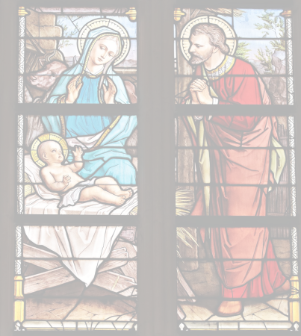
Goals & Expectations
Expectations for leaders in their relationships with children, youth, and adults
Foster highest standards of behavior in ministry settings
Living into policies and practices means we’re living into our love for each other & the world
Notes:
In taking this time to learn more about how we, as the church, must care for and protect each other, we are committing to the body of Christ that we will work together.
This training series, and the model policies of The Episcopal Church, set forth expectations for its leaders in their relationships with children, youth, and adults. Our hope is to foster the highest standards of behavior in ministry settings across The Episcopal Church. In living into these policies and practices, we are living into our love for each other and our love for the world.
Facilitator Notes:
Ask the learners if anyone has taken any of the courses yet on Praesidium Academy and what are the names of those courses.

Slide 7
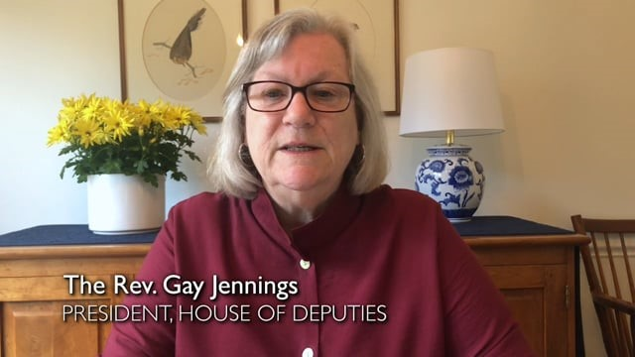
Notes:
Next we’ll hear from The Reverend Gay Jennings, President of the House of Deputies and then again from the Most Rev. Curry.

Slide 8
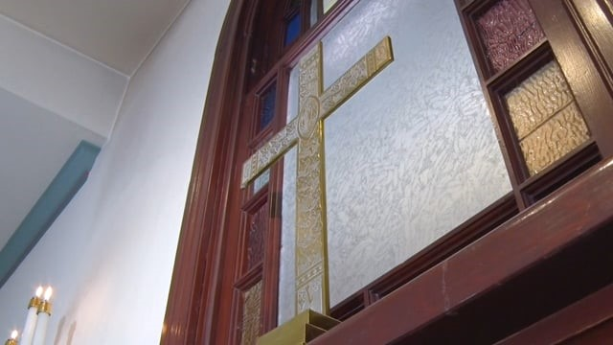
Notes:
Let’s again hear from Presiding Bishop Michael Curry.
Facilitator Note:
Use the prompts on the next slide to discuss both videos.

Slide 9

How do you see your ministry?
How might your ministry impact your church and your community?
Notes:
After those videos, what are your thoughts?
Can you relate to Ruth Miller? How do you see your ministry?
How might your ministry impact your church? How about your community?
Facilitator notes:
Ask the above questions, but use some of the following prompts if learners are hesitant to share:
We have a covenant to care for all
To guide conduct, awareness, resources
So that we know how to respond if we have a concern
To ensure safety and ministry

Slide 10
The goal of the Safe Church, Safe Communities series is to offer “a standard of training that will foster a culture of safety and inclusion for all people that includes a broad overview of issues of vulnerability, power, and healthy boundaries. This training is designed to equip all people to live out their Baptismal Covenant.”
Notes:
The goal of the Safe Church, Safe Communities series is to offer “a standard of training that will foster a culture of safety and inclusion for all people that includes a broad overview of issues of vulnerability, power, and healthy boundaries. This training is designed to equip all people to live out their Baptismal Covenant.”
Facilitator Note:
Ask learners if they have any questions. Ask if they have taken any of the courses in the Safe Church, Safe Communities series already?

Slide 11


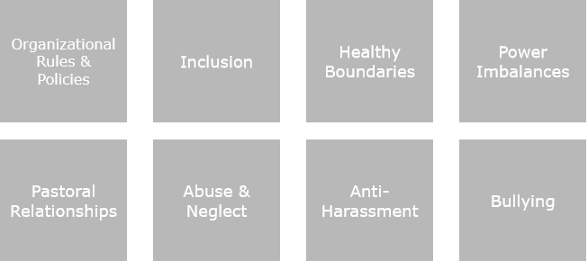
Notes:
In addition to this course there are several other courses that are covered in the Safe Church, Safe Communities series. These courses are offered on Praesidium Academy.
Let’s learn more about each course now.
Facilitator Note:
Over the next slides, introduce the name and description of each course.

Slide 12
Organizational Rules & Policies
Overview of our model policies, best practices, and screening, monitoring, and supervision standards
Notes:
Organizational Rules & Policies is an overview of our model policies, best practices, and screening, monitoring, and supervision standards.

Slide 13
Inclusion
Overview of what it means to be an inclusive community, including requirements of commitment and how to recognize and respond to discriminatory language and behaviors.
Notes:
Inclusion is an overview of what it means to be an inclusive community, including requirements of commitment and how to recognize and respond to discriminatory language and behaviors.

Slide 14
Healthy Boundaries
Review how to respond to unhealthy boundary violations (physical, emotional, external, etc.) and the benefits of managing healthy boundaries.
Notes:
Healthy Boundaries reviews how to respond to unhealthy boundary violations (physical, emotional, external, etc.) and the benefits of managing healthy boundaries.

Slide 15
Power Imbalances
Define healthy relationships within hierarchies and how to respond to unhealthy expressions of power.
Notes:
In Power Imbalances we define healthy relationships within hierarchies and how to respond to unhealthy expressions of power.

Slide 16
Pastoral Relationships
Review roles within pastoral relationships and healthy boundaries.
Notes:
Pastoral Relationships reviews roles within pastoral relationships and healthy boundaries.

Slide 17
Abuse & Neglect
Learn the warning signs of abuse and neglect as well as how to respond and report instances of abuse or neglect.
Notes:
Abuse & Neglect – In this course, we learn the warning signs of abuse and neglect as well as how to respond and report instances of abuse or neglect.

Slide 18
Anti-Harassment
Deeper dive into promoting a healthy parish environment and relationships and how to prevent harassment.
Notes:
Anti-Harassment – Deeper dive into promoting a healthy parish environment and relationships and how to prevent harassment.

Slide 19
Bullying
Overview of types of bullying and how to identify, respond to, and report instances of bullying.
Notes:
Bullying is an overview of types of bullying and how to identify, respond to, and report instances of bullying. This course is a mini-course so it will take a little as 20 minutes to take.

Slide 20

Notes:
This will conclude our discussion on the Introduction & Theological Background course in The Safe Church, Safe Communities Series. Now let’s take a few questions.
Facilitator Note:
Take time for questions and discussions.

