Slide 1



Inclusion
Notes:
Let’s discuss the Inclusion course in the Safe Church, Safe Communities series. This course is offered on Praesidium Academy.
Facilitator Note:
Introduce learners to the Safe Church, Safe Communities series if needed.

Slide 2
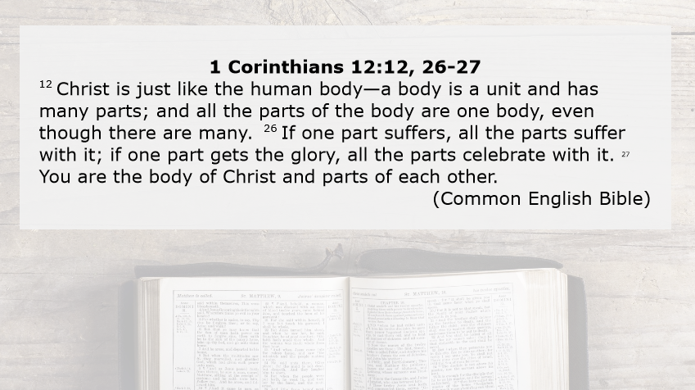
Notes:
1 Corinthians 12:12, 26-27
¹² Christ is just like the human body—a body is a unit and has many parts; and all the parts of the body are one body, even though there are many. ²⁶ If one part suffers, all the parts suffer with it; if one part gets the glory, all the parts celebrate with it. ²⁷ You are the body of Christ and parts of each other. (Common English Bible)
Facilitator Note:
N/A

Slide 3
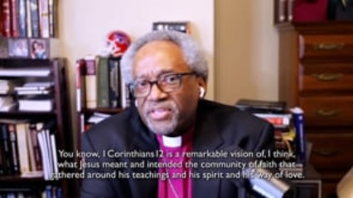
Introduction Video
Notes:
Video:
Click the play button to play the video.
Facilitator Notes:
Before playing the video, tell learners to listen for how Presiding Bishop Most Rev. Michael B. Curry explains 1st Corinthians 12.
Direct link to video - https://player.vimeo.com/video/694976897?h=cccc7d4ab9&amp;badge=0&amp;autopause=0&amp;player_id=0&amp;app_id=58479
Ask: “How does 1st Corinthians 12 help us understand the value and importance of inclusion?”

Slide 4
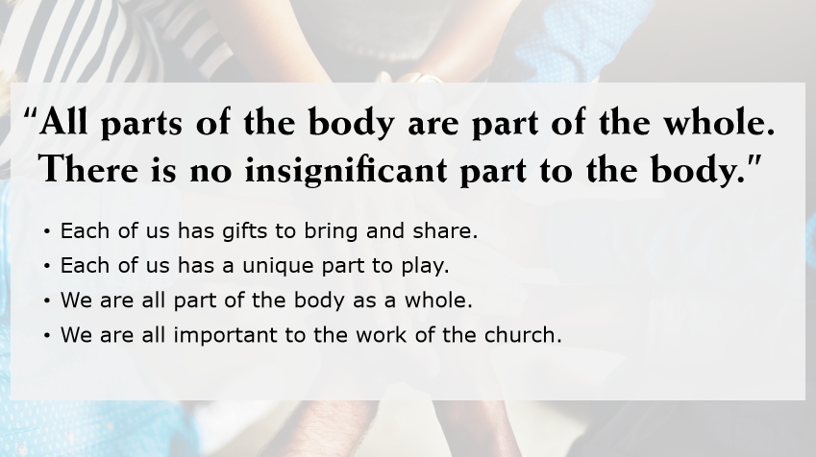
Notes:
As Presiding Bishop Michael Curry said, “All parts of the body are part of the whole. There is no insignificant part to the body.”
Remember each of us has gifts to bring and share. Each of us has a unique part to play in the life of the church and in the life of our communities. We are all part of the body as a whole, and we are all important to the work of the church.
Facilitator Notes:
N/A

Slide 5
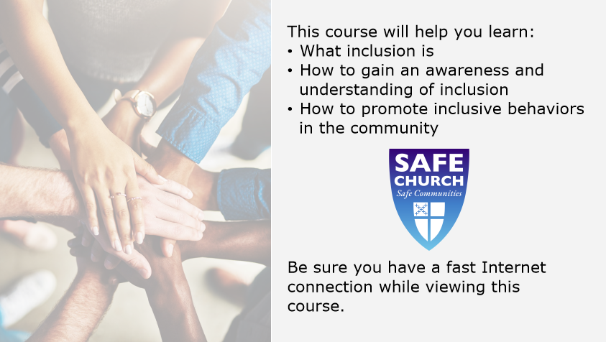
Notes:
In this course, we will define what inclusion is, how to gain an awareness and understanding of inclusion, and how to promote inclusive behaviors in the community.
Facilitator Notes:
N/A

Slide 6
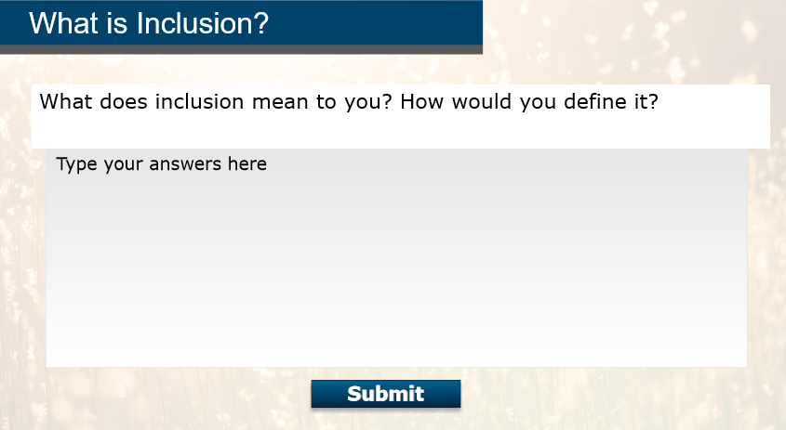
Notes:
What does inclusion mean to you? How would you define it?
Facilitator Notes:
Have the class move into groups of three. Give groups four minutes to discuss, come up with an answer, and choose a representative from the group to share out their answer.

Slide 7
Notes:
Facilitator Notes:
After group representatives share their group answers, share another few good answers:
Inclusion is ensuring equal access to opportunities,
It’s including marginalized people in activities, leadership roles, and decision-making.
Or it’s understanding people have different abilities, backgrounds, and viewpoints.

Slide 8
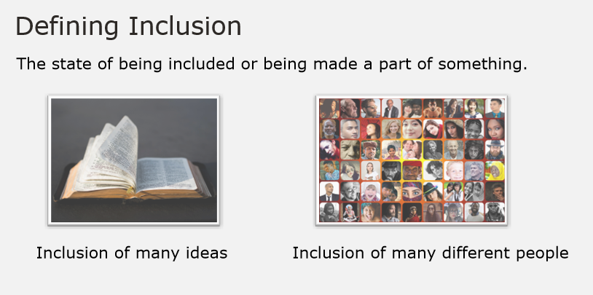
What is Inclusion?
Notes:
One common definition of inclusion is the state of being included or being made a part of something. When a book covers many different ideas and subjects, it is an example of the inclusion of many ideas. When multiple people are all invited to be part of a group, it is an example of the inclusion of many different people.
Facilitator Notes:
N/A

Slide 9
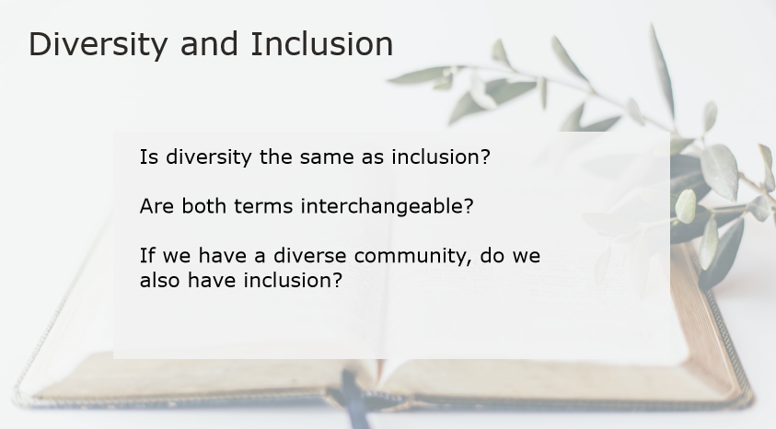
Notes:
When we define inclusion in the context of a community, is it the same as diversity? Are both terms interchangeable? If we have a diverse community, do we automatically have inclusion in that community as well?
Facilitator Note:
Give groups six minutes to discuss the questions, then ask for volunteers to share out something they discussed in their group that resonated with them.

Slide 10
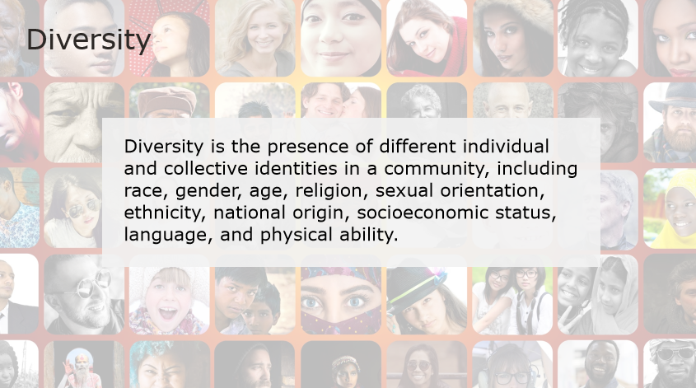
Notes:
Diversity is the presence of different individual and collective identities in a community, including race, gender, age, religion, sexual orientation, ethnicity, national origin, socioeconomic status, language, and physical ability.
Facilitator Notes:
N/A

Slide 11
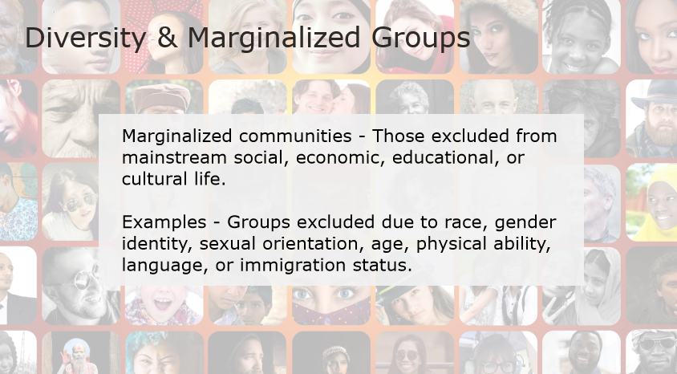
Notes:
Typically these relate to marginalized communities which are those excluded from mainstream social, economic, educational, or cultural life.
Examples of marginalized populations include groups excluded due to race, gender identity, sexual orientation, age, physical ability, language, or immigration status.
Facilitator Notes:
N/A

Slide 12
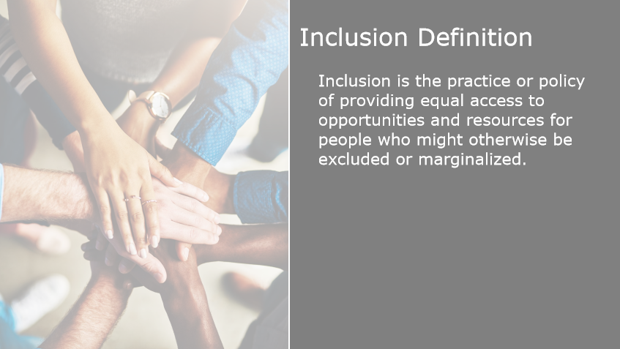
Notes:
Inclusion is the practice or policy of providing equal access to opportunities and resources for people who might otherwise be excluded or marginalized.
Facilitator Note:
N/A

Slide 13
Terms:
Inclusion
Diversity
Marginalized community
Notes:
Facilitator Note:
Assign each group one term to explain to the rest of the class (If you have more than three groups, you can assign other groups to come up with an example of a term)
Inclusion
Diversity
Marginalized Community
Give groups ten minutes to generate their definitions; be sure to move around the room to check in with each group as they’re working to give them feedback. Then, have each group present their definition. Make sure to immediately address any inaccuracies or misconceptions in a gentle way. Avoid making learners feel criticized.

Slide 14
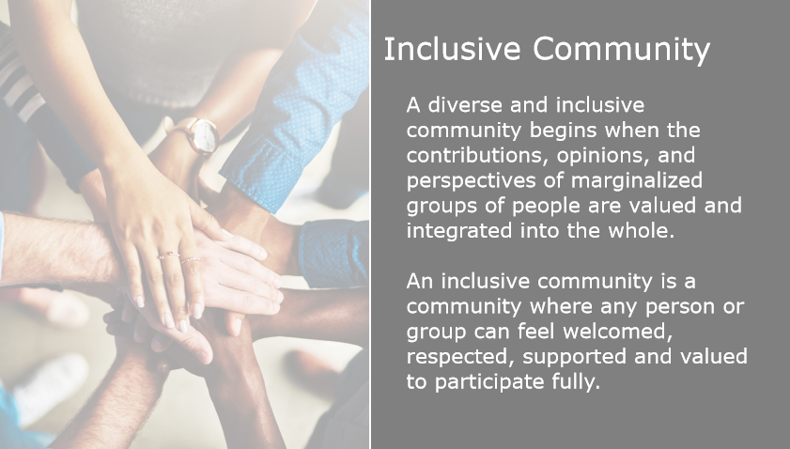
Notes:
A diverse and inclusive community begins when the contributions, opinions, perspectives of marginalized groups of people are valued and integrated into the whole.
An inclusive community is one where any person or group can feel welcomed, respected, supported and valued to participate fully.
Facilitator Note:
N/A

Slide 15
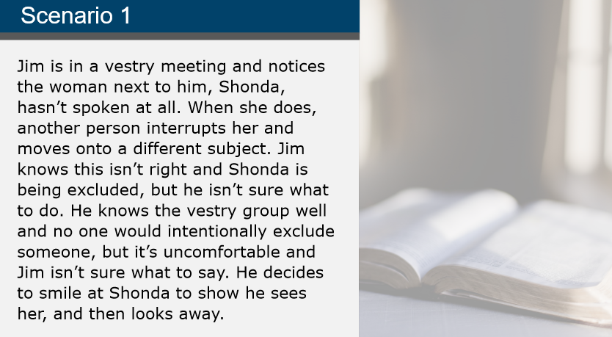
Notes:
Let’s take a moment to consider the following scenario:
Jim is in a vestry meeting and notices the woman next to him, Shonda, hasn’t spoken at all. When she does, another person interrupts her and moves onto a different subject. Jim knows this isn’t right and Shonda is being excluded, but he isn’t sure what to do. He knows the vestry group well and no one would intentionally exclude someone, but it’s uncomfortable and Jim isn’t sure what to say. He decides to smile at Shonda to show he sees her, and then looks away.
Facilitator Note:
After reading the scenario, ask: “Have you ever felt like Jim or Shonda?” and ask learners to share their experiences.

Slide 16
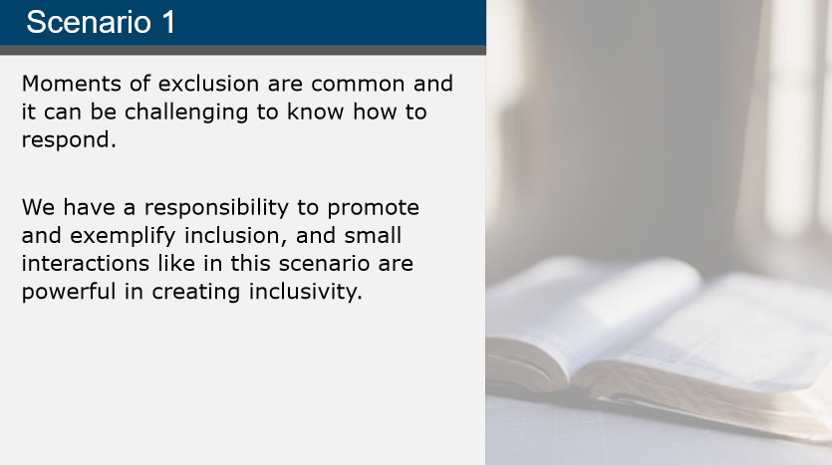
Notes:
Jim’s situation is likely a familiar one. We all encounter moments of exclusion in our day-to-day lives, and it can be challenging to know how to respond. Remember we have a responsibility to promote and exemplify inclusion in our community. Small interactions like the example with Jim and Shonda are often the most powerful in creating inclusivity.
Later in this course, we will revisit this scenario.
Facilitator Note:
N/A

Slide 17
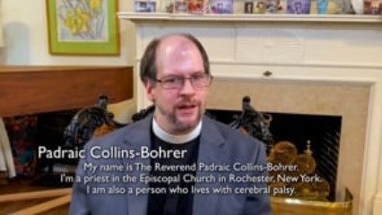
Video Example of Inviting to the Table
Notes:
Video:
Click the play button to play the video.
Facilitator Notes:
Direct link to video - https://player.vimeo.com/video/689736110?h=5e98eb9ee6&amp;badge=0&amp;autopause=0&amp;player_id=0&amp;app_id=58479

Slide 18
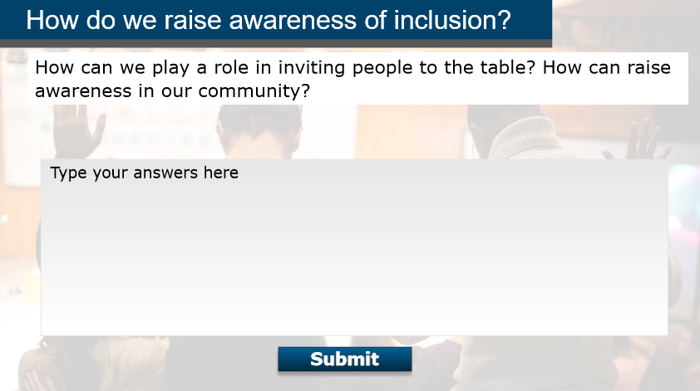
Notes:
Facilitator Notes:
Ask: “Padraic Collins-Bohrer spoke about self-advocacy in this video and the importance of being invited to the table. How can we play a role in inviting people to the table? How can we raise awareness in our community?”
Have learners discuss in their groups for five minutes and select a group representative to share their ideas with the larger class. Have each group share; encourage brainstorming and conversation.

Slide 19
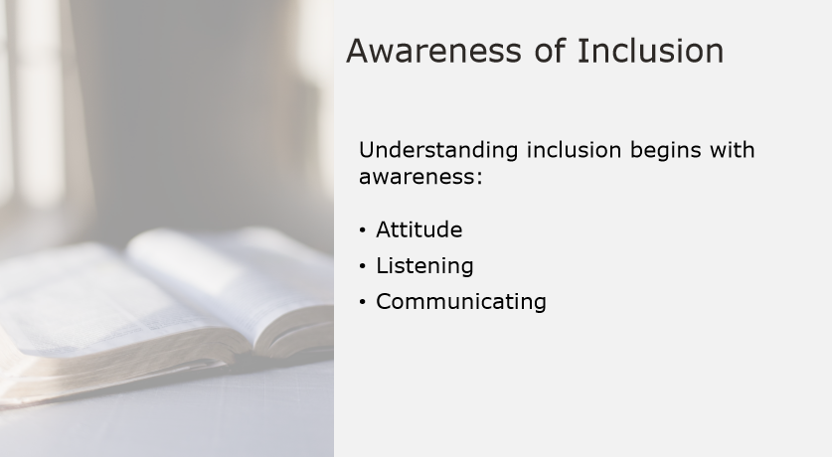
Notes:
Understanding inclusion begins with awareness. A person’s attitude, listening to others, and communicating can start to foster an environment where all people feel safe to freely participate, contribute, and share their voice.
Facilitator Note:
N/A

Slide 20
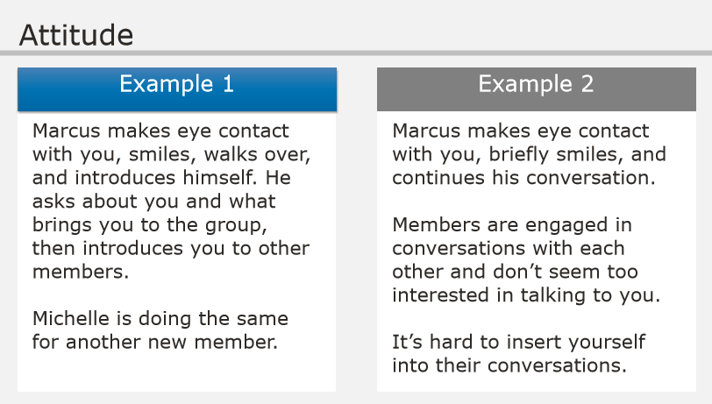
Notes:
A positive attitude opens the door to inclusion.
Imagine you are new to a group. You walk in to your first meeting, and Marcus notices you walking in immediately. He makes eye contact with you, smiles, and then walks over and introduces himself. He asks about you, what brought you to the group, and introduces you to the other members. You notice Michelle, another pre-existing member, is doing the same for another new person in the group. You ask Marcus if him and Michelle are leaders. He says they aren’t, they just happened to be the first people to notice the new members.
Now let’s imagine that scenario plays out differently.
You walk into your first meeting, and Marcus notices you walking in immediately. He makes eye contact with you and briefly smiles before continuing his conversation with another member. The pre-existing members seem nice enough, but they’re talking amongst themselves and don’t seem too interested in you or the other new member. You introduce yourself to a few people, but you’re having a bit of trouble keeping up with the conversations because you’re new and don’t know the background information.
Facilitator Notes:
Ask: “Take a moment to reflect on the two examples. Which group conveys a positive and welcoming attitude to its newest members?” Have learners to raise hands to indicate example 1 or example 2.

Slide 21
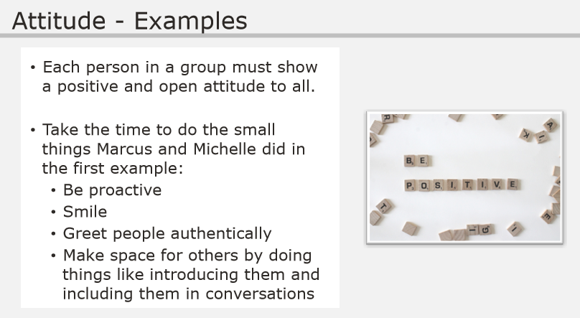
Notes:
In the previous slide, we considered two different examples of how a group could welcome new members.
In both examples, the group would likely describe itself as inclusive and welcoming to new members, but only one truly exemplified a positive and open attitude. Pay special attention to Marcus and Michelle’s roles as non-leaders of the group- to be welcoming and pro-active. Each person in the group needs to take the time to greet people authentically and be hospitable.
Facilitator Notes:
N/A

Slide 22
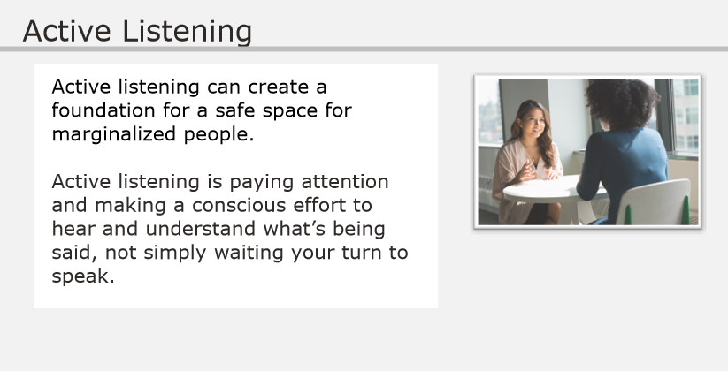
Notes:
Active listening can create a foundation for a safe space for marginalized people. Active listening is paying attention and making a conscious effort to hear and understand what’s being said, not simply waiting your turn to speak.
Facilitator Notes:
N/A

Slide 23
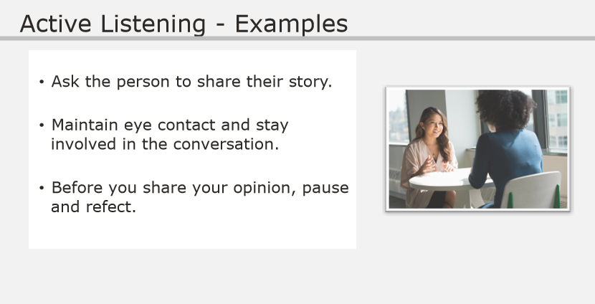
Notes:
Here are a few things you can do to demonstrate active listening:
Ask the person to share their story. This opens a dialogue with the marginalized person and can build trust and rapport.
Maintain eye contact and stay involved in the conversation.
Before you share your opinion, pause and reflect. Listening will likely be the best path to build a relationship with the person. Sometimes all a person needs is to be listened to.
Facilitator Notes:
N/A

Slide 24
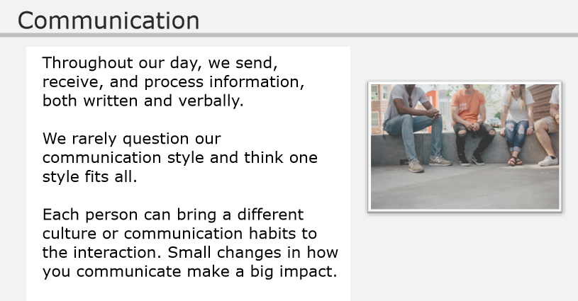
Notes:
Throughout our day, we send, receive, and process information, both written and verbally. We rarely question our communication style and think one style fits all. However, each person may bring a different culture or communication habits to the interaction, and their communication style may differ greatly from yours. Small changes in how you communicate make a big impact.
Facilitator Notes:
N/A

Slide 25
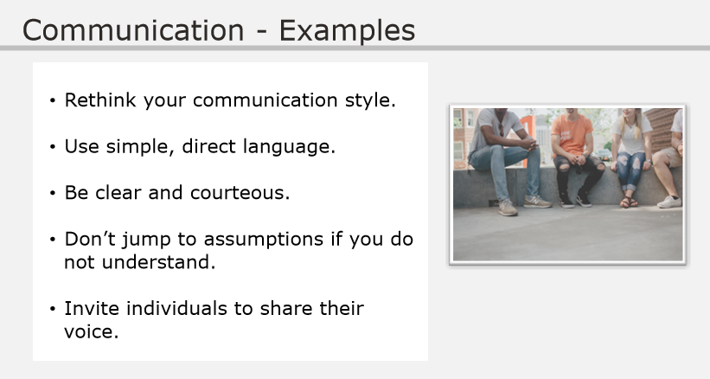
Notes:
When communicating with a person different than you, rethink your communication style. Use simple, direct language. Be clear and courteous. Don’t jump to assumptions if you do not understand. Instead ask for details and more information. Invite the person to share their voice.
Facilitator Notes:
N/A

Slide 26
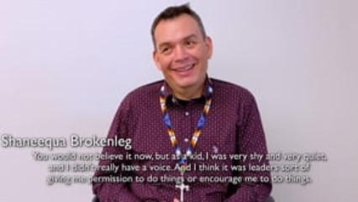
Video Example
Notes:
Video:
Click the play button to play the video.
Facilitator Notes:
Direct link to video - https://player.vimeo.com/video/689785978?h=5a96b3b915&amp;badge=0&amp;autopause=0&amp;player_id=0&amp;app_id=58479
Ask: “Reverend Shaneequa discusses in this video how she found her voice. How did other members of the community help her find her voice?”
After learners discuss, ask: “How can we help others to find their voices?”

Slide 27
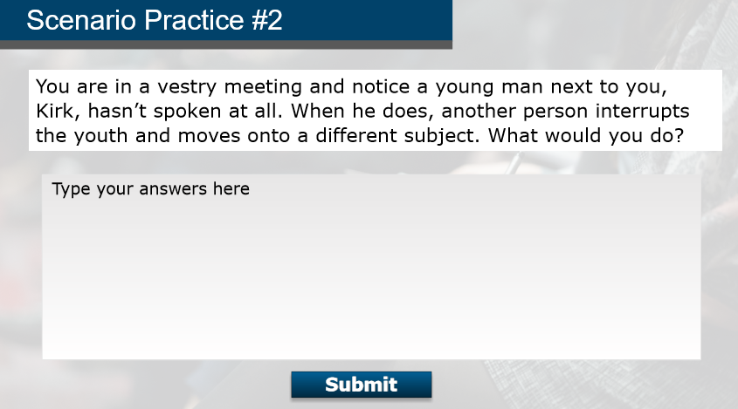
Notes:
Let’s revisit the scenario in Lesson 1. You are in a vestry meeting and notice a young man next to you, Kirk, hasn’t spoken at all. When he does, another person interrupts the youth and moves onto a different subject.
A brief interruption may stop a person from voicing their thoughts. Inviting the person to share their voice creates inclusivity. We have a responsibility to promote and exemplify inclusion in our community.
Facilitator Notes:
Tell learners you’re going to challenge them to come up with a quick response, just like in the scenario. Give learners 30 seconds to (individually) come up with what they would say or do.
Ask learners: “Was it difficult to come up with a response that quickly?” and reinforce the time pressure as part of the reason why we practice inclusive behaviors. By practicing these things, they become natural to us!
Ask: “For those of you who were able to come up with a response, what would you say or do in this situation?”
Make sure to share out these strong answers:
“I think Kirk was speaking. I would like to hear what he has to say.” or
“Can we go back a minute, I think he had a point to make.”

Slide 28
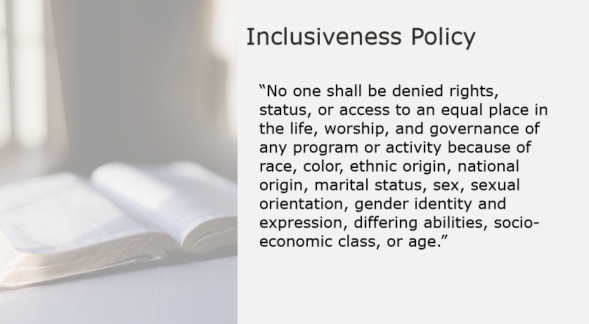
Notes:
In the Episcopal Church Model Policy for the Protection of Vulnerable Adults states that:
No one shall be denied rights, status, or access to an equal place in the life, worship, and governance of any program or activity because of race, color, ethnic origin, national origin, marital status, sex, sexual orientation, gender identity and expression, differing abilities, socio-economic class, or age.
Facilitator Notes:
N/A

Slide 29
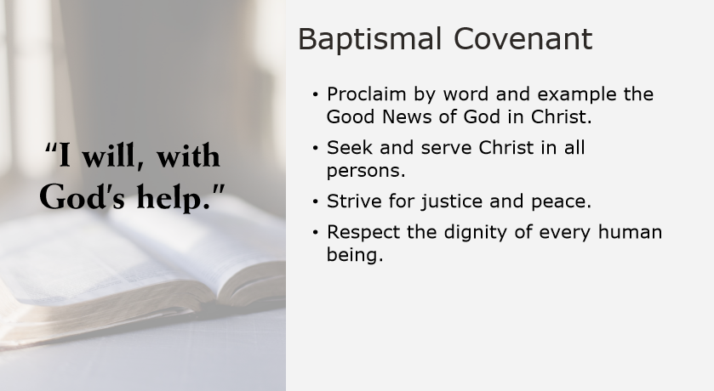
Notes:
The importance of inclusion is a part of our baptismal covenant as well. We proclaim by word and example the Good News of God in Christ. We seek and serve Christ in all persons, loving our neighbor as ourselves. We strive for justice and peace.
And We respect the dignity of every human being.
Facilitator Notes:
N/A

Slide 30
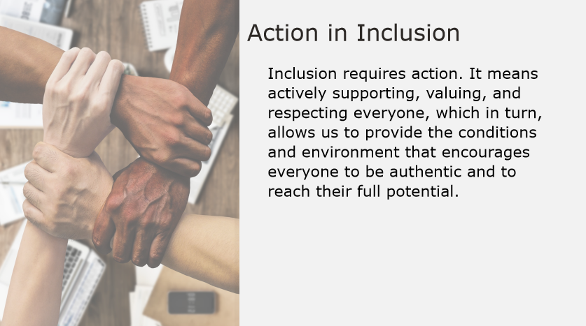
Notes:
Inclusion requires action. It means actively supporting, valuing, and respecting everyone, which in turn, allows us to provide the conditions and environment that encourages everyone to be authentic and to reach their full potential.
Facilitator Note:
N/A

Slide 31
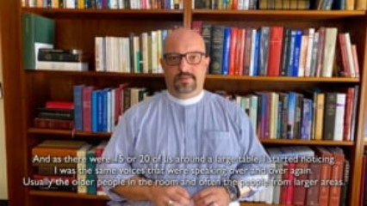
Video Example on Inviting Voices
Notes:
Video:
Click the play button to play the video.
Facilitator Notes:
Direct link to video - https://player.vimeo.com/video/697137422?h=03c6d308ac&amp;badge=0&amp;autopause=0&amp;player_id=0&amp;app_id=58479
Ask: “Think about the instruction: "I want you to pay attention to who's not speaking. Can you pay attention and invite those people in?“. Why is it so important for us to seek out those who are not speaking and invite them in?”

Slide 32
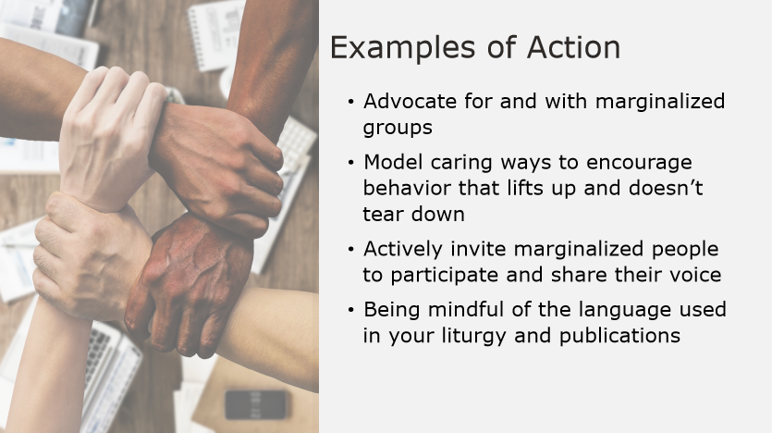
Notes:
Examples of action to promote inclusion may include:
Advocate for and with marginalized groups.
Model caring ways to encourage behavior that lifts up and doesn’t tear down.
Actively invite marginalized people to participate and share their voice.
Be mindful of the language used in your liturgy and publications.
Facilitator Notes:
N/A

Slide 33
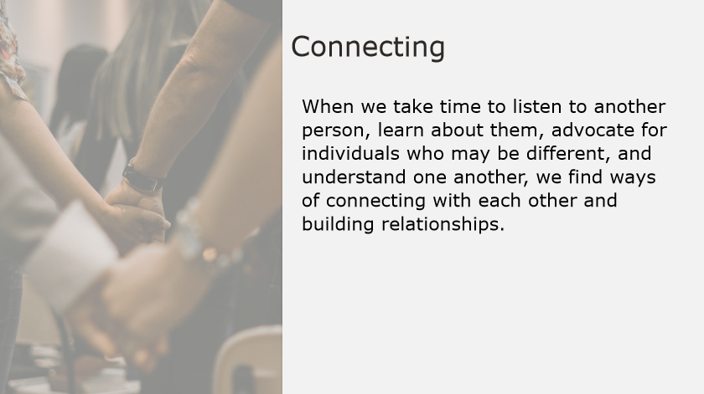
Notes:
When we take time to listen to another person, learn about them, advocate for them, and understand one another, we find ways of connecting with each other and building relationships.
Facilitator notes:
N/A

Slide 34
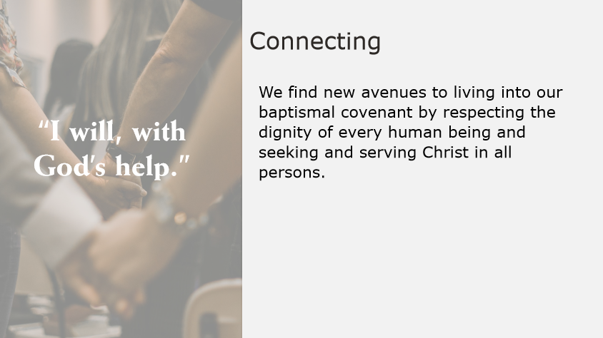
Notes:
We find new avenues to living into our Baptismal Covenant by respecting the dignity of every human being and seeking and serving Christ in all persons.
Facilitator Note:
N/A

Slide 35
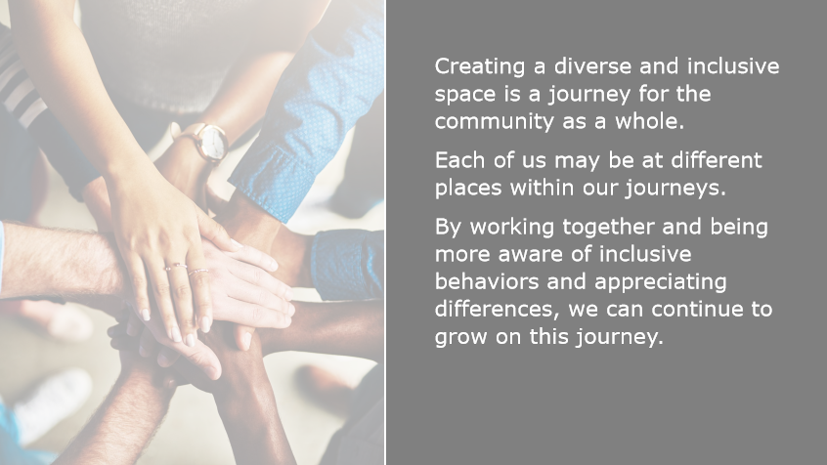
Notes:
Remember that creating a diverse and inclusive space is a journey for the community as a whole, and for those who make up the community. Each of us may be at different places within our journeys as well. By working together and being more aware of inclusive behaviors and appreciating differences, we can continue to grow on this journey.
Facilitator Note:
N/A

Slide 36

Questions and Comments
Let’s take a moment to discuss any questions or comments you may have.
Notes:
Questions and Comments
This will conclude our discussion on this Safe Church, Safe Communities course: Inclusion.
What questions or comments do you have?
Allow participants to answer the first question fully before moving onto the second question:
What have you learned about inclusion that you maybe did not know before this training?
Facilitator Note:
As you wrap up the discussion, be sure to:
Tell participants who they can reach out to if they have further questions or comments about the content covered in this training.
Conclude by thanking participants for their time and dedication.

