Slide 1



Pastoral Relationships
Notes:
Let’s discuss the Pastoral Relationships course in the Safe Church, Safe Communities series. This course is offered on Praesidium Academy.
Facilitator Note:
Introduce learners to the Safe Church, Safe Communities series if needed.

Slide 2
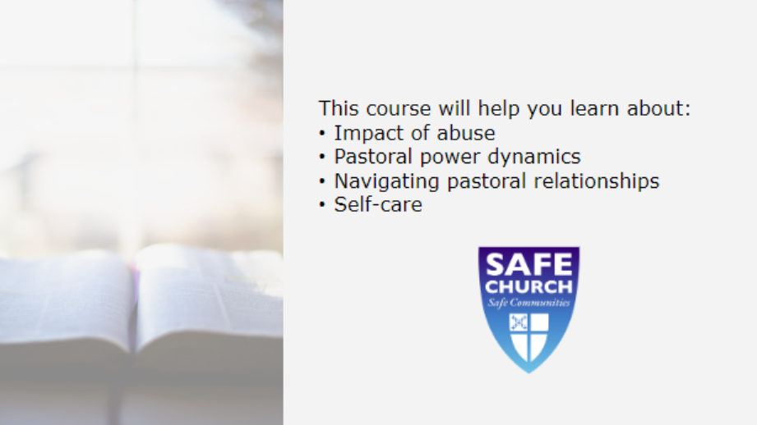
Notes:
This course explores the impact of abuse, pastoral power dynamics, navigating pastoral relationships, and keeping boundaries healthy with self-care.
Facilitator Note:
If you haven’t already done so, this is a good time to set norms surrounding the training session (location of restroom, electronic device expectations, etc).

Slide 3

Notes:
In this lesson, we’ll discuss the definition of a pastoral relationship.
Facilitator Notes:
N/A

Slide 4
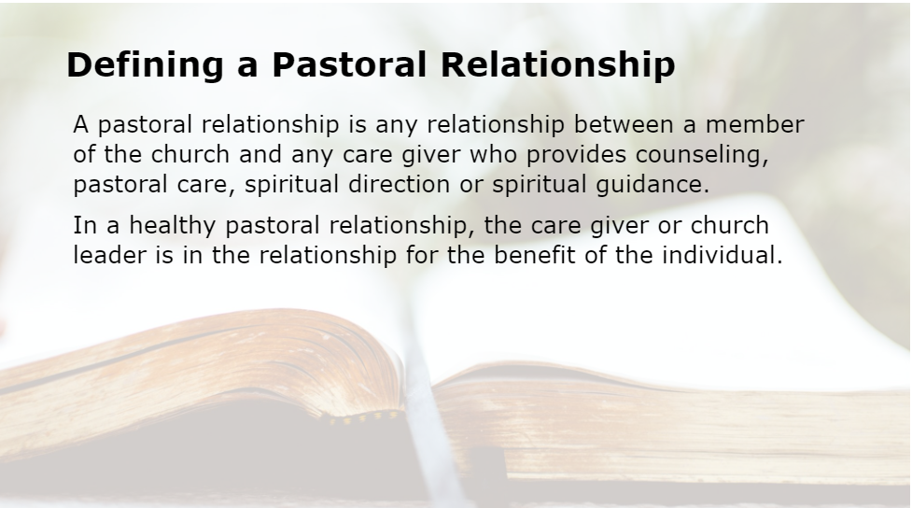
Notes:
A pastoral relationship is any relationship between a member of the church and any care giver who provides counseling, pastoral care, spiritual direction or spiritual guidance. In a healthy pastoral relationship, the care giver or church leader is in the relationship for the benefit of the individual.
Facilitator Notes:
Ask learners: “What stands out in this definition? Did anything surprise you?”
Encourage learners to vocalize their thoughts. If they are struggling to discuss, you can share your own reaction when you read the definition for the first time.

Slide 5

Notes:
Power:
Care giver refers to any church leader such as a minister, pastor, youth leader. Care giver and care provider are used synonymously with the word – church leader.
Facilitator Notes:
N/A

Slide 6
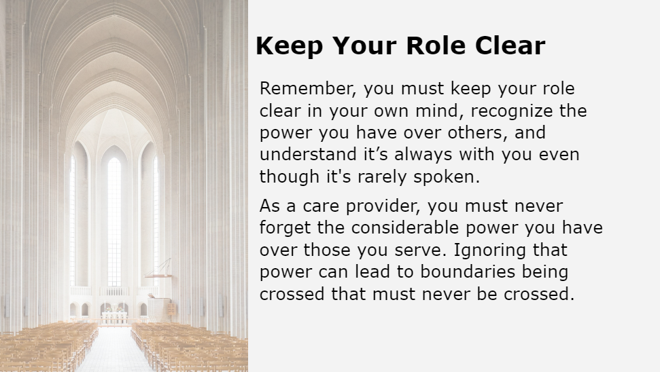
Notes:
Remember, you must keep your role clear in your own mind, recognize the power you have over others, and understand it’s always with you even though it’s rarely spoken.
As a care provider, you must never forget the considerable power you have over those you serve. Ignoring that power can lead to boundaries being crossed that must never be crossed.
Facilitator Notes:
Give learners 30 seconds to quickly pair up (or assign pairs).
Give learners five minutes to define ‘boundaries’ with their partners and prepare to share. Tip: If possible, provide a visual countdown timer so learners know how much time they have left. You can also verbally share time reminders like “2 minutes left”.
If you have a talkative group, when time is up ask who would like to share. If the group is not talkative, call on people to share.
Give feedback in an encouraging, not critical, way. There are many valid definitions for this term. One used in the other courses in the series is: “the limits set with others”.

Slide 7
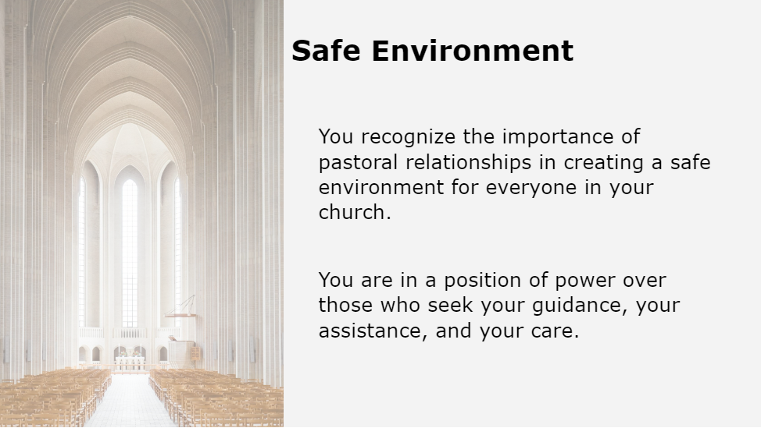
Notes:
You recognize the importance of pastoral relationships in creating a safe environment for everyone in your church. You are in a position of power over those who seek your guidance, your assistance, and your care.
Facilitator Notes:
N/A

Slide 8
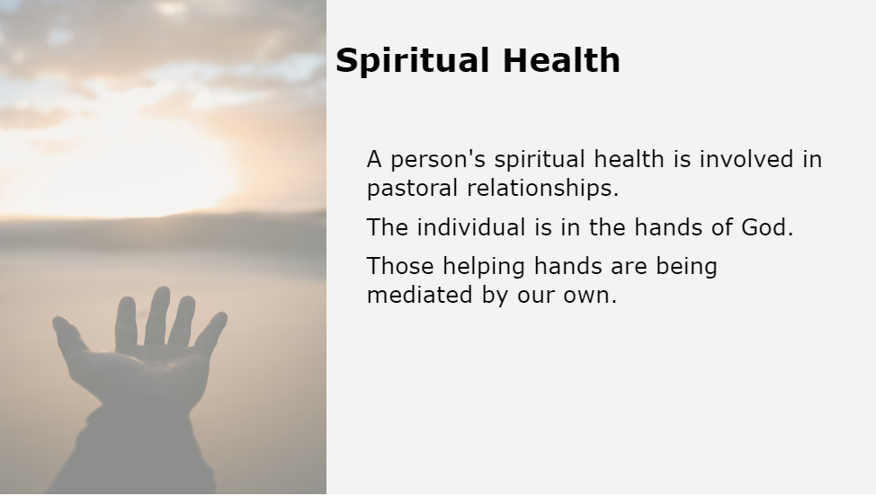
Notes:
A person's spiritual health is involved in pastoral relationships. The individual is in the hands of God. And those helping hands are being mediated by our own. We hope you come away from this course with a better understanding of your role in preventing exploitation and firm resolve to guard against situations that can foster inappropriate relationships.
Facilitator Notes:
N/A

Slide 9
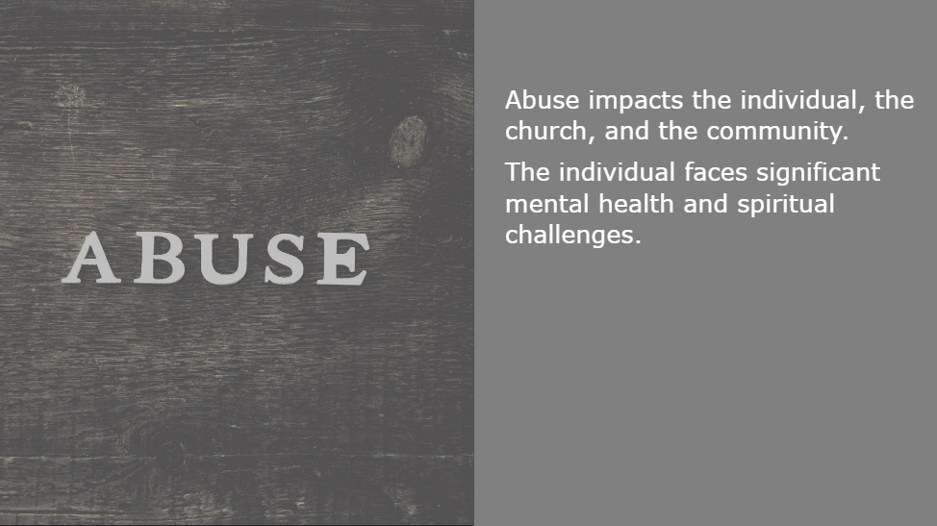
Notes:
As a reminder, abuse impacts the individual, the church, and the community. The individual faces significant mental health and spiritual challenges. The dynamic of the church is changed as others within the church lose trust and sometimes even their own faith. People can feel they have been betrayed by God. An incident of abuse puts a seed of doubt in the minds of church members. The entire community is impacted by an incident of abuse because someone who was meant to serve as an example to the community has done something inappropriate.
Facilitator Notes:
N/A

Slide 10

Notes:
In this lesson we’ll discuss power dynamics in pastoral relationships.
Facilitator Notes:
N/A

Slide 11
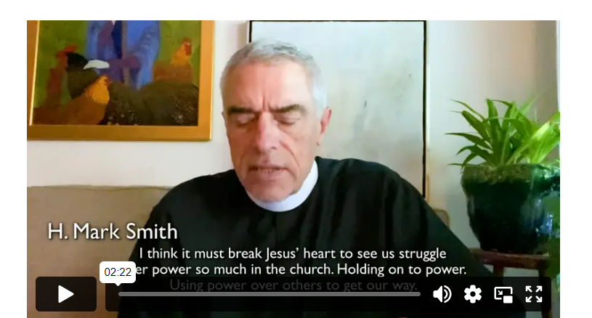
Notes:
Video:
Click the play button to play the video.
Facilitator Notes:
Direct link to video - https://vimeo.com/688940093/882ad854ac

Slide 12
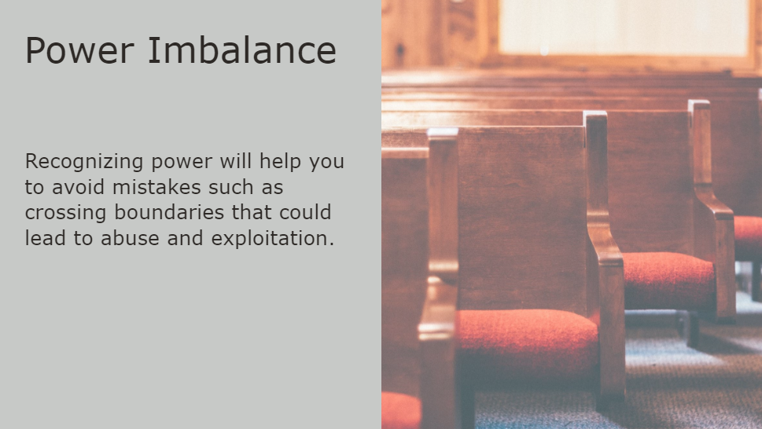
Notes:
An important contributor to boundary violations and abuse in pastoral relationships is power imbalance.
Your success as a care giver in the church depends upon recognizing power that is always present regardless of your feelings about it. Recognizing power will help you to avoid mistakes such as crossing boundaries that could lead to abuse and exploitation.
Facilitator Notes:
N/A

Slide 13
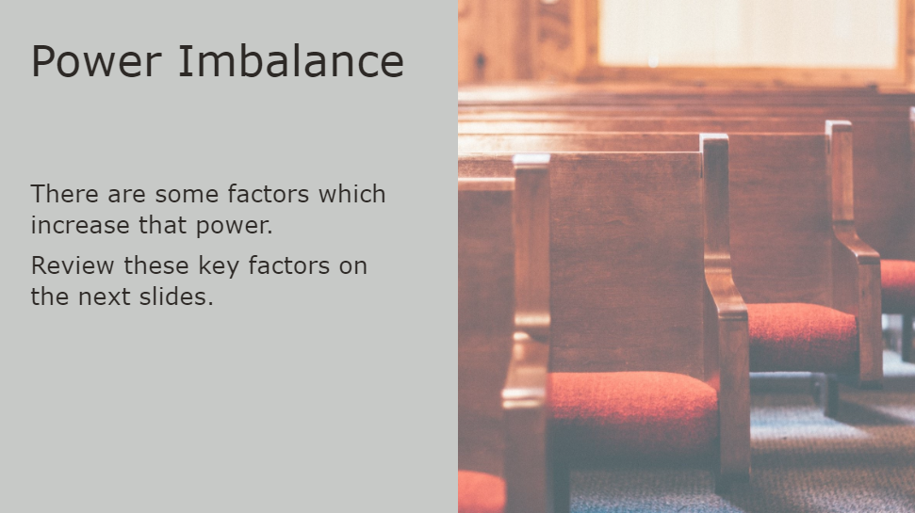
Notes:
Everyone who provides pastoral care inherently has some power because of their role, but there are some factors which increase that power. Review these key factors on the next slides as they specifically relate to pastoral power dynamics.
Facilitator Notes:
Give learners 5 minutes with their partners to answer this question:
“What factors may increase the power a care giver has over someone else?”
Have learners share their responses. Validate their reasoning and encourage others to chime in.
When the conversation is over, tell learners:
“There are many factors which can increase power, including those we just discussed. Next, we’ll review some of the most common factors.”

Slide 14
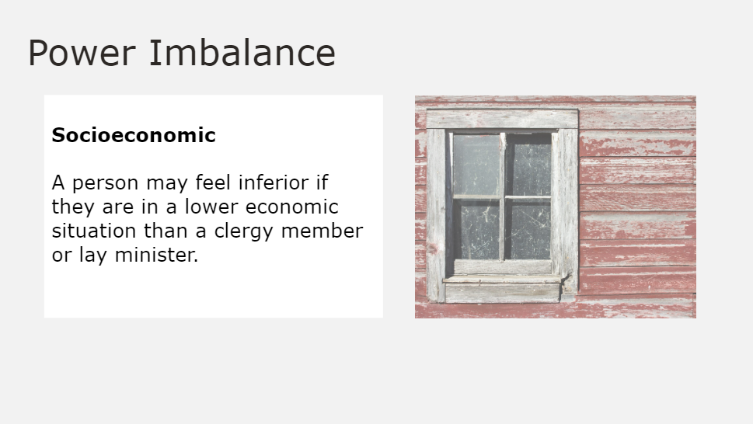
Notes:
Socioeconomic—A person may feel inferior if they are in a lower economic situation than a clergy member or lay minister.
Facilitator Notes:
N/A

Slide 15
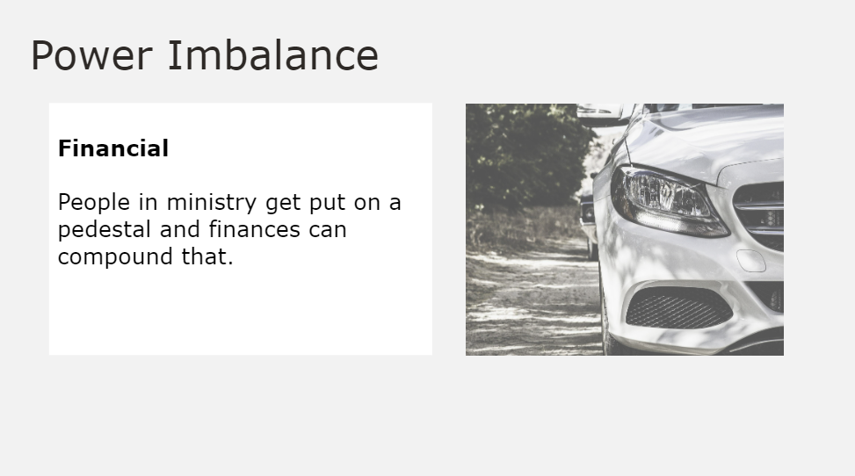
Notes:
Financial-- Similar to socioeconomic status, if a volunteer goes to work in a shelter, and the person being ministered to says “he's driving a nice car but taking time to spend with me.” People in ministry get put on a pedestal and finances can compound that.
Facilitator Notes:
N/A

Slide 16
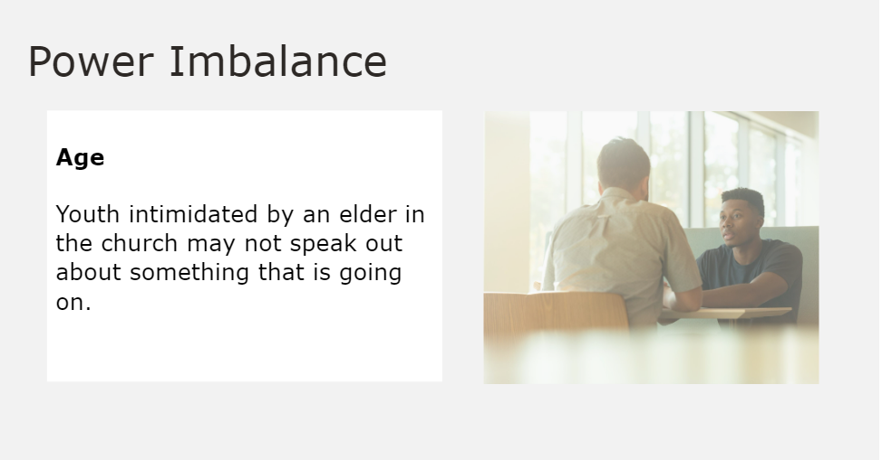
Notes:
Age—Being deferential to someone who is older is common―youth intimidated by an elder in the church may not speak out about something that is going on.
Facilitator Notes:
N/A

Slide 17
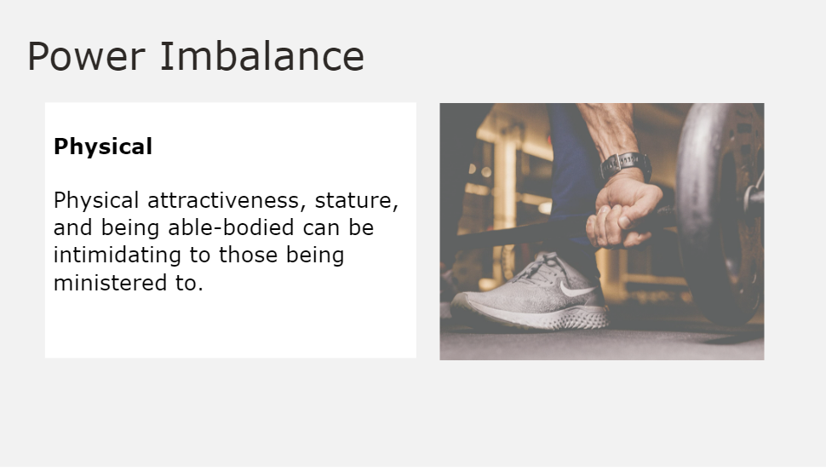
Notes:
Physical—Physical attractiveness, stature, and being able-bodied can be intimidating to those being ministered to.
Facilitator Notes:
N/A

Slide 18
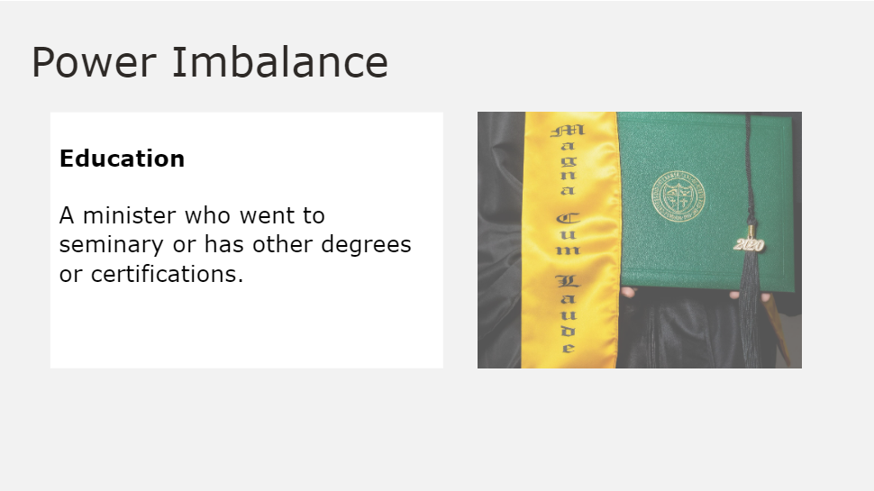
Notes:
Education—Specialized knowledge and training—as a doctor is deferred to, so too a minister who went to seminary or has other degrees or certifications. Some will defer to this expertise even when they have doubts.
Facilitator Notes:
N/A

Slide 19
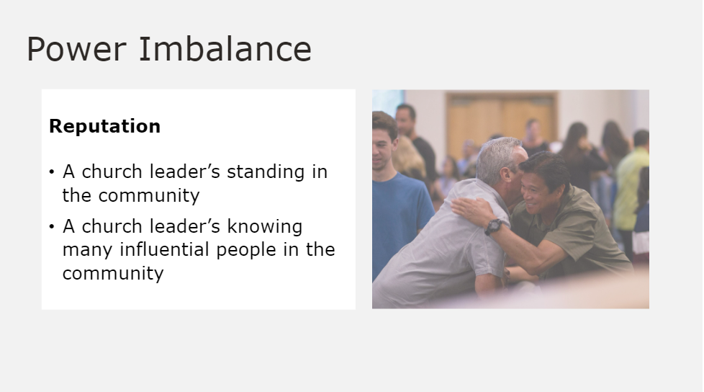
Notes:
Reputation—A church leader’s standing in the community may prohibit a parishioner from speaking out when they should. A church leader could know many influential people in the community.
Facilitator Notes:
N/A

Slide 20
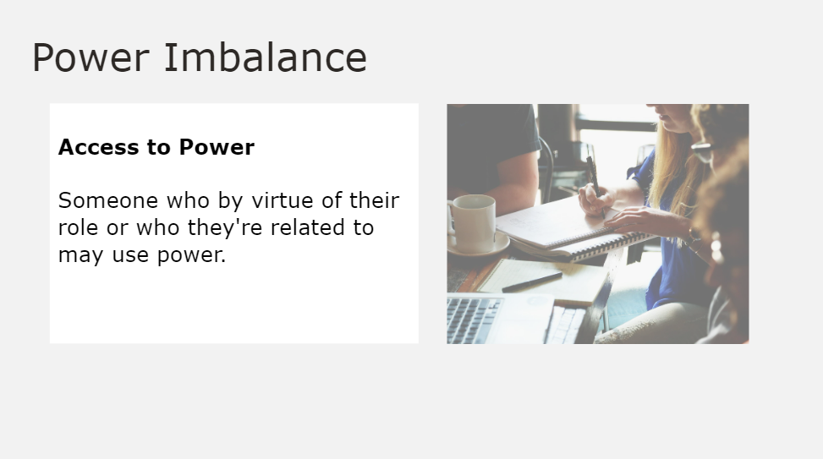
Notes:
Access to Power—Someone who by virtue of their role or who they're related to may use power over another. This is inherent to pastoral relationships.
Facilitator Notes:
N/A

Slide 21
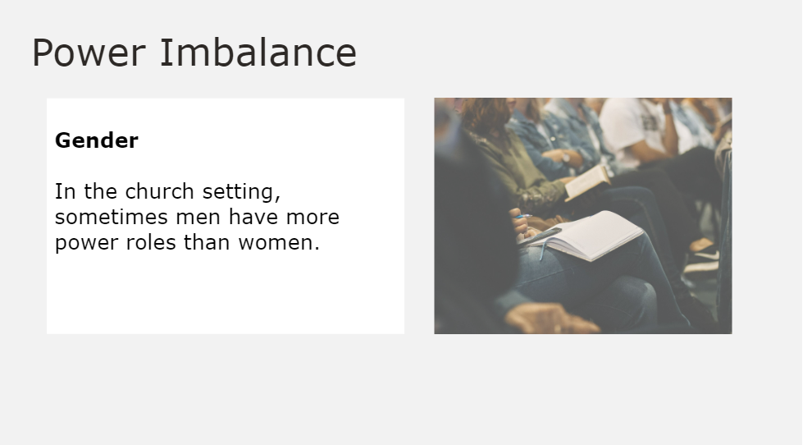
Notes:
Gender—In the church setting, sometimes men have more power roles than women. Deference to “Father” can play a part in power relations. Also transgender and gender non-binary individuals may feel disempowered by the dominant culture, and therefore experience powerlessness.
Facilitator Notes:
N/A

Slide 22
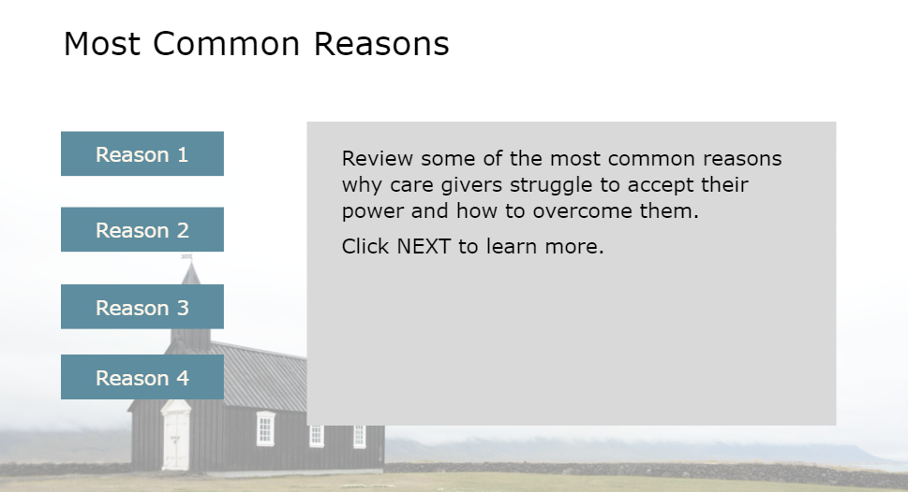
Notes:
Give learners 4 minutes to write down an answer to the question: “Is it difficult for you to accept your power as a care giver? Why or why not?”
Do not call on learners to share, as answers could be highly personal. Instead, give learners the opportunity to share. To get the conversation going you can also share your own response to the question. Encourage learners to discuss why it can be challenging to accept the power inherent to certain roles.
It’s essential for your success as a care giver in the church to accept the power inherent to your role. Next, we’ll review some of the most common reasons why care givers struggle to accept their power in the church and how to overcome them.
Facilitator Notes:
N/A

Slide 23
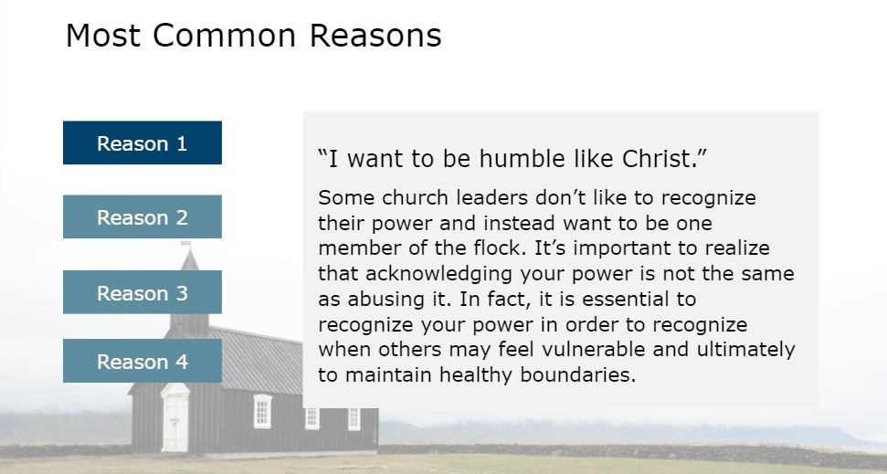
Notes:
“I want to be humble like Christ.”
Some church leaders don’t like to recognize their power and instead want to be one member of the flock. It’s important to realize that acknowledging your power is not the same as abusing it. In fact, it is essential to recognize your power in order to recognize when others may feel vulnerable and ultimately to maintain healthy boundaries.
Facilitator Notes:
N/A

Slide 24
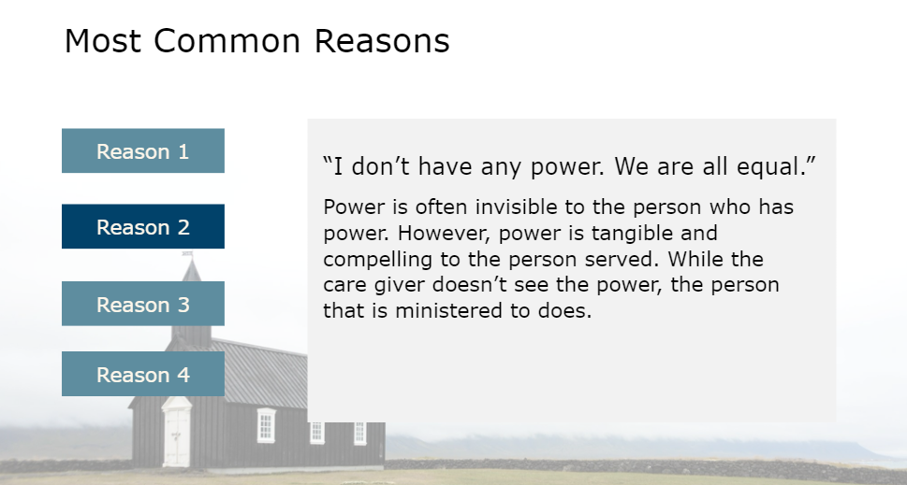
Notes:
“I don’t have any power. We are all equal.”
Power is often invisible to the person who has power. However, power is tangible and compelling to the person served. While the care giver doesn’t see the power, the person that is ministered to does.
Facilitator Notes:
N/A

Slide 25
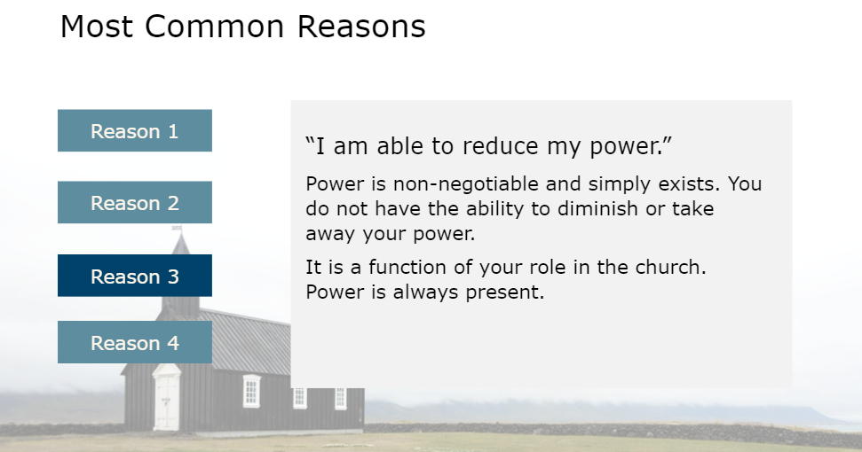
Notes:
“I am able to reduce my power.”
Power is a non-negotiable and simply exists. You do not have the ability to diminish or take away your power. It is a function of your role in the church. Power is always present.
Facilitator Notes:
N/A

Slide 26
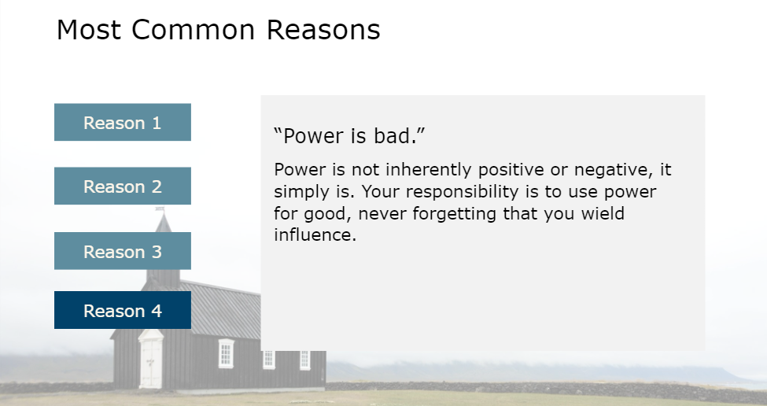
Notes:
“Power is bad.”
Power is not inherently positive or negative, it simply is. Your responsibility is to use power for good, never forgetting that you wield influence.
Facilitator Notes:
N/A

Slide 27
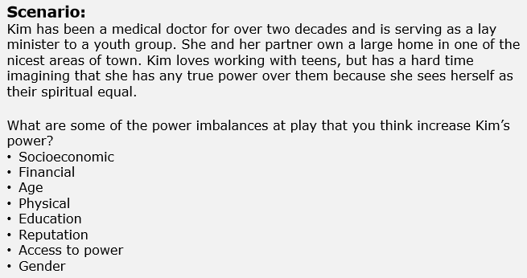
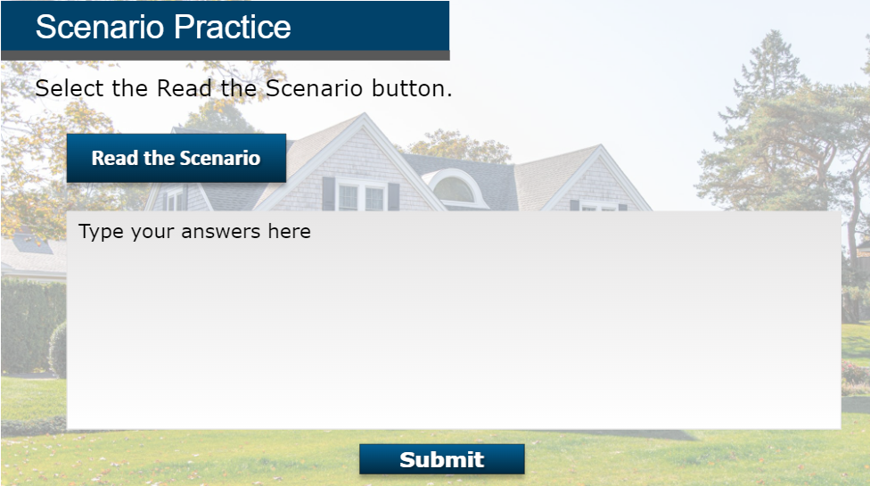
Notes:
SCENARIO
Give learners a couple of minutes to think about the scenario and write down notes (if they choose). Then, ask learners to share their thoughts. As a group, discuss the scenario and different ways one could respond.
Facilitator Notes:
N/A

Slide 28
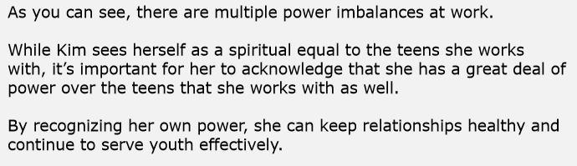
Notes:
SCENARIO FEEDBACK
Give learners a couple of minutes to think about the scenario and write down notes (if they choose). Then, ask learners to share their thoughts. As a group, discuss the scenario and different ways one could respond.
Facilitator Notes:
N/A

Slide 29

Notes:
In this lesson we’ll discuss navigating pastoral relationships.
Facilitator Notes:
N/A

Slide 30
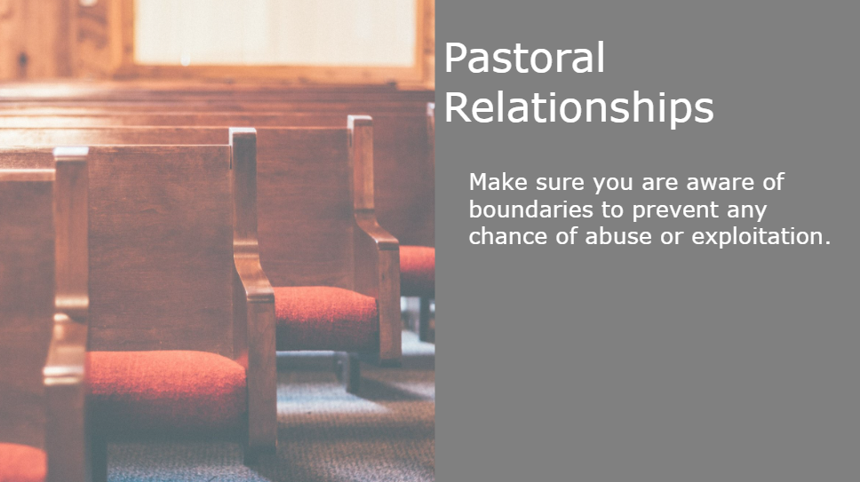
Notes:
To lead a healthy ministry, you must be on guard, always making sure you are aware of boundaries to prevent any chance of abuse or exploitation.
Facilitator Notes:
N/A

Slide 31
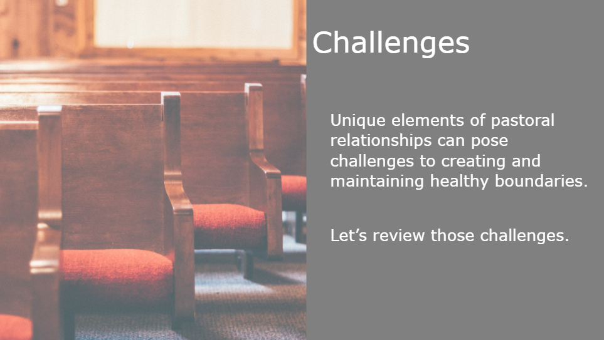
Notes:
However, unique elements of pastoral relationships can pose challenges to creating and maintaining healthy boundaries. On the next slides, let’s review those challenges. As we review the challenges, think about how it relates to your role in the church.
Facilitator Notes:
N/A

Slide 32
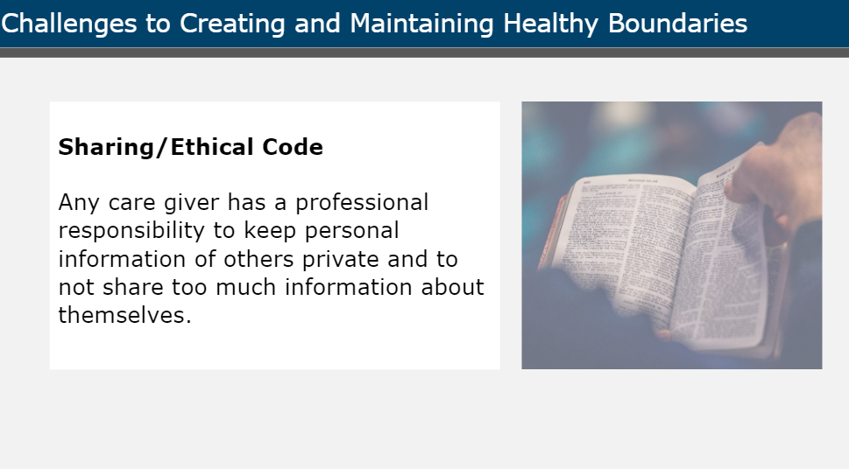
Notes:
Sharing and ethical code.
In churches, people can share a lot with their care giver. Any church leader has a professional responsibility to keep personal information of others private and to not share too much information about themselves. Just as a psychiatrist has professional ethics about the doctor-patient relationship, so too does a care giver, pastor, youth minister, or any church leader in a pastoral relationship.
Facilitator Notes:
N/A

Slide 33
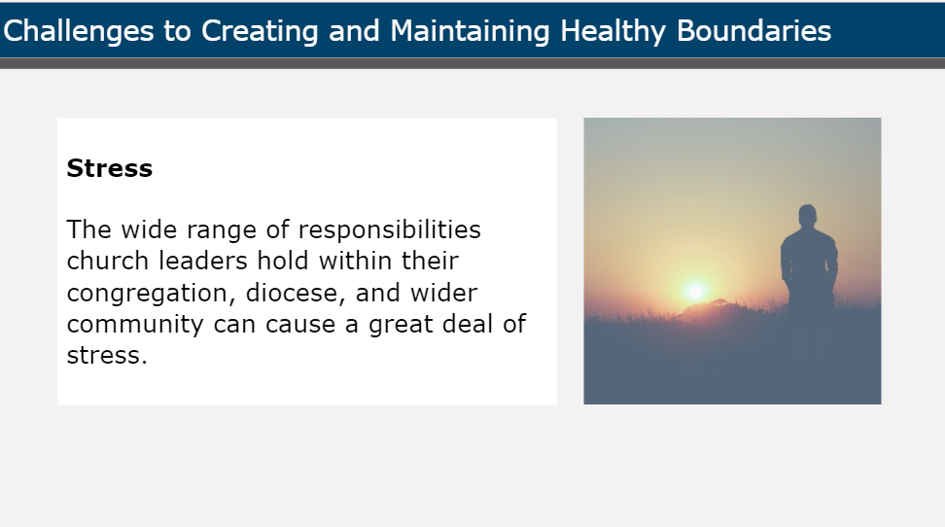
Notes:
Stress.
The wide range of responsibilities church leaders hold within their congregation, diocese, and wider community can cause a great deal of stress. Complications to the pastoral relationship may occur when the church leader’s stress starts to affect healthy boundaries with the individual.
Facilitator Notes:
N/A

Slide 34
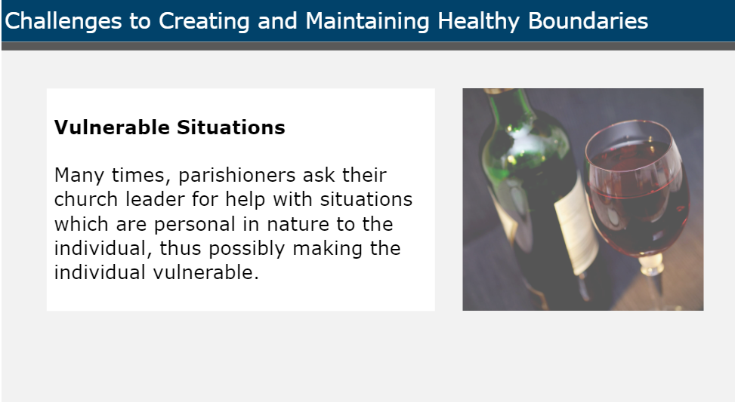
Notes:
Vulnerable Situations.
Many times, parishioners ask their church leader for help or advice with situations which are personal in nature to the individual, thus possibly making the individual vulnerable. Common issues include a spiritual crisis, an addiction, grief, marital problems, mental illness, or loneliness.
Facilitator Notes:
N/A

Slide 35
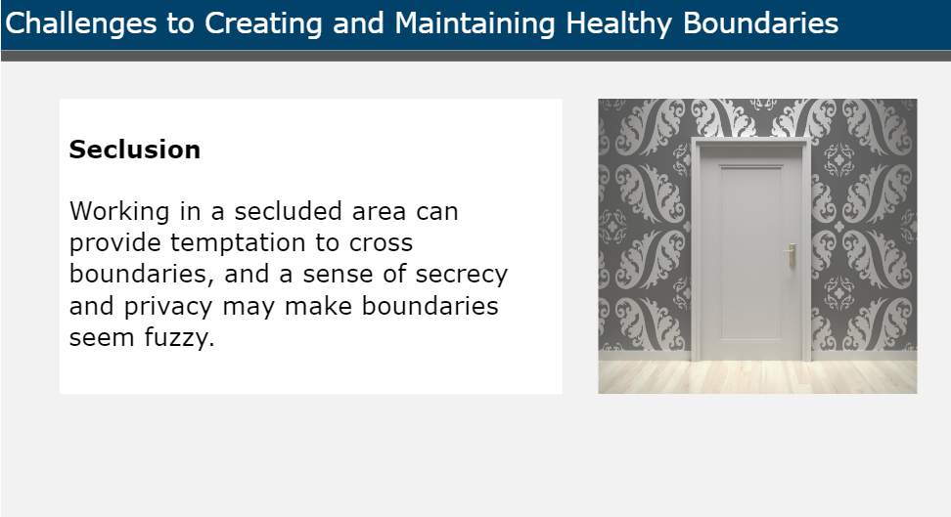
Notes:
Seclusion.
Due to the sensitive nature of many of the things discussed with care givers, one-on-one interactions often occur behind closed doors. Working in a secluded area can provide temptation to cross boundaries, and a sense of secrecy and privacy may make boundaries seem fuzzy.
Facilitator Notes:
N/A

Slide 36
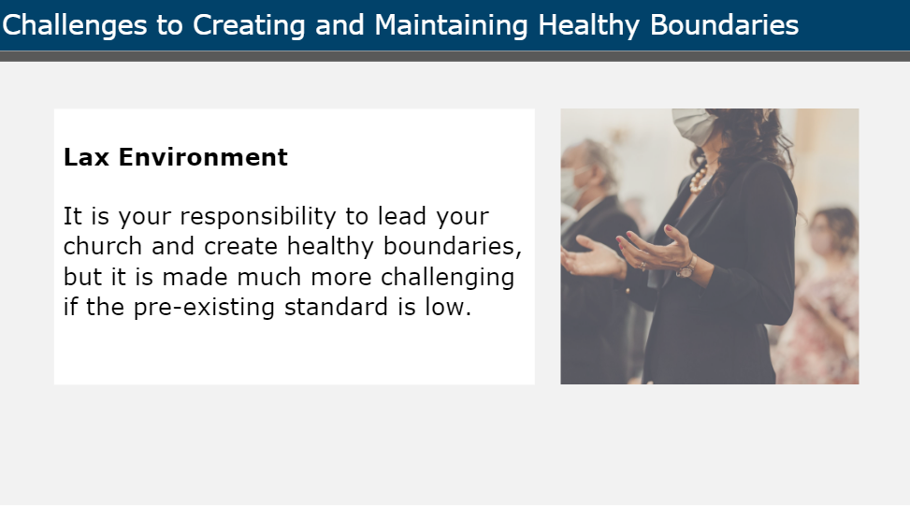
Notes:
Lax Environment.
An environment which is conducive to abuse is one in which general boundaries are unclear or lacking. As a care giver, it is your responsibility to lead your church and create healthy boundaries, but it is made much more challenging if the pre-existing standard is low. For example, there may be a high tolerance for dirty jokes or flirting, or there may not be enough checks and balances.
Facilitator Notes:
N/A

Slide 37
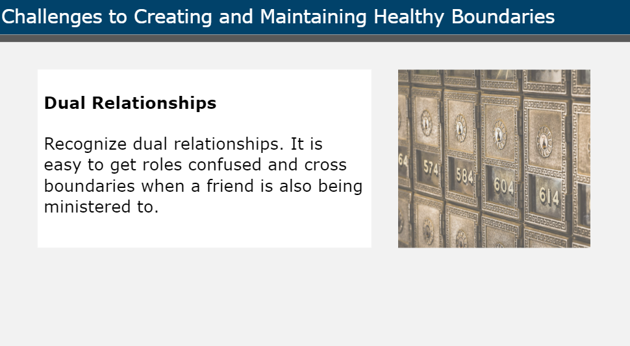
Notes:
Dual relationships.
Recognize dual relationships. People who are in a pastoral relationship may be a coworker and a counselor. You could be both neighbor and church leader. It is easy to get roles confused and cross boundaries when a friend is also being ministered to.
Facilitator Notes:
N/A

Slide 38
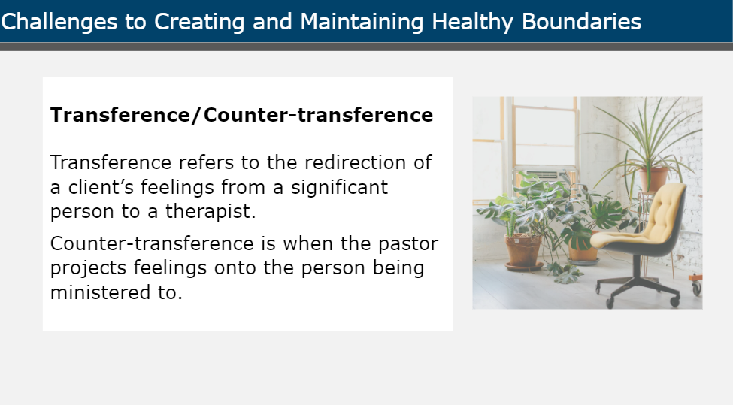
Notes:
Transference and counter-transference.
Transference refers to the redirection of a client’s feelings from a significant person to a therapist. An example is when the person receiving care projects feelings about another person on the minister—they can become very dependent on them and try to break down all boundaries to get access to them. Counter-transference is when the care giver projects feelings onto the person being ministered to. An example is when the care giver may feel flattered by all of the flirting and attention, allowing a crush to grow and spiral out of control.
Facilitator Notes:
N/A

Slide 39
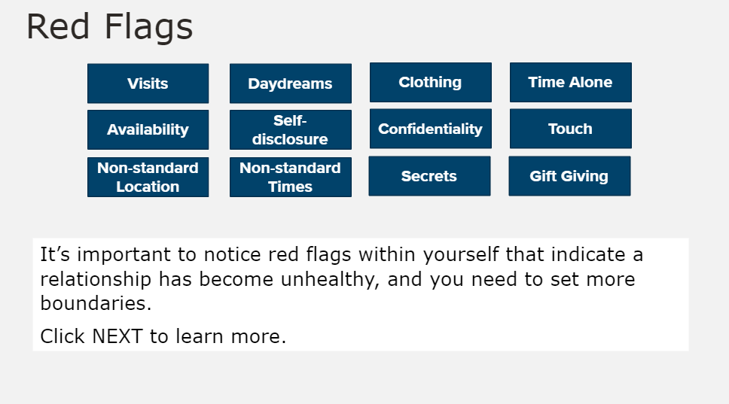
Notes:
It’s important to notice red flags within yourself that indicate a relationship has become unhealthy, and you may need to set more boundaries.
Have learners spend ten minutes with a partner to define each term and explain why each of these red flags is dangerous:
Visits
Daydreams
Clothing
Time alone
Availability
Self-disclosure
Confidentiality
Touch
Non-standard location
Non-standard times
Secrets
Gift giving
When time is up:
“Next we will review each of these red flags”
Facilitator Notes:
N/A

Slide 40
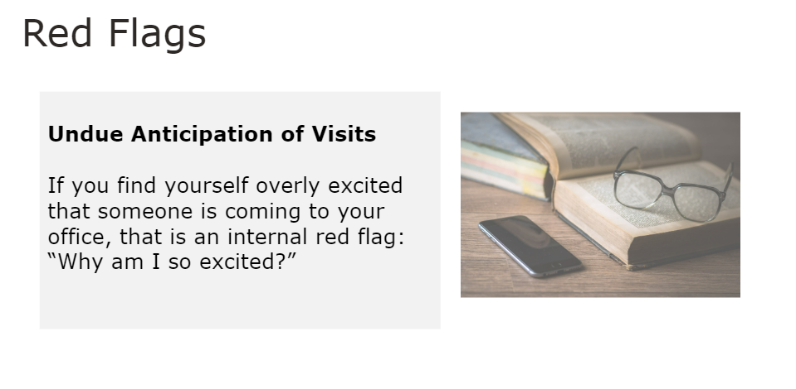
Notes:
Undue anticipation of visits.
If you find yourself overly excited that someone is coming to your office, that is an internal red flag: “Why am I so excited?”
Facilitator Notes:
Ask learners if this definition is similar to theirs. Then, ask them to share why they believe this is a red flag.
There are many good answers to this question. Be sure to keep the focus on boundaries and how relationships can become overly intimate when healthy boundaries are not in place.

Slide 41
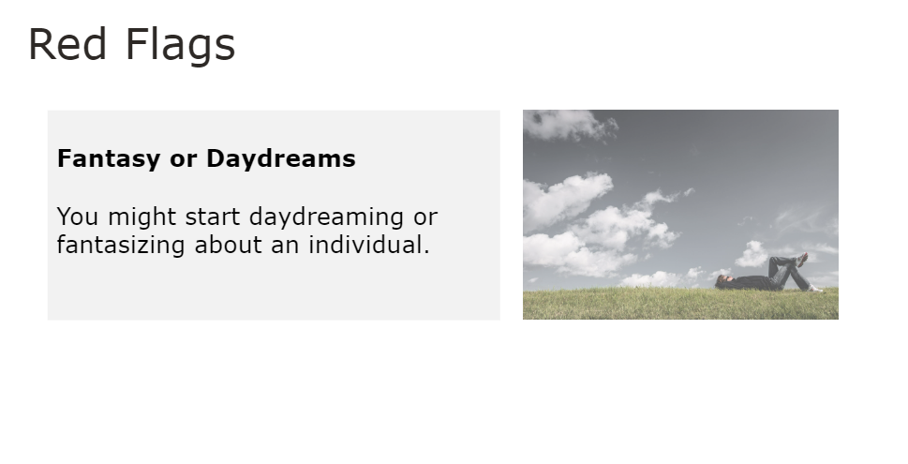
Notes:
Fantasy or daydreams.
You might start daydreaming or fantasizing about an individual.
Facilitator Notes:
Ask learners if this definition is similar to theirs. Then, ask them to share why they believe this is a red flag.
There are many good answers to this question. Be sure to keep the focus on boundaries and how relationships can become overly intimate when healthy boundaries are not in place.

Slide 42
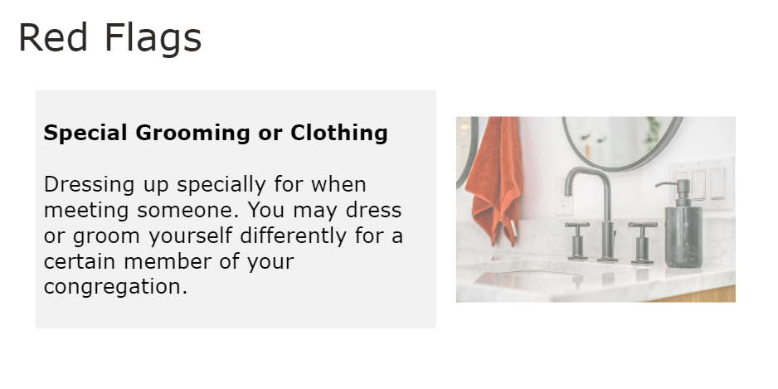
Notes:
Special grooming or clothing.
Dressing up specially for when meeting someone. You may dress or groom yourself differently for a certain member of your congregation.
Facilitator Notes:
Ask learners if this definition is similar to theirs. Then, ask them to share why they believe this is a red flag.
There are many good answers to this question. Be sure to keep the focus on boundaries and how relationships can become overly intimate when healthy boundaries are not in place.

Slide 43
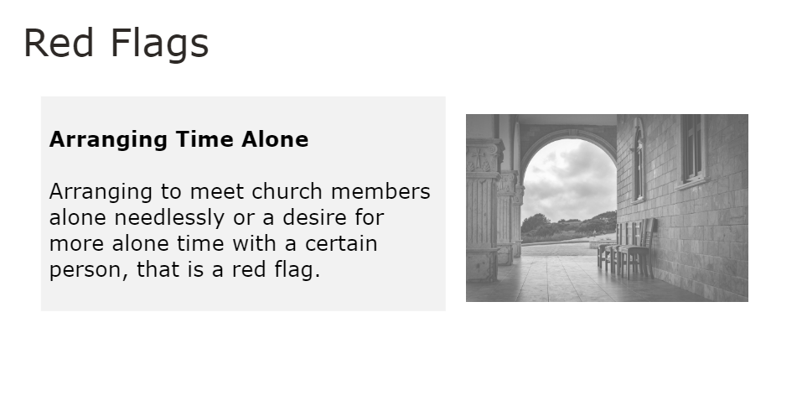
Notes:
Arranging time alone.
Arranging to meet church members alone needlessly or a desire for more alone time with a certain person. That is a red flag.
Facilitator Notes:
Ask learners if this definition is similar to theirs. Then, ask them to share why they believe this is a red flag.
There are many good answers to this question. Be sure to keep the focus on boundaries and how relationships can become overly intimate when healthy boundaries are not in place.

Slide 44
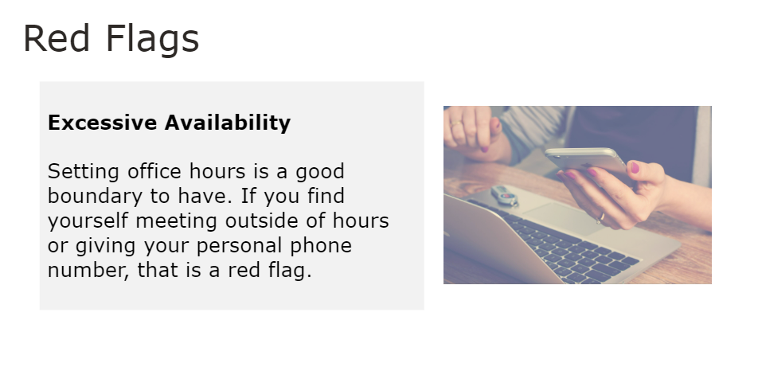
Notes:
Excessive availability.
Setting office hours is a good boundary to have. If you find yourself meeting outside of hours or giving your personal phone number, that is a red flag.
Facilitator Notes:
Ask learners if this definition is similar to theirs. Then, ask them to share why they believe this is a red flag.
There are many good answers to this question. Be sure to keep the focus on boundaries and how relationships can become overly intimate when healthy boundaries are not in place.

Slide 45
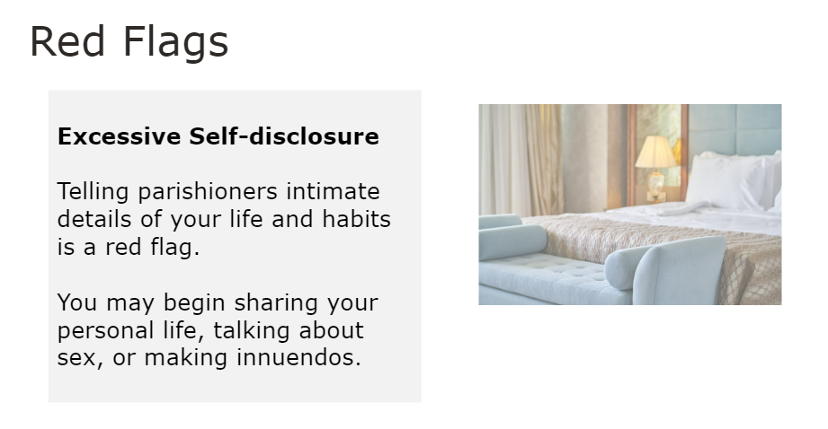
Notes:
Excessive self-disclosure.
Telling parishioners intimate details of your life and habits is a red flag. You may begin sharing your personal life, talking about sex, or making innuendos.
Facilitator Notes:
Ask learners if this definition is similar to theirs. Then, ask them to share why they believe this is a red flag.
There are many good answers to this question. Be sure to keep the focus on boundaries and how relationships can become overly intimate when healthy boundaries are not in place.

Slide 46
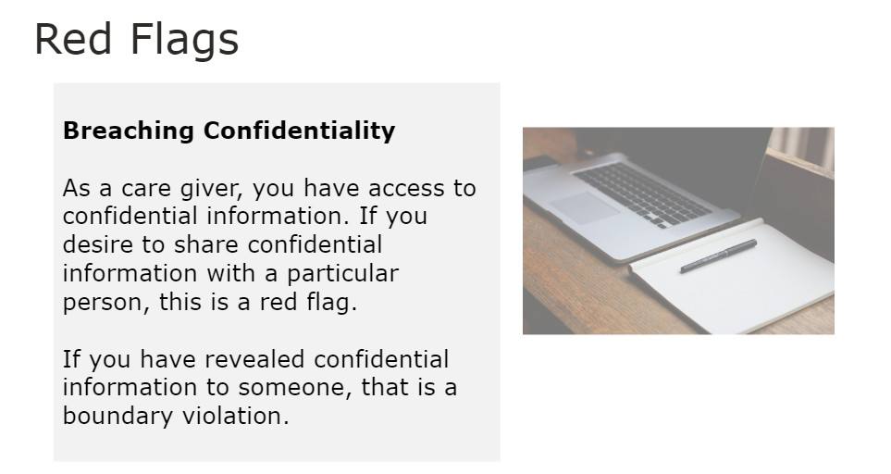
Notes:
Breaching confidentiality.
As a care giver, you have access to confidential information. If you desire to share confidential information with a particular person, this is a red flag. If you have revealed confidential information to someone, that is a boundary violation.
Facilitator Notes:
Ask learners if this definition is similar to theirs. Then, ask them to share why they believe this is a red flag.
There are many good answers to this question. Be sure to keep the focus on boundaries and how relationships can become overly intimate when healthy boundaries are not in place.

Slide 47
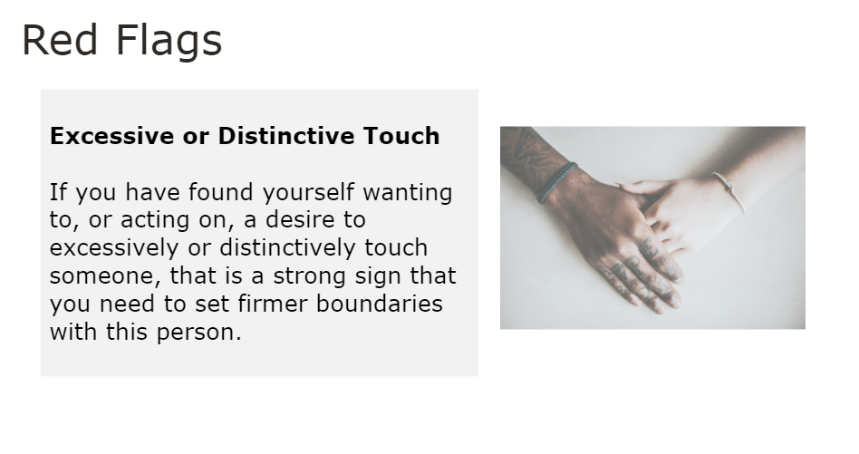
Notes:
Excessive or Distinctive Touch.
If you have found yourself wanting to, or acting on, a desire to excessively or distinctively touch someone, that is a strong sign that you need to set firmer boundaries with this person.
Facilitator Notes:
Ask learners if this definition is similar to theirs. Then, ask them to share why they believe this is a red flag.
There are many good answers to this question. Be sure to keep the focus on boundaries and how relationships can become overly intimate when healthy boundaries are not in place.

Slide 48
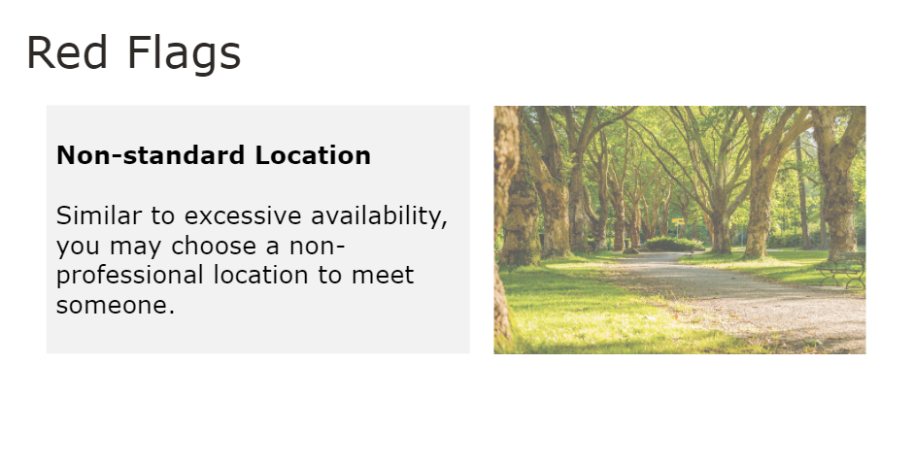
Notes:
Non-standard Location.
Similar to excessive availability, you may decide to choose a non-professional location to meet someone.
Facilitator Notes:
Ask learners if this definition is similar to theirs. Then, ask them to share why they believe this is a red flag.
There are many good answers to this question. Be sure to keep the focus on boundaries and how relationships can become overly intimate when healthy boundaries are not in place.

Slide 49
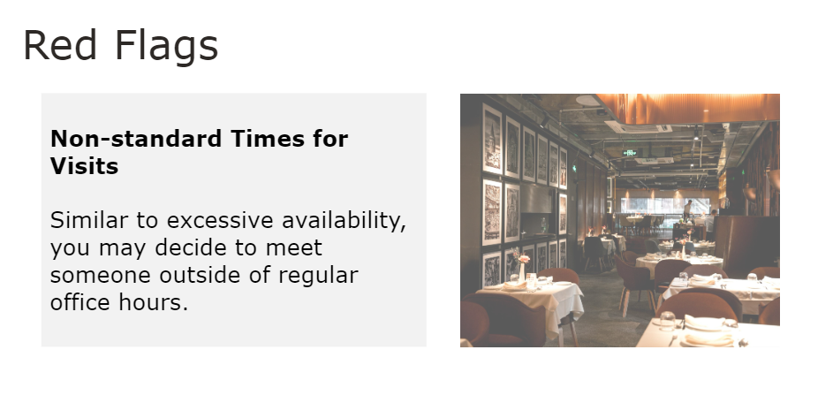
Notes:
Non-standard times for visits.
Similar to excessive availability, you may decide to meet someone outside of regular office hours.
Facilitator Notes:
Ask learners if this definition is similar to theirs. Then, ask them to share why they believe this is a red flag.
There are many good answers to this question. Be sure to keep the focus on boundaries and how relationships can become overly intimate when healthy boundaries are not in place.

Slide 50
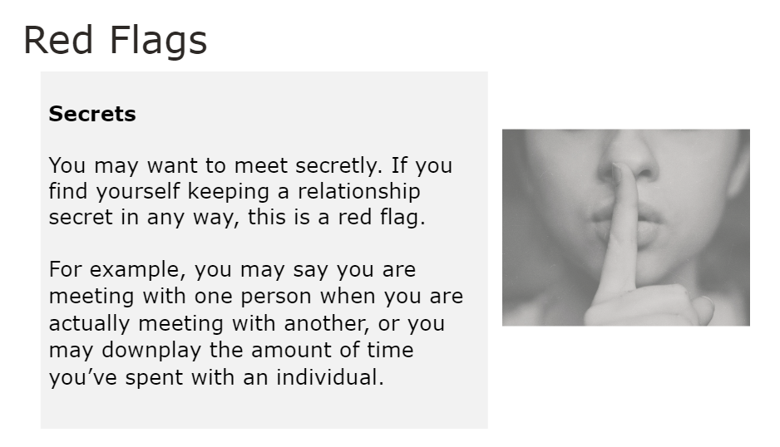
Notes:
Secrets.
You may want to meet secretly. If you find yourself keeping a relationship secret in any way, that is a red flag. For example, you may say you are meeting with one person when you are actually meeting with another, or you may downplay the amount of time you’ve spent with an individual.
Facilitator Notes:
Ask learners if this definition is similar to theirs. Then, ask them to share why they believe this is a red flag.
There are many good answers to this question. Be sure to keep the focus on boundaries and how relationships can become overly intimate when healthy boundaries are not in place.

Slide 51
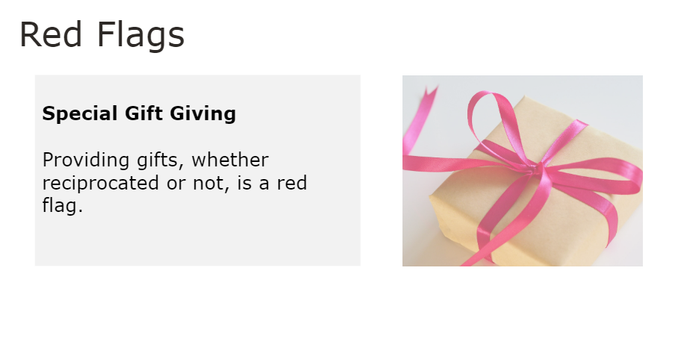
Notes:
Special gift giving.
Providing gifts, whether reciprocated or not, is a red flag.
Facilitator Notes:
Ask learners if this definition is similar to theirs. Then, ask them to share why they believe this is a red flag.
There are many good answers to this question. Be sure to keep the focus on boundaries and how relationships can become overly intimate when healthy boundaries are not in place.

Slide 52

Notes:
In this lesson we’ll discuss self-care.
Facilitator Notes:
N/A

Slide 53
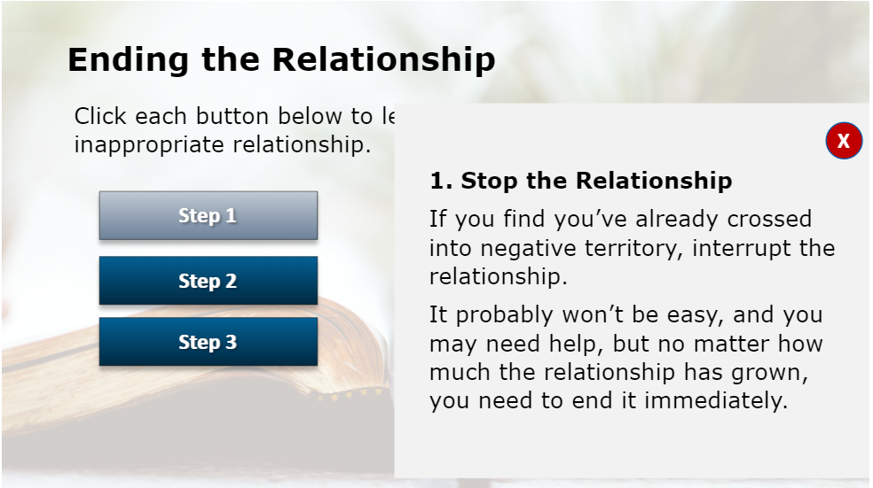
Notes:
If you find yourself in an inappropriate relationship, follow these steps to end the relationship. Remember it’s up to you to safeguard your ministry.
Step 1: Stop! End the relationship. If you find you’ve already crossed into negative territory, interrupt the relationship. It probably won’t be easy, and you may need help, but no matter how much the relationship has grown, you need to end it immediately.
Step 2: Immediately seek advice and counsel from a third party. It could be a peer, a supervisor, even a friend. Don’t depend only on yourself.
Step 3: Review the church’s policies on managing misconduct. If you find you’ve violated the policy or rules, you must seek help from colleagues or professionals. You may be obligated to discuss this with your bishop or other church leaders.
Facilitator Notes:
If available, it can be helpful to write “step 1,” “step 2,” and “step 3” on a board or large poster and have the group come up with a brief summary of each step.

Slide 54
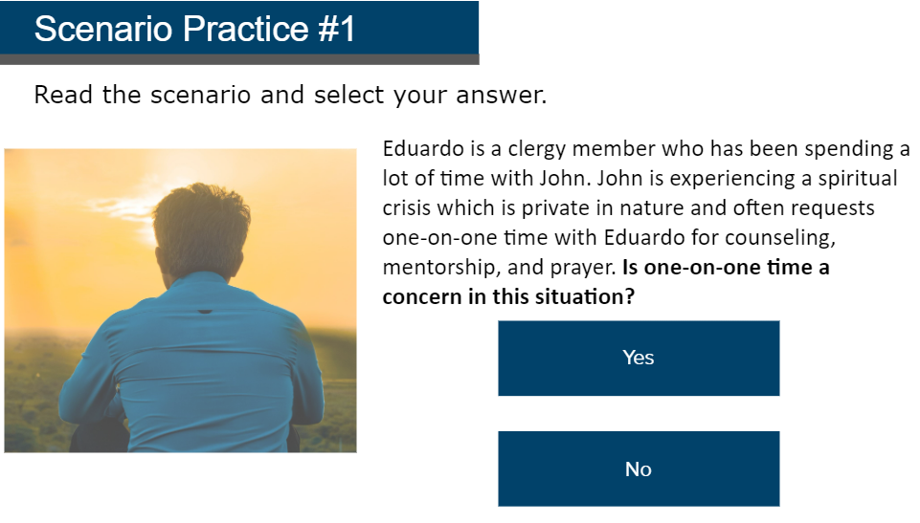
Is one-on-one time a concern in this situation?
Notes:
Next we will practice a couple scenarios. Think about if you have ever encountered a similar situation in your role and how you would respond.
Eduardo is a clergy member who has been spending a lot of time with John. John is experiencing a spiritual crisis which is private in nature and often requests one-on-one time with Eduardo for counseling, mentorship, and prayer. Is one-on-one time a concern in this situation?
Emphasize the question, then ask for a show of hands. Who thinks one-on-one time is a concern in this situation?
Facilitator Notes:
N/A

Slide 55
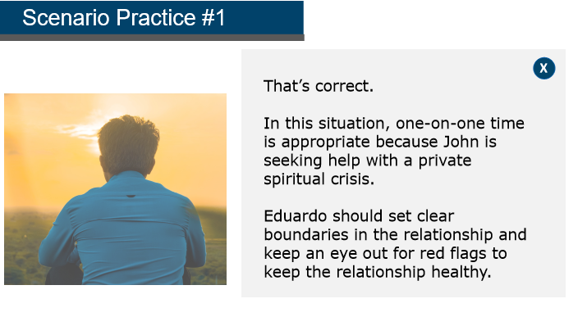
Notes:
The correct answer is no, one-on-one time is not a concern in this situation.
In this situation, one-on-one time is appropriate because John is seeking help with a private spiritual crisis. Eduardo should set clear boundaries in the relationship and keep an eye out for red flags to keep the relationship healthy.
Facilitator Notes:
N/A

Slide 56

Is this a red flag?
Notes:
During one of Eduardo and John’s meetings, Eduardo finds himself feeling closer with John. During one meeting, Eduardo pats John on the back—something Eduardo normally only does with family members. Is this a red flag?
Emphasize the question, then ask for a show of hands. Who thinks this is a red flag?
Facilitator Notes:
N/A

Slide 57

Notes:
The correct answer is yes, this is a red flag.
Although patting someone on the back can be appropriate, in this case Eduardo normally does not engage in this type of physical touch with a church member. This is a sign that boundaries may becoming blurred, and the relationship may become unhealthy.
Facilitator Notes:
N/A

Slide 58

Notes:
Now let’s talk about some ideas for self-care.
One way to keep boundaries healthy is to identify resources to meet your own spiritual and emotional needs. Develop a routine or habits that will allow you to refuel. Remember you cannot get your own spiritual and emotional needs met in an environment in which you are the leader. Make it a priority to seek out opportunities to “refuel” if you are to continue serving others.
Ask the group: “What are some ways that you refuel?”. If possible, write answers on a board or large poster.
Facilitator Notes:
Common responses generally fall into these categories:
Sports or recreation
Retreats
Sabbath
Therapy or
Spiritual direction

Slide 59

Notes:
Identify sources of support and feedback to ensure you’re not alone as a care giver in the church.
An important preventative strategy is to form and maintain support systems to help you stay healthy. Be informed and understand your boundaries and have the tools to be safe.
Facilitator Notes:
If you have a personal example to share of someone you go to for support, this is a great opportunity to share. Depending on time, you can ask learners to share as well.

Slide 60

Notes:
Accountability will keep you from unintentionally crossing boundaries. A network of your peers can help. It can be comprised of any peers who are willing to do this for each other.
Facilitator Notes:
N/A

Slide 61

Notes:
Giving and accepting feedback from others is critical in your position. Many individuals who have been involved in misconduct have been described as refusing to accept feedback from others. Sometimes it is more difficult to see high-risk behaviors in ourselves than in others.
Facilitator Notes:
N/A

Slide 62

Notes:
Remember your physical health. Overwork, undernourishment, isolation, lack of sleep - these may contribute to chemical changes in the brain that impair judgment and increase suggestibility.
They can lead to:
Poor decisions
“Out of character” actions or
Impairment
Facilitator Notes:
N/A

Slide 63

Notes:
We need to do everything we can do to keep ourselves healthy. It is vital to maintain a balanced life so that we can establish and maintain healthy boundaries. Ultimately, this enables us to perform the sacred task of assisting others to find the balance in their spiritual lives.
Facilitator Notes:
N/A

Slide 64

Questions and Comments
Let’s take a moment to discuss any questions or comments you may have.
Notes:
Questions and Comments
This will conclude our discussion on this Safe Church, Safe Communities course: Pastoral Relationships.
What questions or comments do you have?
Allow participants to answer the first question fully before moving onto the second question:
What have you learned about pastoral relationships that you maybe did not know before this training?
Facilitator Note:
As you wrap up the discussion, be sure to:
Tell participants who they can reach out to if they have further questions or comments about the content covered in this training.
Conclude by thanking participants for their time and dedication.

