Slide 1



Abuse & Neglect
Notes:
Let’s discuss The Abuse & Neglect course in the Safe Church, Safe Communities series. This course is offered on Praesidium Academy.
Facilitator Note:
Introduce learners to the Safe Church, Safe Communities series if needed.

Slide 2
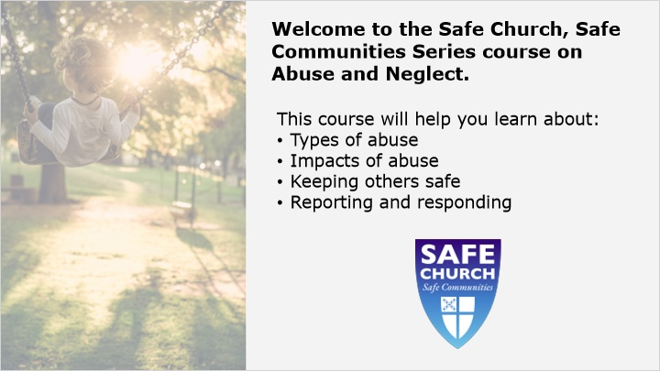
Notes:
Welcome to the Safe Church, Safe Communities Series course on Abuse and Neglect. Abuse and neglect are serious public health problems that can have a long-term impact on a person's health, opportunity, and well-being. The course will help you learn about the types of abuse and their impact, how to keep others safe, and how to take action by responding to and reporting abuse.
Facilitator Note:
Welcome to the Safe Church, Safe Communities Series course on Abuse and Neglect. Abuse and neglect are serious public health problems that can have a long-term impact on a person's health, opportunity, and well-being. The course will help you learn about the types of abuse and their impact, how to keep others safe, and how to take action by responding to and reporting abuse.

Slide 3
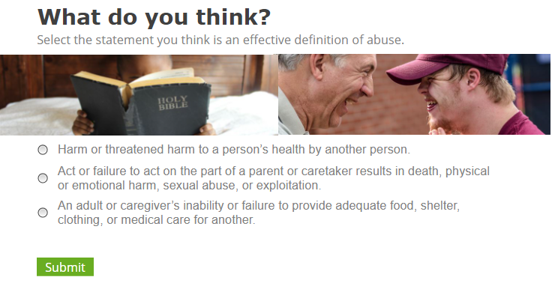
Notes:
Abuse can happen between an adult and a child or between peers (youth-to-youth). Abuse can also occur among adults, for example when one adult is in a power position and abuses their power over the other adult or between an adult and a vulnerable adult.
Facilitator Notes: Ask the following questions:
How familiar are you with the definition of abuse? How is it different from neglect?
Read the statements below and ask the class which statement is an effective definition of abuse.

Slide 4
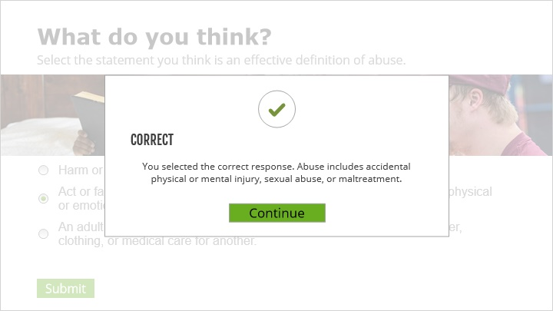
Notes:
The correct answer is the second option - “Act or failure to act on the part of a parent or caretaker results in death, physical or emotional harm, sexual abuse, or exploitation.”
Facilitator Notes:
Give the correct answer (Option 2) and discuss with the group.

Slide 5
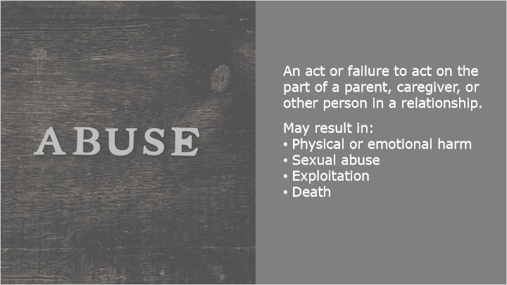
Notes:
There is no one size fits all abuse definition, however, the CDC describes abuse as an intentional act or failure to act by a parent, caregiver, or other person in a relationship. This can result in: serious physical or emotional harm, sexual abuse, exploitation, or even death.
It is important to recognize types of abuse and neglect and to be aware that abuse profoundly affects how a person may think, act, or feel, which we will focus on in the next lesson.
Facilitator Note:
Ask learners what their definition of abuse is? Is it close to what the CDC describes?

Slide 6

Notes:
Lesson 2: Types & Impacts of Abuse
Recognizing abuse starts with understanding the common types of abuse and neglect, short term and long-term effects of the abuse, and identifying possible signs of abuse.
Let’s review some common types of abuse.
Facilitator Note:
Ask learners to think of types of abuse they may already be aware of.

Slide 7
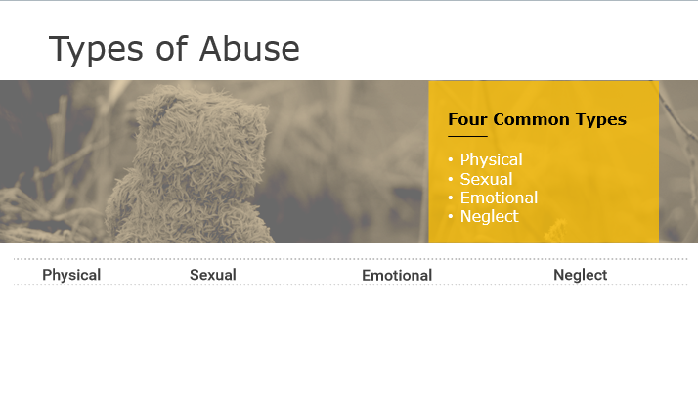
Notes:
Types of Abuse:
Let’s review four common types of abuse. They include:
Physical abuse
Sexual abuse
Emotional abuse
Neglect.
Physical Abuse: Physical abuse is the intentional use of force that can result in harm or injury.
Sexual Abuse: Sexual abuse is the engaging in sexual contact with a person who is below a specified age or who is incapable of giving consent because of age or mental or physical incapacity.
Emotional Abuse: Emotional abuse is behaviors that harm a person’s emotional well-being.
Neglect: Neglect is the failure to meet a person's basic survival needs including nutrition, clothing, shelter, hygiene, and medical care.
Facilitator Notes:
Ask the class to think of an example of each type. Give them 5 minutes to write down a few examples.
Go to the next slide to show examples listed. Then discuss with the group.

Slide 8
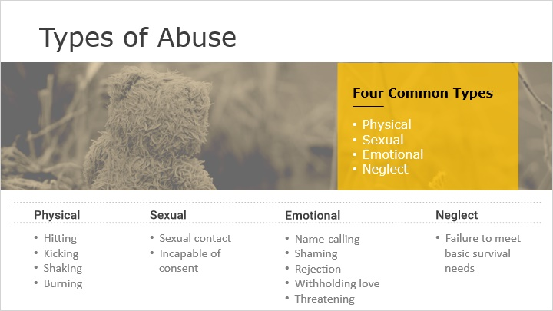
Notes:
Types of Abuse - Examples:
What are some examples you wrote down?
Now let’s go over examples of each common type of abuse.
Physical Abuse: Examples include hitting, kicking, shaking, burning, or other shows of force against a child or vulnerable adult.
Sexual Abuse: Examples are sexual contact, incapable of consent.
Emotional Abuse: Examples are name-calling, shaming, rejection, withholding love, and threatening.
Neglect: Failure to meet basic survival needs.
Facilitator Note:
Ask the group to share a few of their examples. Then share examples of abuse listed on the slide above.

Slide 9
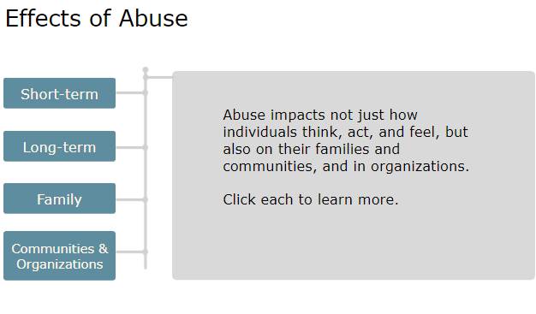
Notes:
Effects of Abuse
Regardless of the type of abuse, it sets off a ripple effect, leaving an impact on how the abused individual thinks, acts, and feels, on their families, and within the communities and organizations where abuse takes place.
Facilitator Note:
Review the effects of abuse on the next slides.

Slide 10
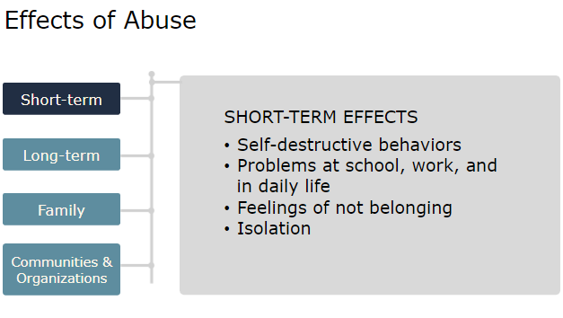
Notes:
Effects of Abuse – Short-Term Effects
Individuals who have been abused may experience many types of short terms effects.
They may be more likely to engage in self-destructive behaviors, or have problems at school, work, or in daily life.
Often, they may feel they don’t belong, have low self-esteem, feel angry and worthless, or isolated and different from family and friends.
Facilitator Notes:
Ask the group to think of other short-term effects? Acting out in anger? Shortness with others?

Slide 11
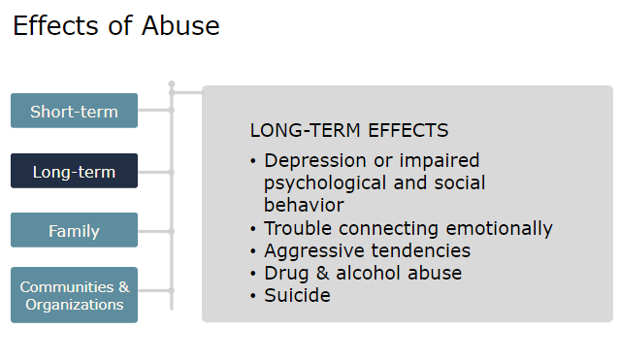
Notes:
Effects of Abuse – Long Effects
Individuals who were abused as children or youth may suffer many years later as adults. They may suffer from serious depression, may have impaired psychological and social behavior, and have difficulty forming relationships.
They also are at higher risk of:
Have trouble connecting emotionally with others
Be aggressive
Develop eating disorders
Abuse drugs and alcohol or Attempt suicide

Slide 12
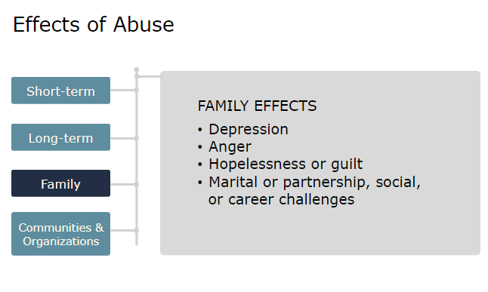
Notes:
Effects of Abuse – Family Effects
Family members of abused individuals may also experience depression, anger, feelings of helplessness or guilt. The effects may create marital/partnership, social and career challenges.

Slide 13
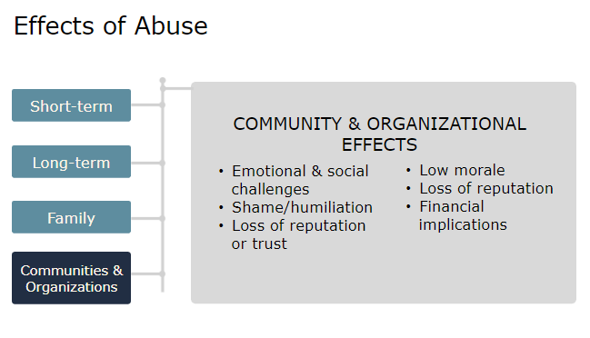
Notes:
Effects of Abuse – Community & Organizational Effects
When abuse happens within a community or organization, many others often feel the impacts. Community members, employees and volunteers may also face an array of emotional and social challenges like depression/anxiety, anger, shame, humiliation, loss of reputation or trust. Organizations often experience low morale, loss of reputation, and possible financial implications.

Slide 14
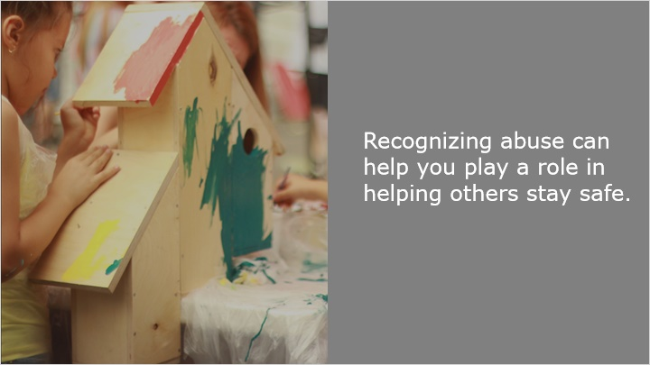
Notes:
Knowing the types and effects of abuse will better help you recognize abuse. In the next lesson, we’ll review how you play a role in helping others stay safe.

Slide 15
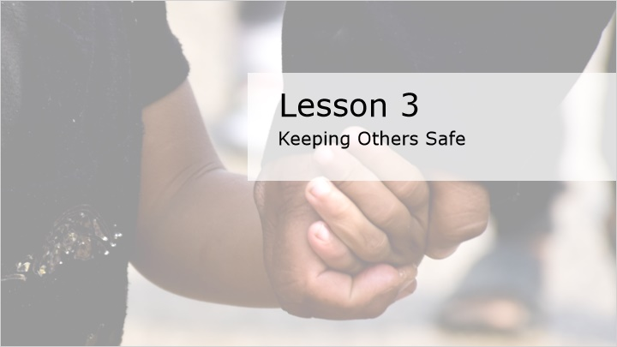
Notes:
Lesson 3: Keeping Others Safe
As members of this community, it’s important to look out for one another and be on the alert for certain things such as someone who may be experiencing abuse or someone who may potentially harm another in high-risk locations and situations.

Slide 16
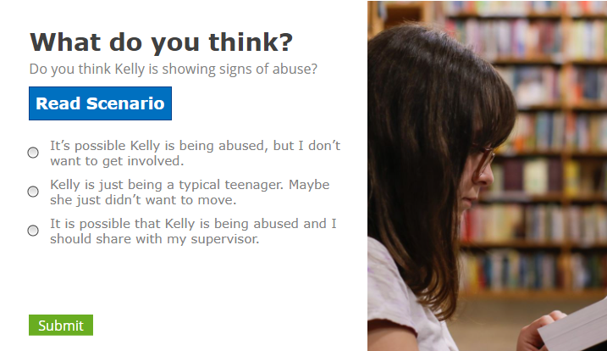
Notes:
What do you think?
Knowing the signs of abuse can aid in identifying and stopping abuse. Some of these signs can also be an indication of inappropriate behaviors that may progress to abuse.
Let’s read the scenario.
Kelly is 15 years old and a new member of the church. She is nice, but she seems hesitant to participate in youth activities. As the youth minister, you have asked her a few times if she isn’t feeling well because you recognize she is withdrawn and does not like to make eye contact with others. At church service on Sunday, you see Kelly bump into another church goer and she winces in pain. The remainder of the church service she sits in the back church pew and holds her wrist in discomfort.
Do you think Kelly is showing signs of abuse? Let’s view our options. What’s the best choice?
It’s possible Kelly is being abused, but I don’t want to get involved.
Kelly is just being a typical teenager. Maybe she just didn’t want to move.
It is possible that Kelly is being abused and I should share with my supervisor.
Facilitator notes:
Read the scenario. Ask the class if they think Kelly is showing signs of abuse?
Discuss each statement. Click the next slide to discuss the answer.

Slide 17
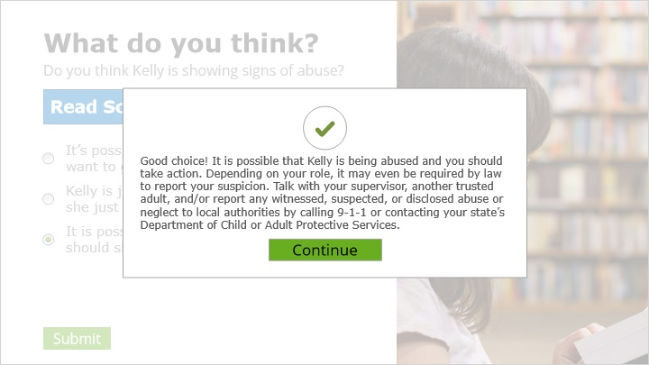
Notes:
Option 3 is correct. It is possible that Kelly is being abused and you should take action. Depending on your role, it may even be required by law to report your suspicion. Talk with your supervisor, another trusted adult, and/or report any witnessed, suspected, or disclosed abuse or neglect to local authorities by calling 9-1-1 or contacting your state’s Department of Child or Adult Protective Services.
Facilitator Note:
The correct answer is option 3. “It is possible that Kelly is being abused and I should share with my supervisor.”

Slide 18
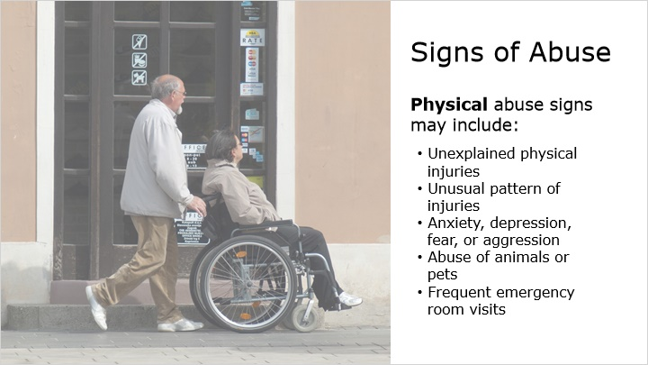
Notes:
Individuals will often show signs of being abused. Knowing these signs will make you more aware.
Signs of possible physical abuse may include some of the following.
When a person has unexplained physical injuries like cuts, bruises, broken bones, black eyes, burns, etc. Or when they have an unusual pattern of injuries.
When a person seems anxious, depressed, withdrawn, scared, or aggressive.
If someone is harming animals or pets
Or if you know of an individual making frequent trips to the emergency room for injuries.

Slide 19
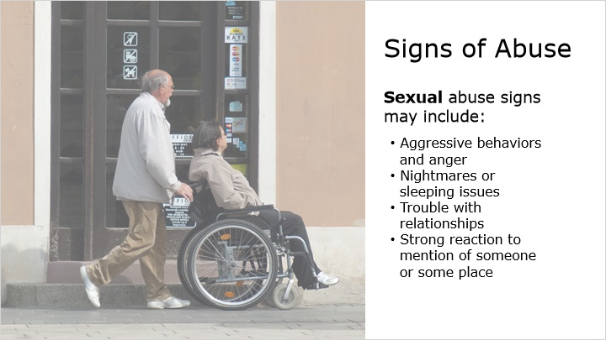
Notes:
Signs of possible sexual abuse may include some of the following.
When a person shows aggressive behavior or is angry for no obvious reason.
When a person has nightmares or problems with sleeping.
If a person has trouble developing or maintaining relationships.
Or if a person become upset or reacts negatively when a person or place is mentioned.

Slide 20
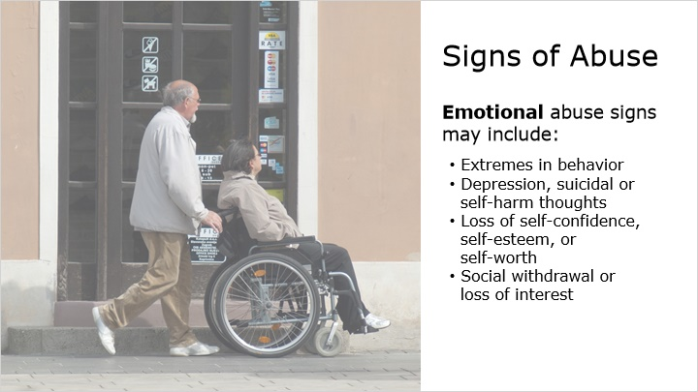
Notes:
Signs of possible emotional abuse may include some of the following.
If a person shows extremes in behavior, such as being overly compliant or demanding, extremely passive, or aggressive.
When a person shows signs of depression, has suicidal thoughts, or harms oneself.
If a person has a loss of self-confidence, self-esteem, or self-worth.
Or if a person becomes socially withdrawn or has a loss of interest or enthusiasm in activities they once enjoyed.

Slide 21
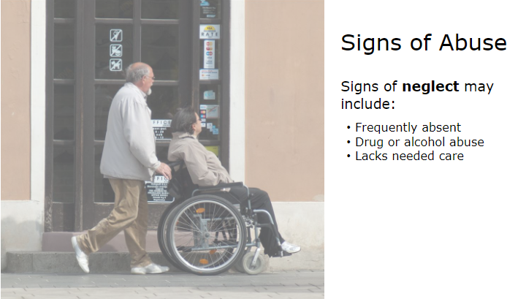
Notes:
Signs of possible neglect may include some of the following.
If a person is frequently absent from school or work.
When a person abuses alcohol or drugs.
Or if it is evident or disclosed that a person doesn’t receive needed care. For example, if an injury or illness occurs and they don’t get care recommended by a healthcare professional.

Slide 22
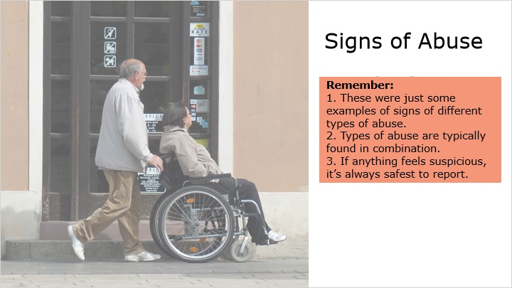
Notes:
Remember, these are just some of the examples of signs of abuse and it is important to understand that types of abuse are more typically found in combination than alone. If anything feels off or suspicious, it’s always safest to talk to someone and report your suspicions.
Facilitator Note:
Pause and ask the group if they have any questions or comments to share.

Slide 23
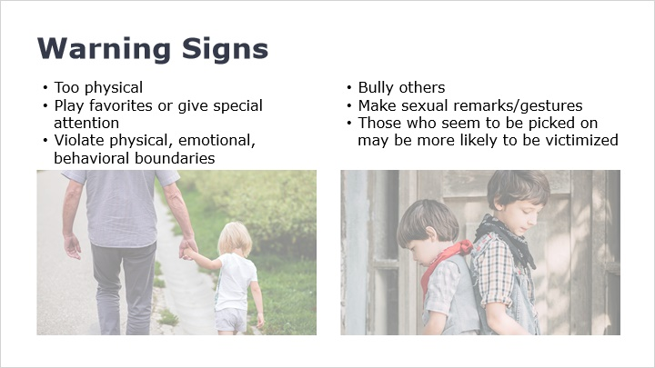
Notes:
It’s important to watch all adults at your organization - not just employees and volunteers, as everyone has something in common: access to children and vulnerable adults. This is also true among peers. Here are some possible warning signs that someone may be abusive.
Individuals who are too physical with youth and vulnerable adults. Those who play favorites or give special attention or gifts to certain individuals. Those who violate physical, emotional, or behavioral boundaries.
Or individuals who bully others or make sexual remarks and gestures. Also, pay close attention to those who are picked on. They may be more likely to be victimized.

Slide 24
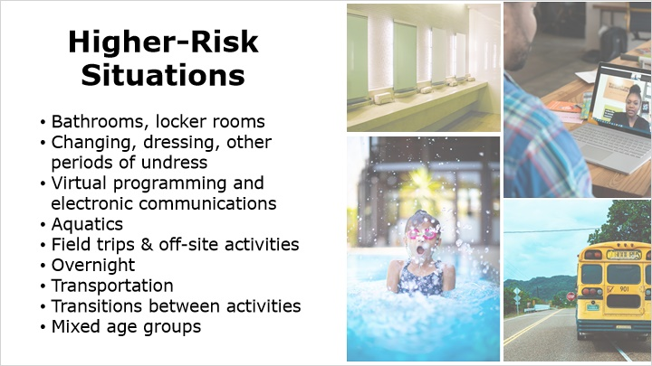
Notes:
High risk areas or situations include bathrooms, private rooms or locked doors, virtual programming and electronic communications, field trips and overnight events, aquatics, mixed age groups, and high ratio of children to adults where proper supervision isn’t provided.
Ensuring proper supervision and monitoring of youth and vulnerable adults, especially in these higher-risk situations can discourage inappropriate activity from occurring. Check your policies for supervision and monitoring guidelines.

Slide 25
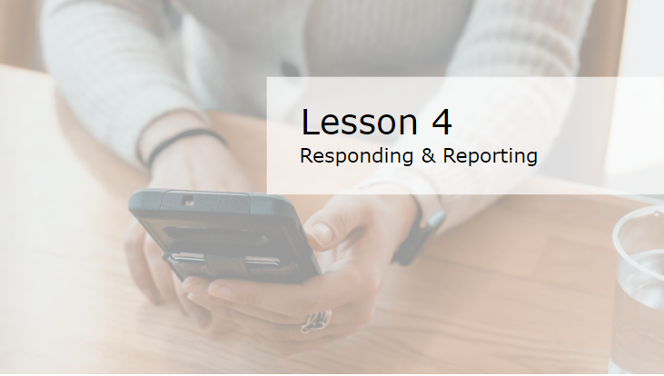
Notes:
Lesson 4: Responding & Reporting
If you suspect or witness abuse or boundary violations, or if something is disclosed to you, your response may vary based on your role, but it’s important to take action.

Slide 26
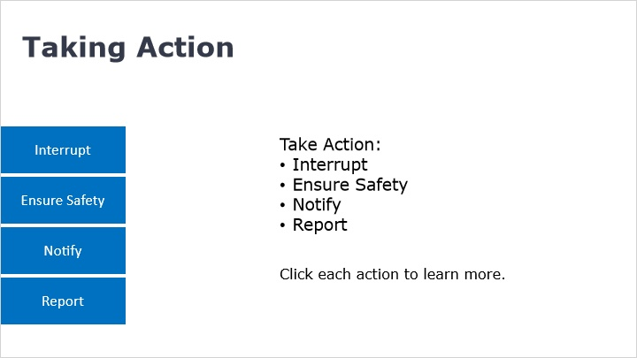
Notes:
How do you take action?
Taking Action includes following these steps:
Interrupt
Ensure Safety
Notify
Report
Let’s discuss each action now.
Facilitator Note:
Before each action is reviewed, ask learners to write down the four steps in Taking Action.

Slide 27
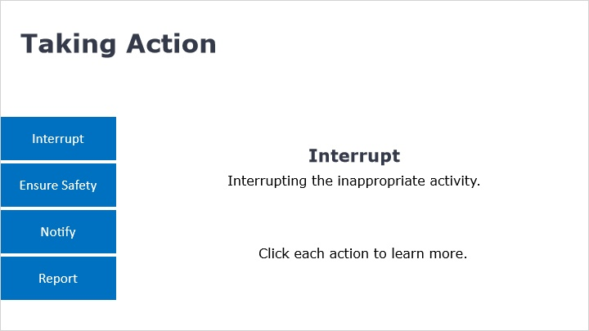
Notes:
Interrupt the inappropriate activity.
Interrupting may be as simple as calling someone over that looked like they were in an uncomfortable situation, to calling out an adult employee or volunteer who escorts a youth into a bathroom alone. Sometimes you may hear about a violation and though you may not be able to interrupt at that point, you can still ensure safety of the person who is reporting the information to you.

Slide 28
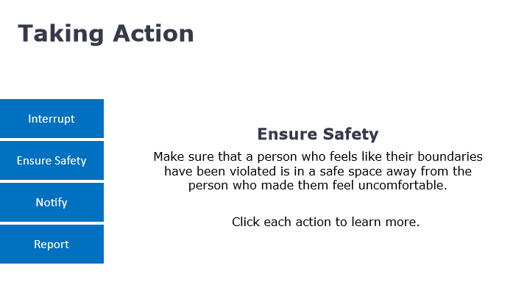
Notes:
Ensure Safety.
Make sure that a person who feels their boundaries have been violated is in a safe space away from the person who made them feel uncomfortable. For example, after interrupting in the situation where an adult was escorting a youth into the bathroom, stay with the child until you are able to locate their guardian.

Slide 29
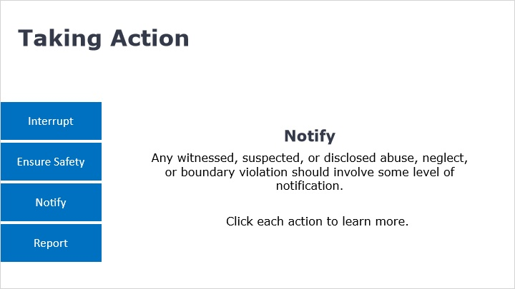
Notes:
Notify.
Any witnessed, suspected, or disclosed abuse, neglect, or incident of a boundary violation or bullying, should involve some level of notification. Even if you are unsure that what you saw, heard, or suspected is a true violation or abuse, notifying someone in charge or the authorities will help to discern and make it possible to monitor suspicious behaviors or potentially link someone to repeat incidents.

Slide 30
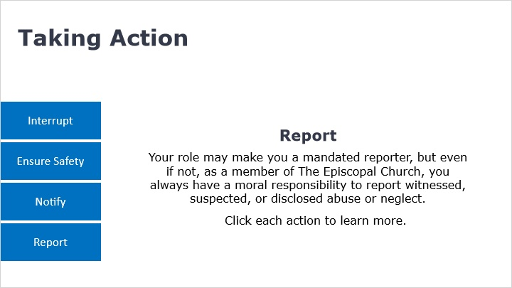
Notes:
Report.
Though your role may not mandate reporting, as a member of The Episcopal Church, you always have a moral responsibility to report witnesses, suspected, or disclosed abuse or neglect to local authorities by calling 9-1-1 or by contacting your state’s Department of Child or Adult Protective Services. Depending on your role, you may also have a legal responsibility to report this information to authorities.

Slide 31
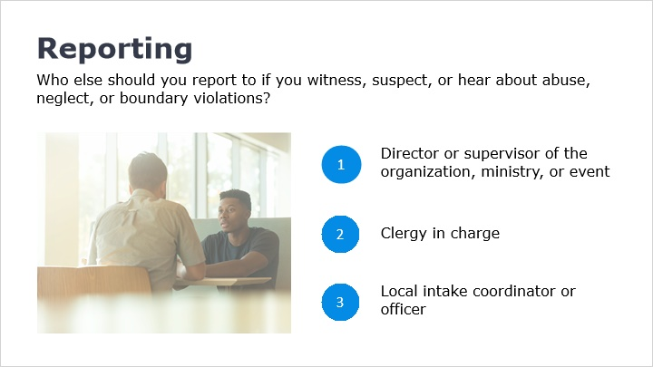
Notes:
Reporting
If an incident has taken place within a facility or ministry in your diocese, congregation, or other organization, you should also immediately inform one of the following:
1. The director or supervisor of the organization, ministry, or event
2. Clergy in charge
3. Or your local intake coordinator or officer.
If ever in doubt, you can access local resources such as your congregational or diocesan policies or The Episcopal Church website.

Slide 32
Questions and Comments
Let’s take a moment to discuss any questions or comments you may have.
Notes:
This will conclude our discussion on the Abuse & Neglect.
Does anyone have any questions?
What have you learned about abuse and neglect that you maybe did not know before this training?
Facilitator Note:
Ask learners what they have learned from this discussion.
Thank them for participating in the training.

