Slide 1
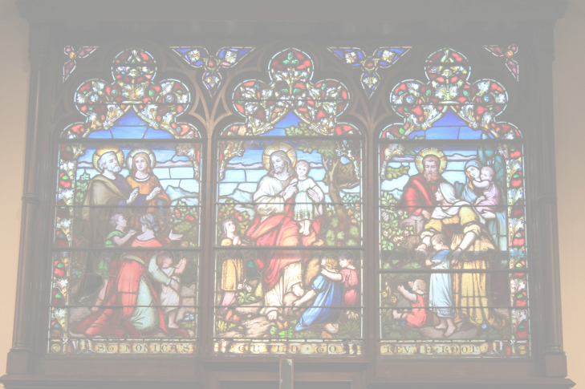


Power & Relationships
Notes:
Let’s discuss the Power and Relationships course in the Safe Church, Safe Communities series. This course is offered on Praesidium Academy.
Facilitator Note:
Introduce learners to the Safe Church, Safe Communities series if needed.

Slide 2
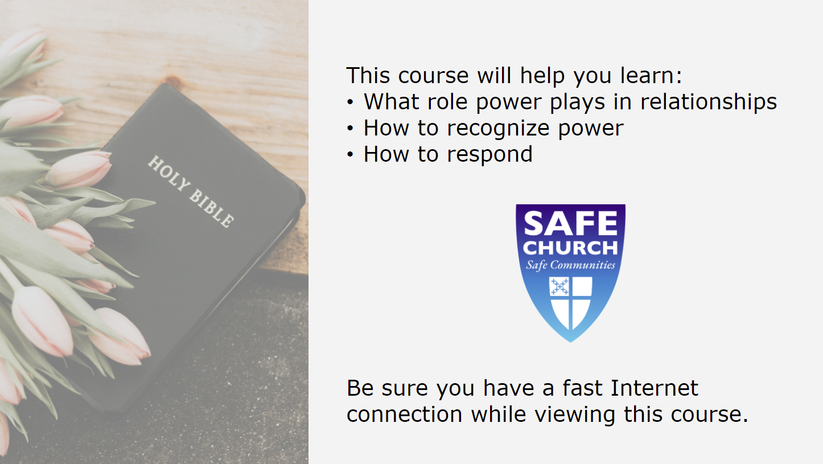
Notes:
This course explores how power plays a role in relationships, and how to recognize and respond if someone is expressing their power in an unhealthy manner.
Facilitator Note:
If you haven’t already done so, this is a good time to set norms surrounding the training session (location of restroom, electronic device expectations, etc).

Slide 3
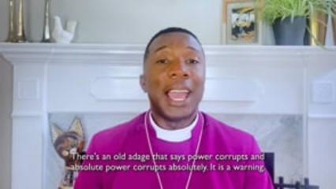
Introduction Video
Notes:
Video:
Click the play button to play the video.
Facilitator Notes:
Before viewing the video, ask: “When you are in a position of power, how does that make you feel?”
Guide the discussion towards an understanding that being in a position of power can be uncomfortable, and many people think of power as a bad thing.
Direct link to video - https://player.vimeo.com/video/689247219?h=1687a2fd7c&amp;badge=0&amp;autopause=0&amp;player_id=0&amp;app_id=58479

Slide 4
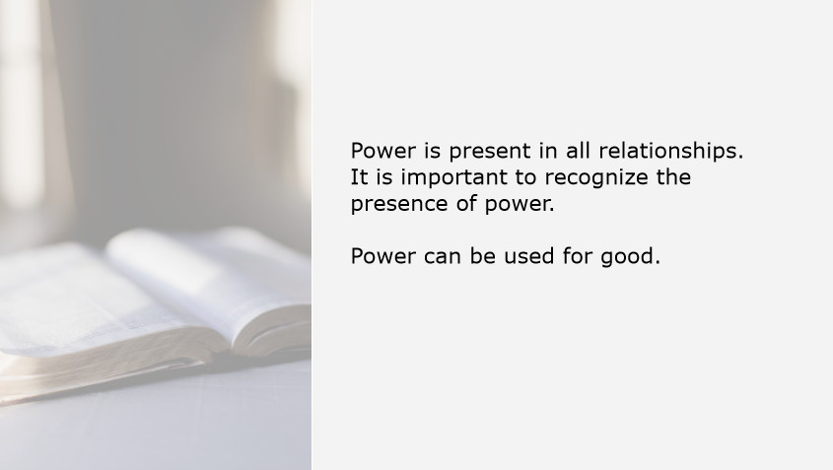
Notes:
Power is present in all relationships. It can’t be eliminated, but it is important to recognize the presence of power. It’s also important to remember that power is not a negative thing and can actually be used for good. All of us here today have some level of power in our communities. What matters most is how we use that power.
Facilitator Notes:
N/A

Slide 5
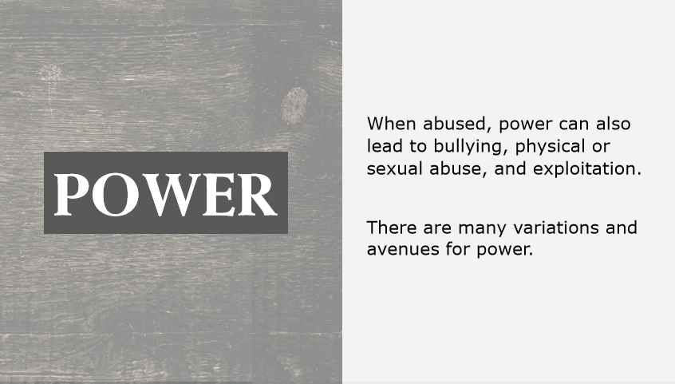
Notes:
Power:
Unfortunately, when abused, power can also lead to bullying, physical or sexual abuse, and exploitation. There are many variations and avenues for power.
Facilitator Notes:
N/A

Slide 6
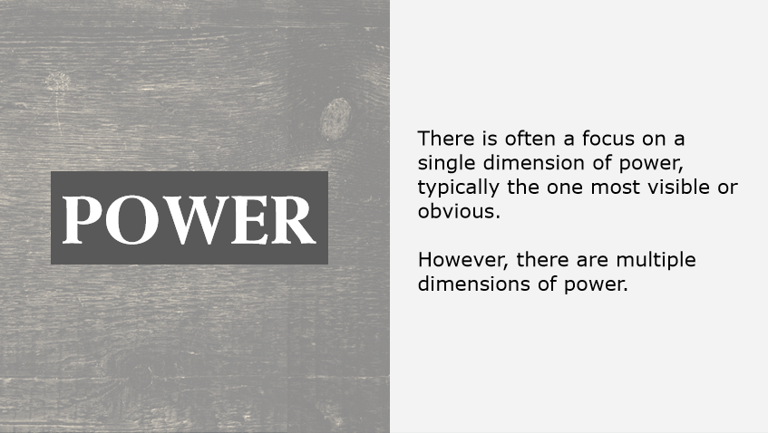
Notes:
Power:
There is often a focus on a single dimension of power, typically the one most visible or obvious. However, there are multiple dimensions of power.
Facilitator Notes:
N/A

Slide 7
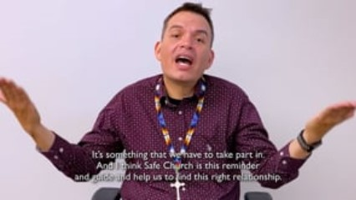
Video Example
Notes:
Video:
Click the play button to play the video.
Facilitator Notes:
Direct link to video - https://player.vimeo.com/video/689795168?h=3248bc39cb&amp;badge=0&amp;autopause=0&amp;player_id=0&amp;app_id=58479
After viewing the video, ask: “What does the word Wolakota mean?”
When the group has reached an accurate definition, then ask: “How does Wolakota relate to power?”
Some takeaways the group may have:
Wolakota is an action. Choosing to use power in healthy and productive ways is also an ongoing action, not a one-time decision.
Wolakota refers to balance with others, within ourselves, and with the Creator. That balance cannot be reached if power is being abused.

Slide 8
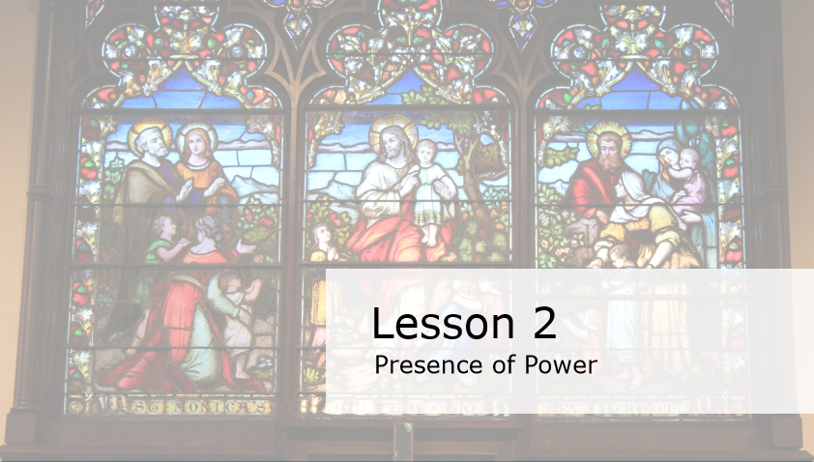
Notes:
Lesson 2: Presence of Power
In this lesson, we will discuss the presence of power.
Facilitator Note:
N/A

Slide 9
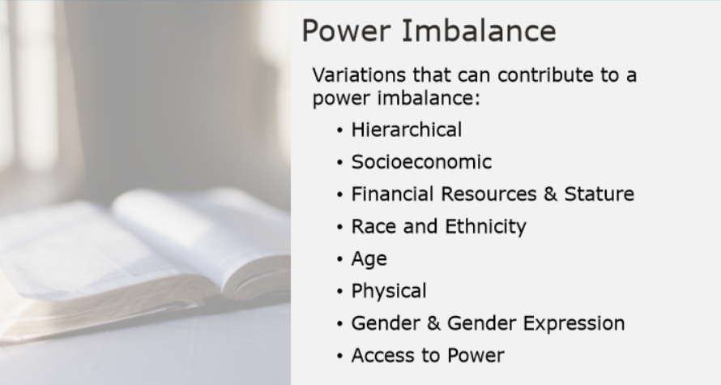
Notes:
Power Imbalance:
Let’s review the many variations that can contribute to a power imbalance. Those areas include:
Hierarchical
Socioeconomic
Financial Resources & Stature
Race and Ethnicity
Age
Physical
Gender and Gender Expression
Access to Power
Facilitator Notes:
Tell participants to put themselves into groups of three (you can vary this number depending on how many participants you have, but groups of three tend to be the most productive). Once groups are established, tell them they have four minutes to write down at least one example for each category. Be sure to set a timer.
Once the timer goes off, tell participants to save their answers to compare to the examples shared on the next slides.

Slide 10
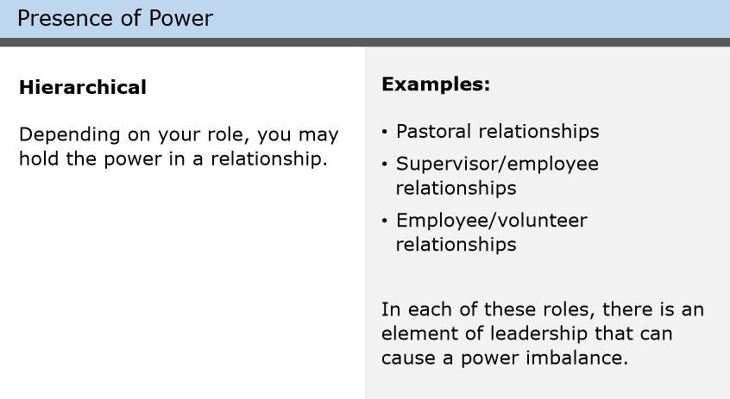
Notes:
Hierarchical: (pronunciation: higher-ark-ick-all)– Depending on your role, you may hold the power in a relationship.
What are some examples you wrote down for Hierarchical?
Facilitator Note:
Ask the group to share a few of their examples. Be sure to ask at least one sharer to explain why their group thinks the source of the power is hierarchical.
For example, learners may say something like “a pastor and a member of the church”. Then, ask why that fits the hierarchical definition. The answer should be something like “Because the pastor has power which is derived from their role”.

Slide 11
Notes:
Some examples of hierarchical power include:
Pastoral relationships, supervisor/employee relationships, and employee/volunteer relationships.
In each of these roles, there is an element of leadership that can cause a power imbalance.
Facilitator Note:
If the group was previously confused when asked to supply their own examples, this is the time to clarify and ensure participants understand before proceeding.

Slide 12
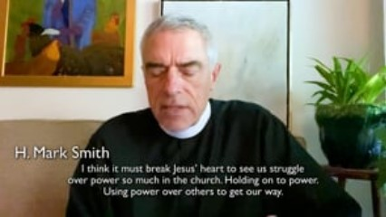
Video Example of Hierarchical
Notes:
Video:
Click the play button to play the video.
Facilitator Notes:
Direct link to video - https://player.vimeo.com/video/688940093?h=882ad854ac&amp;badge=0&amp;autopause=0&amp;player_id=0&amp;app_id=58479
After viewing the video, ask: “H. Mark Smith touched on how easy it can be, in a position of power, to ignore your power. He said: “my intention to not harm doesn’t mean I am not harming”. What does this mean?”
Help participants understand the difference between intent and impact. Intent: what you set out to do. Impact: the actual result of your behavior and actions.
Work with the group to generate an example of a good intention leading to a bad impact. If you have a whiteboard, chalkboard, or large poster available, it would be helpful to write it down so learners who process information better visually can better absorb the example.
Key takeaways for learners:
Both intent and impact are important.
H. Mark Smith specifically focused on the importance of recognizing impact, even when it’s difficult, and not dismissing issues simply because they weren’t intentional.

Slide 13
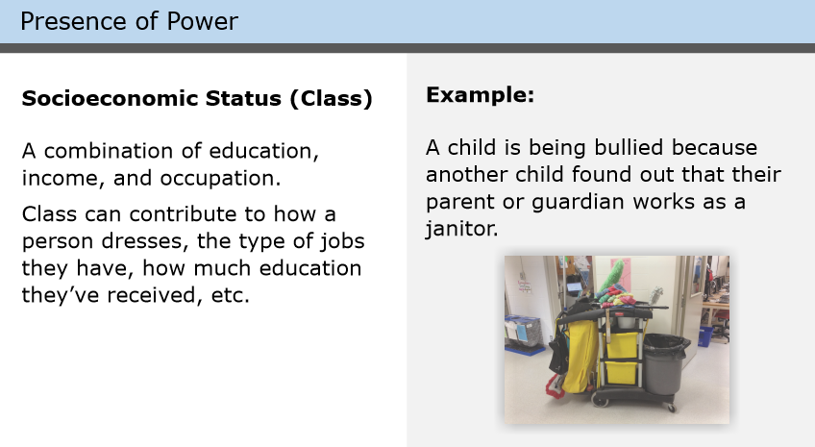
Notes:
Socioeconomic Status (Class)
Socioeconomic status, also known as class, is measured as a combination of education, income, and occupation.
Class can contribute to how a person dresses, the type of jobs they have, how much education they’ve received, and so on.
What are some examples you wrote down for socioeconomic status?
Facilitator Note:
Ask the group to share examples and to explain how they fit the category.

Slide 14
Notes:
The example here is of a child being bullied because another child found out that their parent or guardian works as a janitor.
Facilitator Note:
If the group struggled previously to provide examples or is confused, ask if anyone can explain why this example fits the category of socioeconomic status.

Slide 15
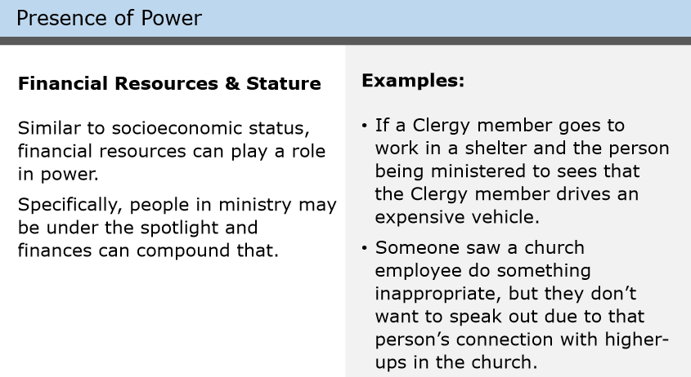
Notes:
Financial Resources & Stature
Similar to socioeconomic status, financial resources can play a role in power. Specifically, people in ministry may be under the spotlight and finances can compound that.
Facilitator Note:
Ask the group to share an example and explain why it fits the category.

Slide 16
Notes:
Examples include: If a Clergy member goes to work in a shelter and the person being ministered to sees that the Clergy member drives an expensive vehicle. Or someone saw a church employee do something inappropriate, but they don’t want to speak out due to that person’s connection with higher-ups in the church.
Facilitator Note:
If the group struggled previously to provide examples or is confused, ask if anyone can explain why this example fits the category of financial resources and stature.

Slide 17
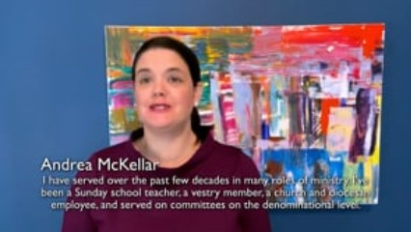
Video Example of Financial Resources
Notes:
Video:
Click the play button to play the video.
Facilitator Notes:
Direct link to video - https://player.vimeo.com/video/689273050?h=1b845adff3&amp;badge=0&amp;autopause=0&amp;player_id=0&amp;app_id=58479
After viewing the video, ask: “Andrea McKellar describes budgets in this video as “theological documents”. What do you think she means by this?”
After some discussion, ask: “How does this relate to how financial resources create power?”
Key takeaways for participants:
Budgets are a way to carry out Jesus’ mission in the world.
Asking the same limited group of people to create budgets year after year creates a power dynamic which could be problematic.

Slide 18
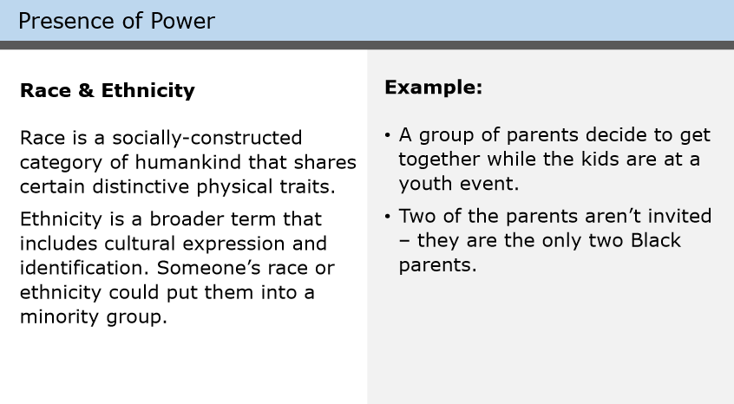
Notes:
Race & Ethnicity
Race is a socially-constructed category of humankind that shares certain distinctive physical traits. Ethnicity is a broader term that includes cultural expression and identification. Someone’s race or ethnicity could put them into a minority group.
Facilitator Notes:
Ask the group to share an example and explain why it fits the category.

Slide 19
Notes:
An example: A group of parents decide to get together while the kids are at a youth event. Two of the parents aren’t invited – they are the only two Black parents.
Facilitator Notes:
If the group struggled previously to provide examples or is confused, ask if anyone can explain why this example fits the category of race and ethnicity.

Slide 20
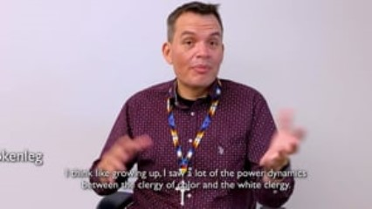
Video Example of Race and Ethnicity
Notes:
Video:
Click the play button to play the video.
Facilitator Notes:
Before watching the video, say: “Often times, sources of power overlap. See if you’re able to catch an example in the video of race and ethnicity overlapping with another source of power.”
Direct link to video - https://player.vimeo.com/video/689747100?h=0f1dbc52d8&amp;badge=0&amp;autopause=0&amp;player_id=0&amp;app_id=58479
Ask learners to share what they noticed.
One possible answer: Financial resources because a clergy member of color was paid less than white clergy members.

Slide 21
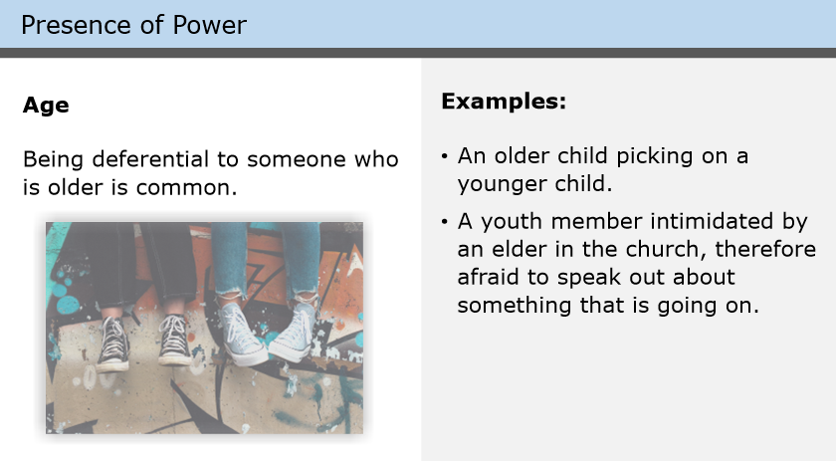
Notes:
Age
Power imbalances can be based on a person’s age. The idea of being deferential to someone who is older is common, but the power imbalance may shift toward prejudice or discrimination (ageism) when the tendency to pity another is linked to seeing older or younger people as “friendly” but incompetent.
Facilitator Notes:
Ask the group to share an example and explain why it fits the category.

Slide 22
Notes:
Examples include: An older child picking on a younger child. Or a youth member intimidated by an elder in the church and therefore afraid to speak out about something that is going on.
Facilitator Notes:
If the group struggled previously to provide examples or is confused, ask if anyone can explain why this example fits the category of age.

Slide 23
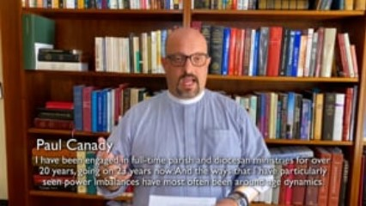
Video Example of Age
Notes:
Video:
Click the play button to play the video.
Facilitator Notes:
Direct link to video - https://player.vimeo.com/video/689753968?h=15d0b5b2d7&amp;badge=0&amp;autopause=0&amp;player_id=0&amp;app_id=58479
After viewing the video, ask the class to comment.

Slide 24
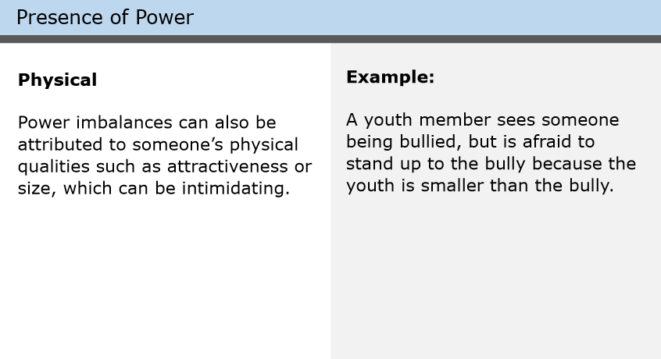
Notes:
Physical
Power imbalances can also be attributed to someone’s physical qualities such as attractiveness or size, which can be intimidating.
Facilitator Notes:
Ask the group to share an example and explain why it fits the category.

Slide 25
Notes:
Physical
Power imbalances can also be attributed to someone’s physical qualities such as attractiveness or size, which can be intimidating.
An example would be: A youth member sees someone being bullied, but is afraid to stand up to the bully because the youth is smaller than the bully.
Facilitator Notes:
If the group struggled previously to provide examples or is confused, ask if anyone can explain why this example fits the category of physical.

Slide 26
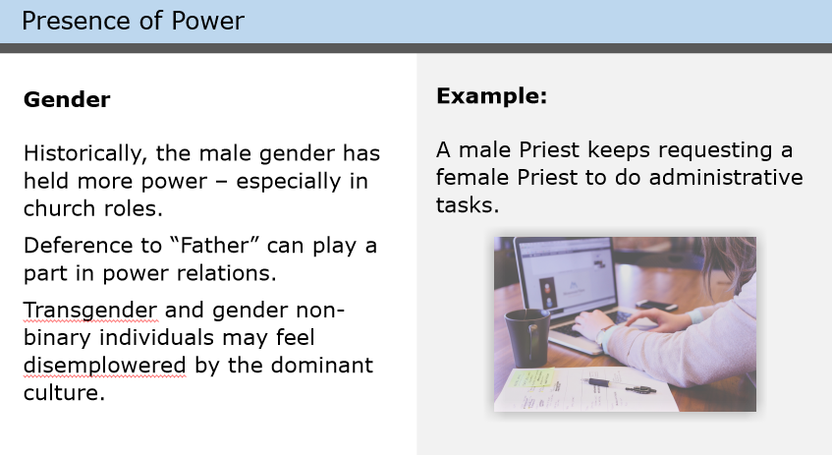
Notes:
Gender
Historically, the male gender has held more power – especially in church roles. Deference to “Father” can play a part in power relations. Also transgender and gender non-binary individuals may feel disempowered by the dominant culture, and therefore experience powerlessness.
Facilitator Notes:
Ask the group to share an example and explain why it fits the category.

Slide 27
Notes:
One example is if a male Priest keeps requesting a female Priest to do administrative tasks.
Facilitator Notes:
If the group struggled previously to provide examples or is confused, ask if anyone can explain why this example fits the category of gender.

Slide 28
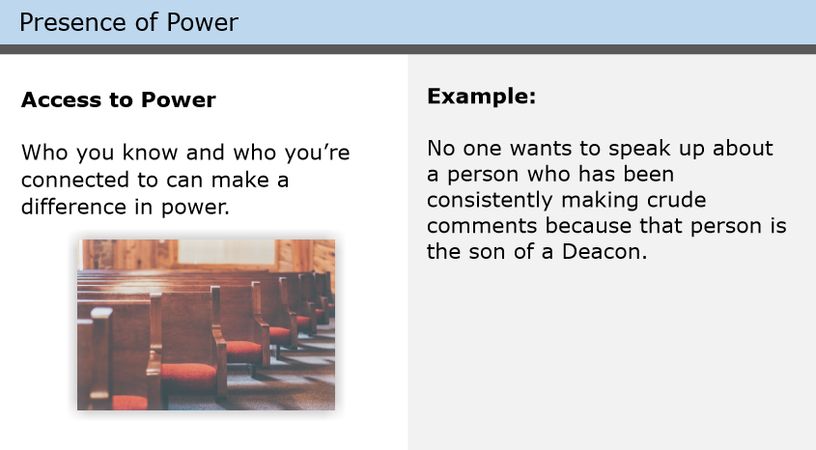
Notes:
Access to Power
Who you know and who you’re connected to can make a difference in power.
Facilitator Notes:
Ask the group to share an example and explain why it fits the category.

Slide 29
Notes:
One example is: No one wants to speak up about a person who has been consistently making crude comments because that person is the son of a Deacon in the church.
Facilitator Notes:
If the group struggled previously to provide examples or is confused, ask if anyone can explain why this example fits the category of access to power.

Slide 30
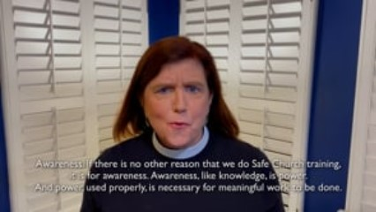
Video Example of Access to Power
Notes:
Video:
Click the play button to play the video.
Facilitator Notes:
Direct link to video - https://player.vimeo.com/video/689258888?h=b60b598a21&amp;badge=0&amp;autopause=0&amp;player_id=0&amp;app_id=58479
After viewing the video, ask participants: “How did this example of access to power help you better understand power dynamics?”

Slide 31
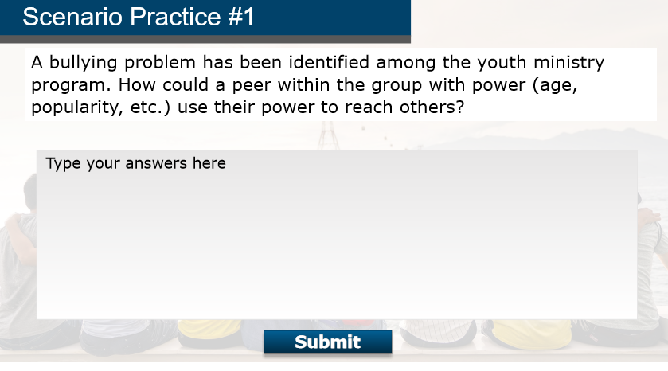
Notes:
Scenario Practice #1
Before we discuss dual relationships in the next lesson, let’s take a few moments to review a scenario. A bullying problem has been identified among the youth ministry programs. How could a peer within the group with power (age, popularity, etc) use their power to reach others?
Facilitator Notes:
Have participants break off into groups of three. Give the groups five minutes to brainstorm an answer and select a group representative to explain the group’s answer to the rest of the class. Be sure to set a timer.
When the timer goes off, ask the representative from each group to share out their answer.

Slide 32
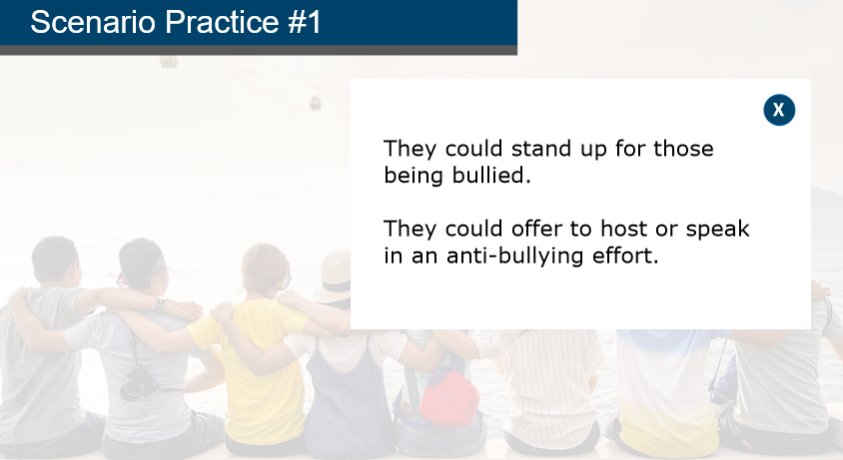
Notes:
Feedback:
You may have said that they could stand up for those being bullied. Or perhaps they could offer to host or speak in an anti-bullying effort, like an event or workshop for the program.
Facilitator notes:
Help participants draw parallels between the answers they provided and the example answers. Emphasize there is no one right way to address these situations, but there are certainly wrong ways (ignoring it, for example).

Slide 33
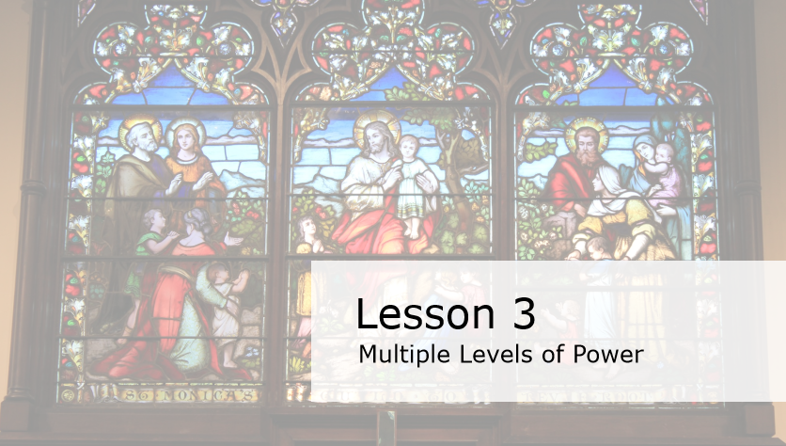
Notes:
Lesson 3: Multiple Levels of Power
In this lesson, we will talk about multiple levels of power.
Facilitator Note:
N/A

Slide 34
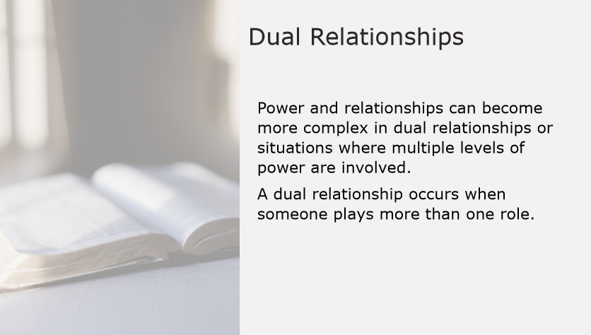
Notes:
Dual Relationships
Power and relationships can become more complex in dual relationships or situations where multiple levels of power are involved.
A dual relationship occurs when someone plays more than one role.
Facilitator Note:
N/A

Slide 35
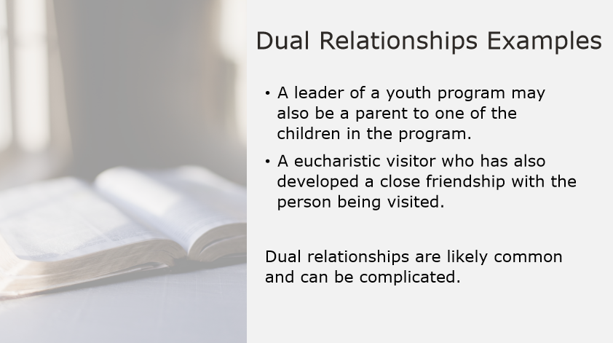
Notes:
Dual Relationships Examples
Examples of a dual relationship or situations include:
A leader of a youth program may also be a parent to one of the children in the program, or
Another example is a eucharistic visitor who has also developed a close friendship with the person being visited.
Especially in a tight-knit community, dual relationships are likely common and can be complicated.
Facilitator Note:
N/A

Slide 36
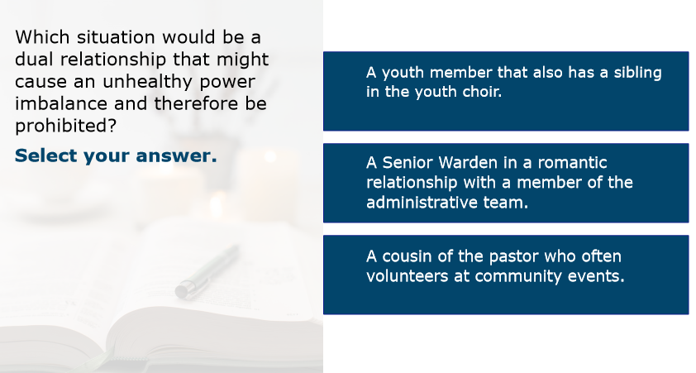
Notes:
Scenario
Which situation would be a dual relationship that might cause an unhealthy power imbalance and therefore be prohibited?
A youth member that also has a sibling in the youth choir
A Senior Warden in a romantic relationship with a member of the administrative team
A cousin of the pastor who often volunteers at community events
Facilitator Note:
Give learners a moment to process the question and possible answers, then ask them to raise their hands to indicate which answer choice they believe is correct.

Slide 37
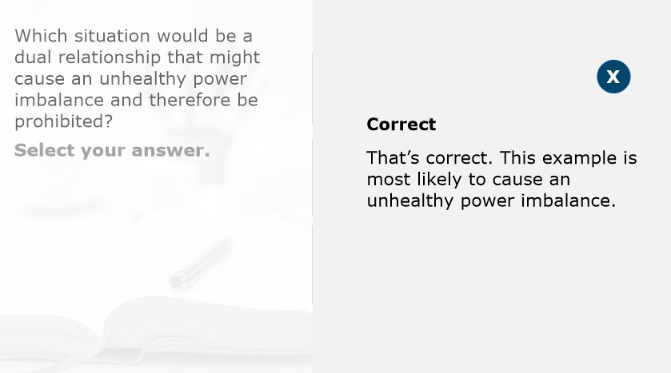
Notes:
Feedback:
That’s correct. This example is most likely to cause an unhealthy power imbalance.
Facilitator Note:
Ask someone to share why that example was most likely to cause an unhealthy power imbalance.

Slide 38
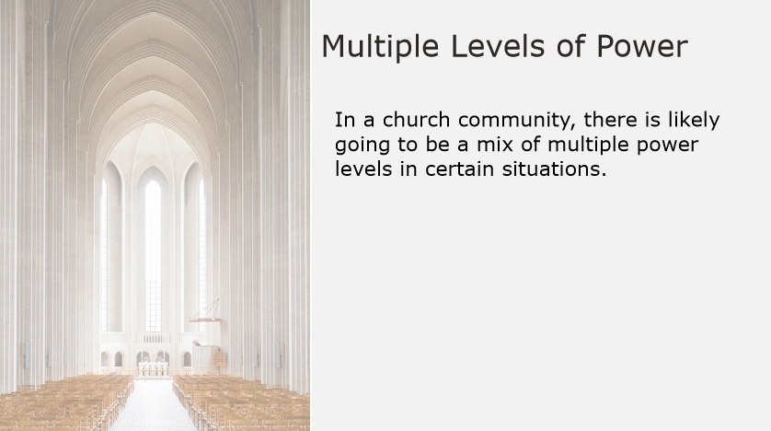
Notes:
Multiple Levels of Power
Just like with dual relationships, in a church community there is likely going to be a mix of multiple power levels in certain situations. Let’s look at a few examples on the next slides.
Facilitator Note:
Ensure learners are in their groups before proceeding.

Slide 39
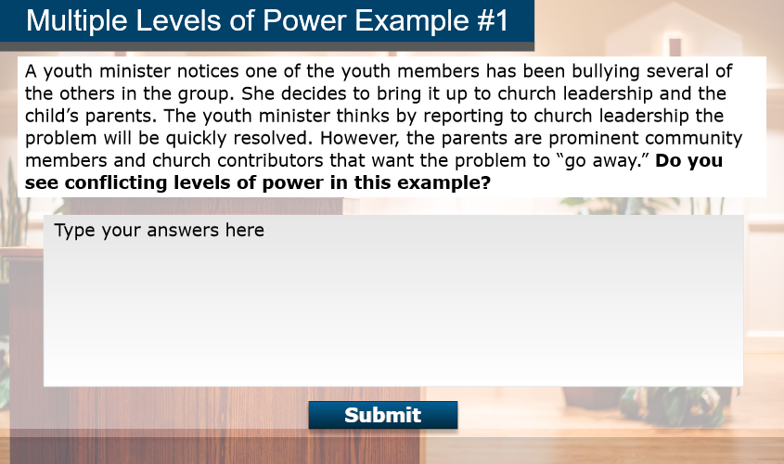
Notes:
Multiple Levels of Power Example #1
A youth minister notices one of the youth members has been bullying several of the others in the group. She decides to bring it up to church leadership and the child’s parents. The youth minister thinks by reporting to church leadership the problem will be quickly resolved. However, the parents are prominent community members and church contributors that want the problem to “go away.” Do you see conflicting levels of power in this example?
Facilitator Note:
Give the groups five minutes to brainstorm an answer and select a group representative to explain the group’s answer to the rest of the class. Be sure to set a timer.
When the timer goes off, ask the representative from each group to share out their answer.

Slide 40
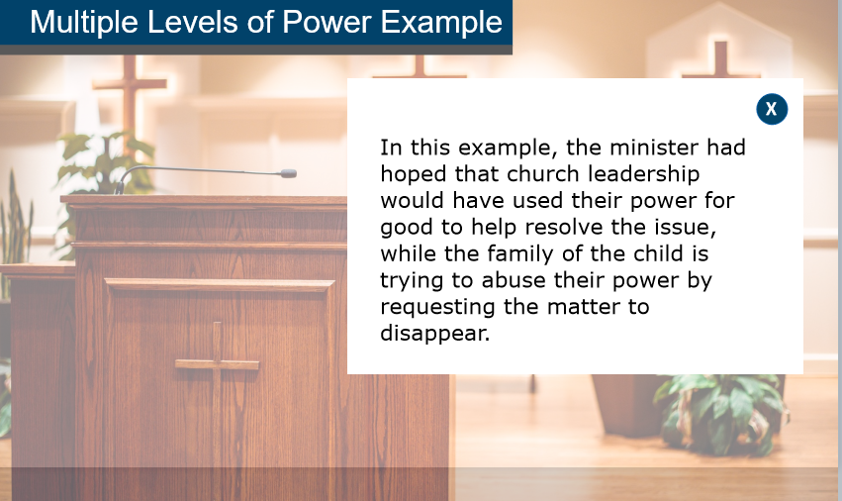
Notes:
Feedback:
In this example, the minister had hoped that church leadership would have used their power for good to help resolve the issue, while the family of the child is trying to abuse their power by requesting the matter to disappear.
Facilitator Note:
Help participants to draw parallels between the answers they provided and the example answers.

Slide 41
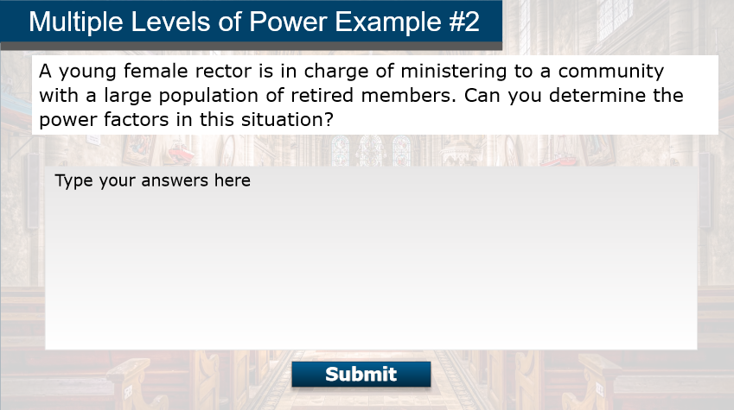
Notes:
Multiple Levels of Power Example #2
A young female rector is in charge of ministering to a community with a large population of retired members. Can you determine the power factors in this situation?
Facilitator Notes:
Give the groups five minutes to brainstorm an answer and select a group representative to explain the group’s answer to the rest of the class. Be sure to set a timer.
When the timer goes off, ask the representative from each group to share out their answer.

Slide 42
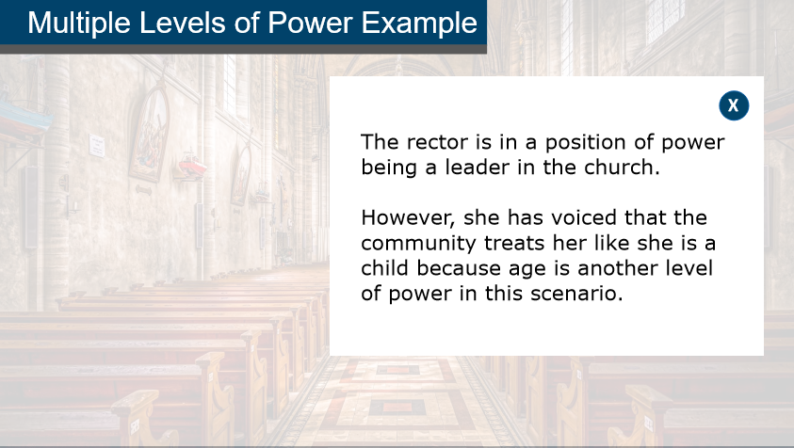
Notes:
The rector is in a position of power being a leader in the church. However, she has voiced that the community treats her like she is a child because age is another level of power in this scenario.
Facilitator Notes:
Help participants to draw parallels between the answers they provided and the example answers. Emphasize that there is no one right way to address these situations, but there are certainly wrong ways (ignoring it, for example).

Slide 43
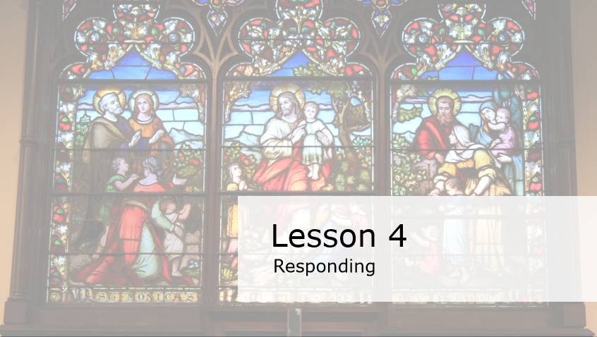
Notes:
Lesson 4: Responding
In this lesson, we’ll discuss how to respond if someone is expressing their power in an unhealthy manner.
Facilitator Note:
N/A

Slide 44
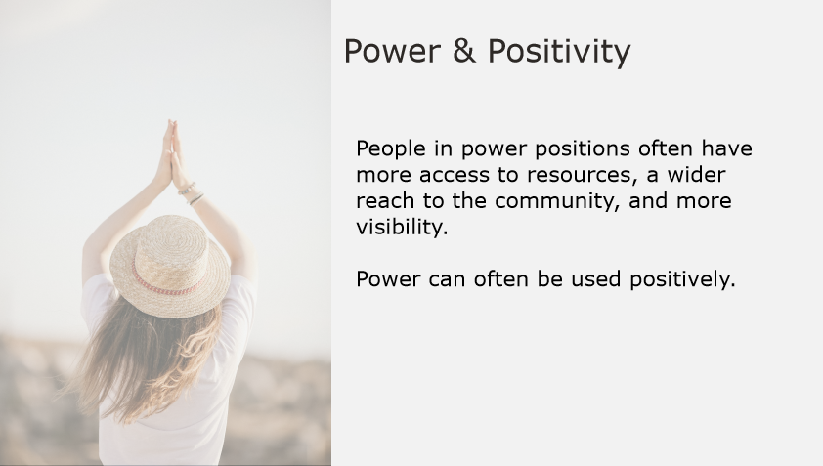
Notes:
Power & Positivity
People in power positions often have more access to resources, a wider reach to the community, and more visibility. Though we should recognize power and imbalances to prevent things like bullying, abuse, or exploitation, it should be noted that power can often be used positively.
Facilitator Notes:
N/A

Slide 45
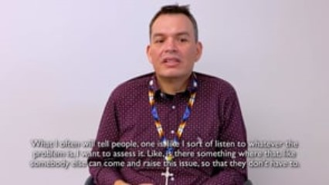
Video Example
Notes:
Video:
Click the play button to play the video.
Facilitator Notes:
As you watch the video, listen to how Reverend Shaneequa uses her power in a relationship to respond to a problem.
Direct link to video - https://player.vimeo.com/video/689790815?h=5a0c1b41e3&amp;badge=0&amp;autopause=0&amp;player_id=0&amp;app_id=58479
After viewing the video, ask: “How could you apply this example in your community?”.

Slide 46
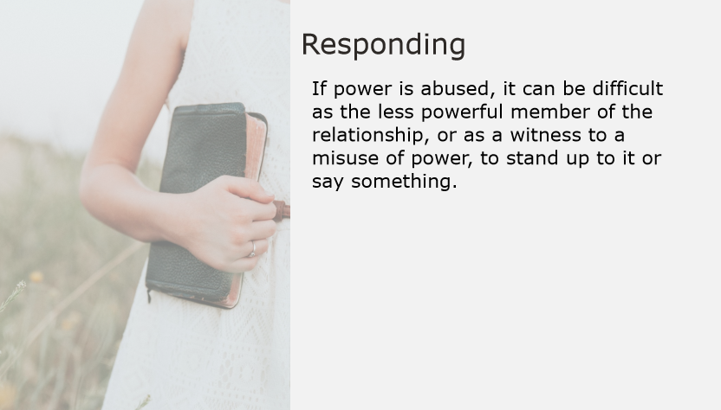
Notes:
Responding to Unhealthy Expressions of Power:
If power is abused, it can be difficult as the less powerful member of the relationship, or as a witness to a misuse of power, to stand up to it or say something.
Facilitator Notes:
N/A

Slide 47
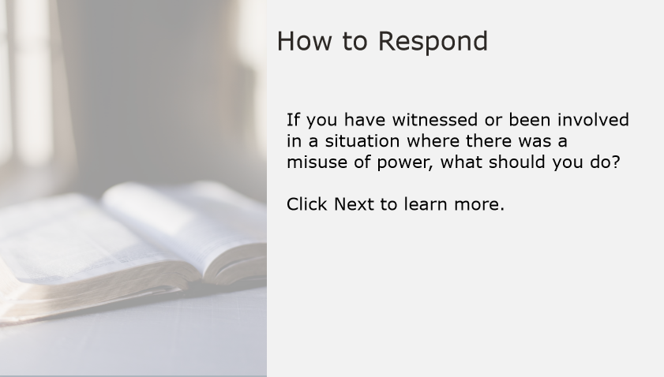
Notes:
How to Respond:
If you have witnessed or been involved in a situation where there was a misuse of power, what should you do?
Facilitator Notes:
Have participants share out their answers with the full group.

Slide 48
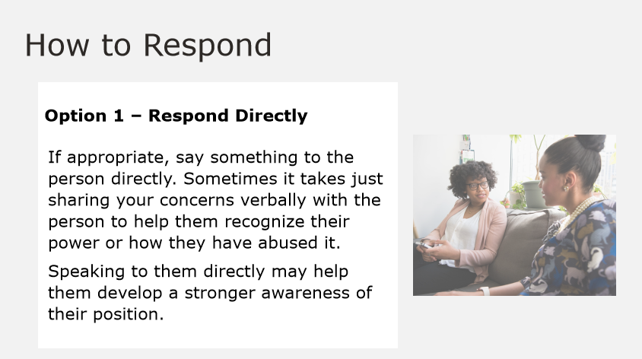
Notes:
How to Respond – Option 1: Respond Directly
If appropriate, say something to the person directly. Sometimes it takes just sharing your concerns verbally with the person to help them recognize their power or how they have abused it. Speaking to them directly may help them develop a stronger awareness of their position.
Facilitator Notes:
Ask participants: “When would this be a good option to choose?”.
Answers may include:
When you are in a position of power (or equal power) with the person who is misusing their power.
When you feel comfortable doing so.
When the person who is misusing their power is open to feedback.

Slide 49
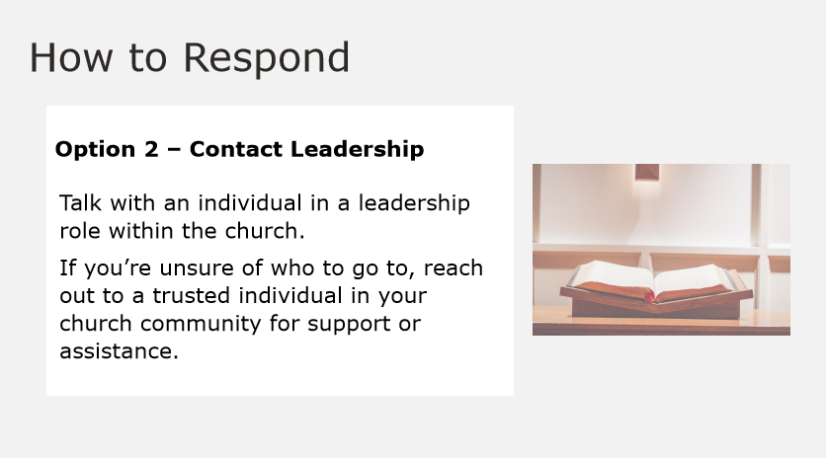
Notes:
How to Respond – Option 2: Contact Leadership
If you feel the situation should be reported or handled by a person with more authority, or if you are concerned about your safety, take it to an individual in a leadership role within the church. If you’re unsure of who to go to, reach out to a trusted individual in your church community for support or assistance.
Facilitator Notes:
Ask participants: “When would this be a good option to choose?”.
Answers may include:
When the misuse of power is significant or otherwise serious.
When the person misusing their power is unapproachable in some way (perhaps because of your power dynamic with the individual).
When you already have gone directly to the person and the interaction did not go well or the behavior hasn’t changed.

Slide 50
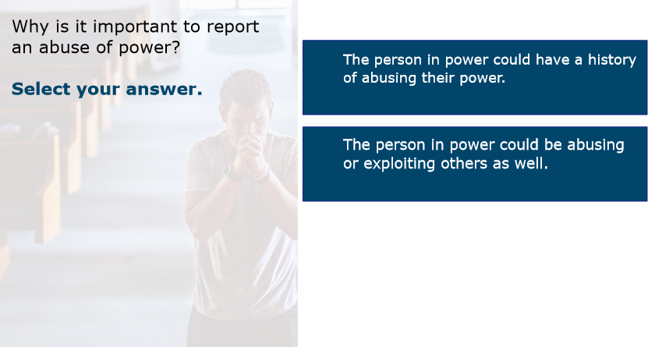
Notes:
Scenario Practice:
Why is it important to report an abuse of power?
The person in power could have a history of abusing their power.
The person in power could be abusing or exploiting others as well.
Facilitator Notes:
Give participants a moment to process, then ask them to raise their hands to indicate which answer they believe is correct.

Slide 51
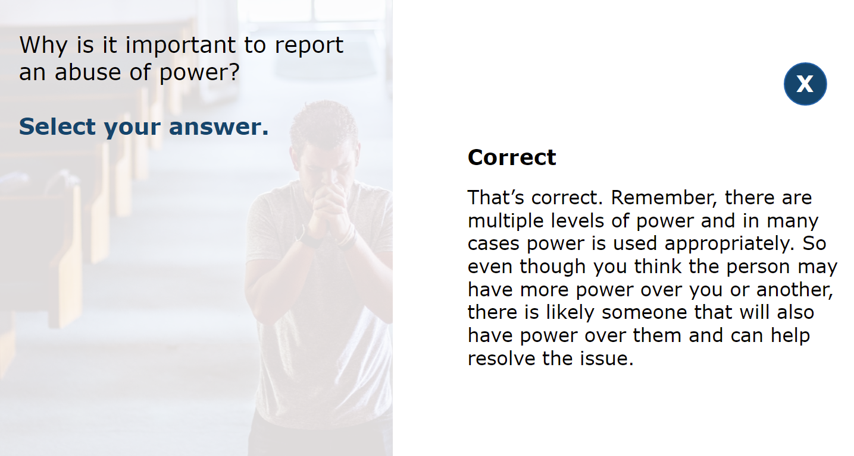
Notes:
Feedback:
Both answers are correct, although one answer may resonate more with each of us individually. Remember, there are multiple levels of power and in many cases power is used appropriately. So even though you think the person may have more power over you or another, there is likely someone that will also have power over them and can help resolve the issue.
Facilitator Notes:
N/A

Slide 52
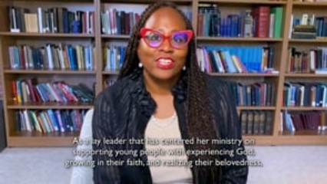
Video Example
Notes:
Video:
Click the play button to play the video.
Facilitator Notes:
Let’s look at one last video in this course. Listen carefully to how she relates power and love.
Direct link to video - https://player.vimeo.com/video/689843797?h=a028bfe63f&amp;badge=0&amp;autopause=0&amp;player_id=0&amp;app_id=58479
After viewing the video, ask: “Myra mentions in the video the relationship between power and love. She says: “Sometimes I think the way that I see power play out in the church is that we may not be loving one another in an appropriate way”. What do you think she’s referring to with this statement?”
Responses may include things like:
The abuse of power is not love.
We are called to love one another, and part of that calling means we are thoughtful and responsible about how we manage power and how we balance our intent and impact.

Slide 53
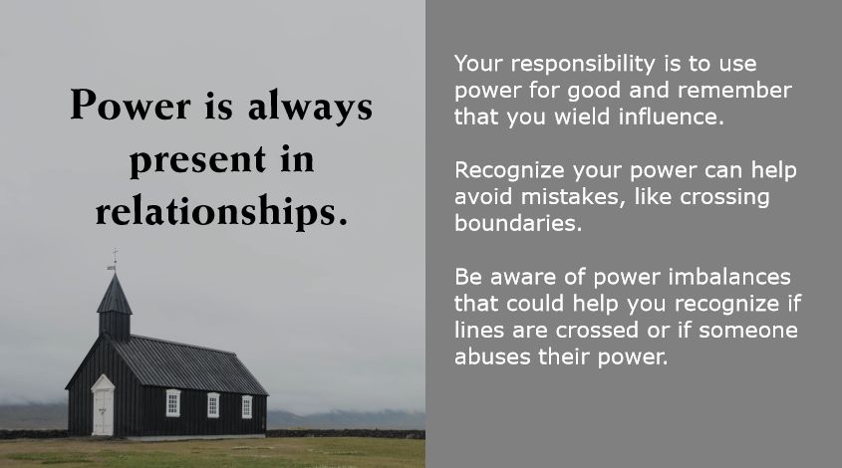
Notes:
Power is Always Present in Relationships
Power is always present in relationships. Though it’s not inherently positive or negative, if you are in a position of power your responsibility is to use power for good and remember that you wield influence. When you are the one with the power, recognizing your power can help avoid mistakes, like crossing boundaries. Even when not in the power position, you can be aware of power imbalances that could help you recognize if lines are crossed or if someone abuses their power.
Facilitator Notes:
N/A

Slide 54

Questions and Comments
Let’s take a moment to discuss any questions or comments you may have.
Notes:
Questions and Comments
This will conclude our discussion on this Safe Church, Safe Communities course: Power and Relationships.
What questions or comments do you have?
Allow participants to answer the first question fully before moving onto the second question:
What have you learned about power and relationships that you maybe did not know before this training?
Facilitator Note:
As you wrap up the discussion, be sure to:
Tell participants who they can reach out to if they have further questions or comments about the content covered in this training.
Conclude by thanking participants for their time and dedication.

