Slide 1

Thank you, High Plains Diocese!
Covenant Cupboard Food Pantry appreciates your ongoing support!

Slide 2

Our revised mission statement:
to address the food security needs of our community in a compassionate, dignified and secure environment.

Slide 3
With your help . . .
In 2025, Covenant Cupboard Food Pantry served:
8,163 households = 31,360 individuals.
a weekly average of 160 households.
12% seniors, 34% children, and 54% adults.
429 new client households, an average of 8 per week.

Slide 4
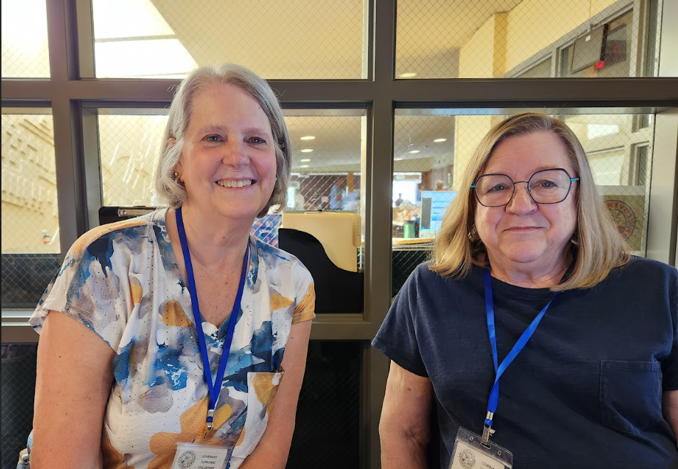
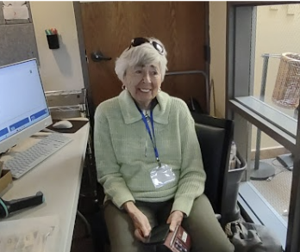
Friendly faces waiting to help new clients get registered to receive food.

Slide 5
With your help . . .
From January-July 2026, Covenant Cupboard Food Pantry served:
4,582 households = 16,439 individuals.
a weekly average of 148 households.
16% seniors, 33% children, and 51% adults.
185 new client households, an average of 6 per week.

Slide 6
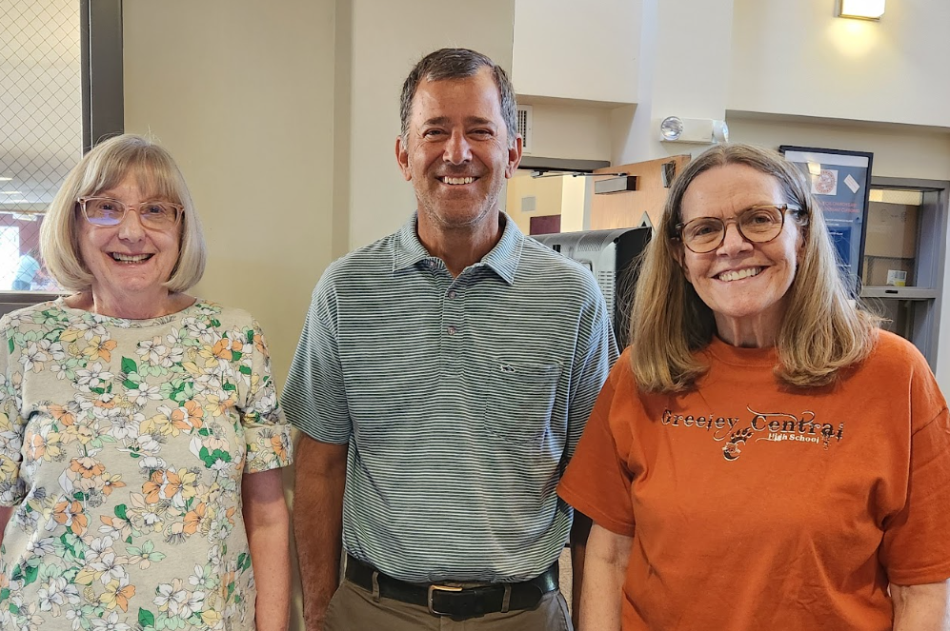
More friendly faces ready to greet our guests.

Slide 7
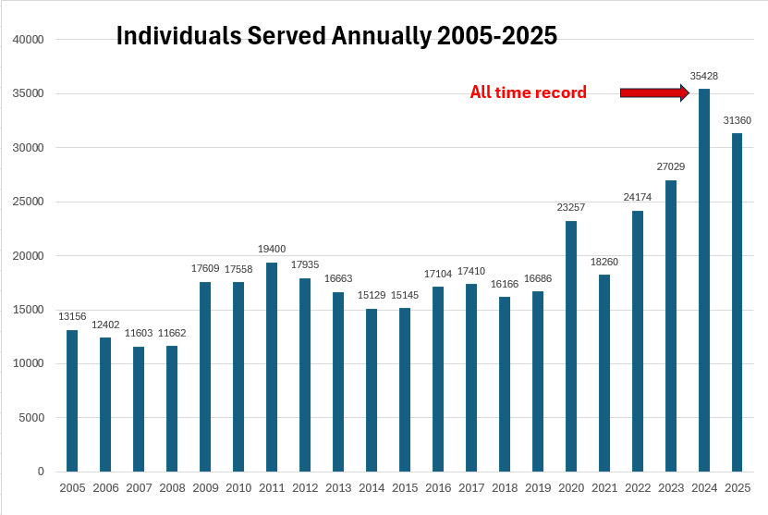

Slide 8
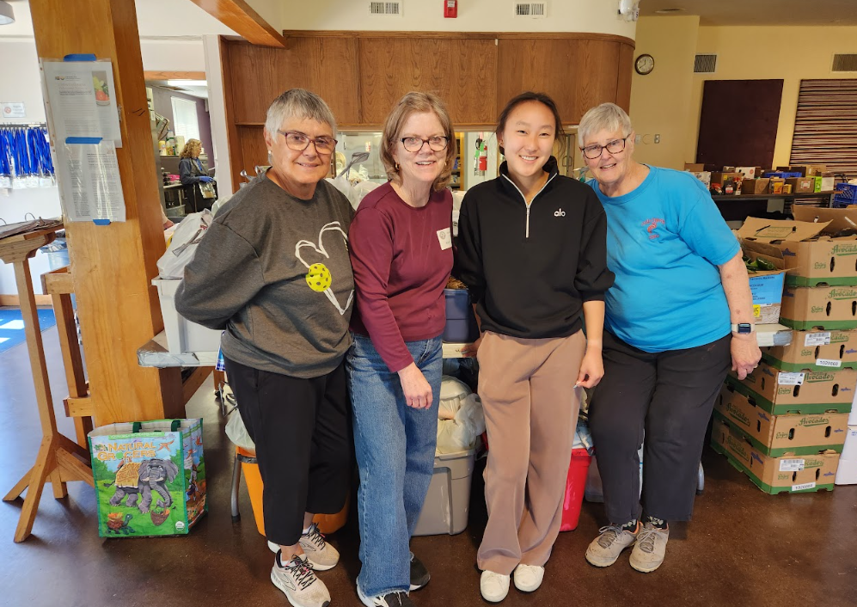
One of our Friday AM preparation crews.
Notes:
One of our Friday morning distribution crews

Slide 9
We strive to provide healthy and desirable food
2 TEFAP pick-ups every month from Food Bank of the Rockies
Food sourced from Food Bank of the Rockies Agency Express and Supplemental TEFAP weekly
Grocery Rescue - 14 pick-ups at 9 sites per week
Additional food purchased from Restaurant Depot
Organic produce from CSU’s Silo Park Master Garden during the growing season

Slide 10
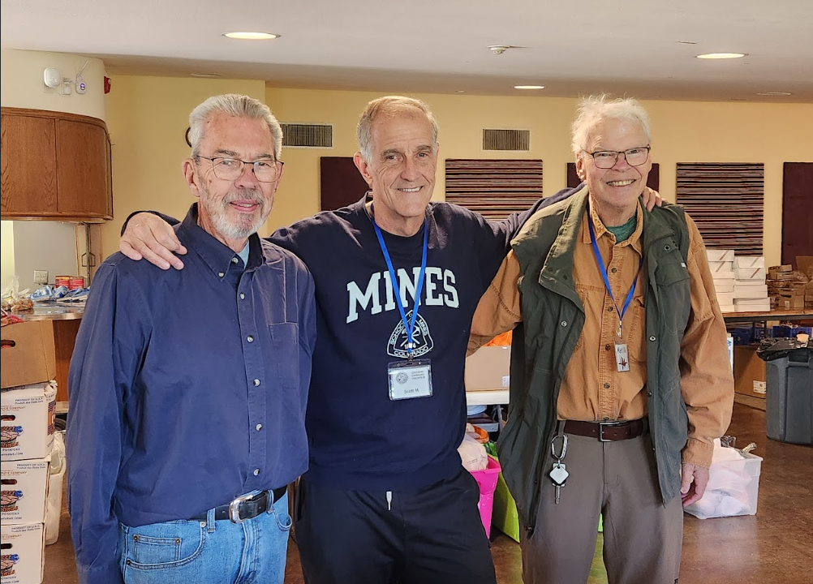
Some of our commodity distribution team members.

Slide 11
We strive to provide healthy and desirable food
Emphasis on fresh produce and high quality proteins
Day boxes for late arrivals or ineligible visits with list of other pantries
Surplus food donated to other organizations fighting hunger
299 families served at Thanksgiving distribution in Nov 2025
229 Everyday Eats boxes provided for low-income seniors

Slide 12
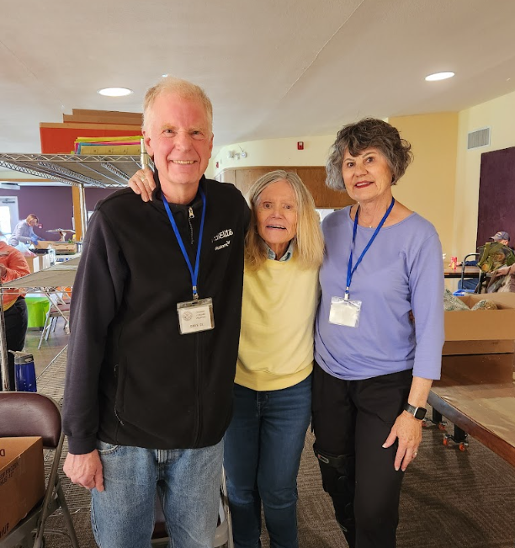
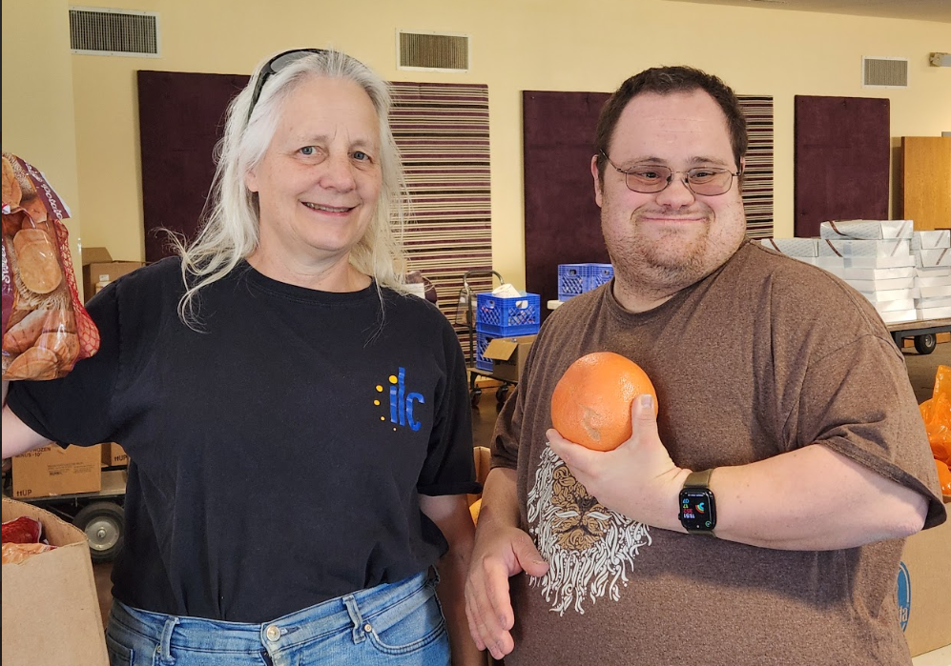
Ready to let guests know how many items to choose from various areas.

Slide 13
CCFP moves a lot of food!
TEFAP (The Emergency Food Assistance Program) 117,061 pounds
Agency Express 35,525 pounds
Grocery Rescue 172,703 pounds
(King Soopers, Walmart, Sprouts, Trader Joe’s)
Food Donation Connection 55,043 pounds
(Whole Foods, Chick Fil-A)
Community Food Drives 16,000+ pounds
Stamp Out Hunger Food Drive 2026 5,100 pounds
Purchases from Restaurant Depot during 2025 totaled $8,874

Slide 14
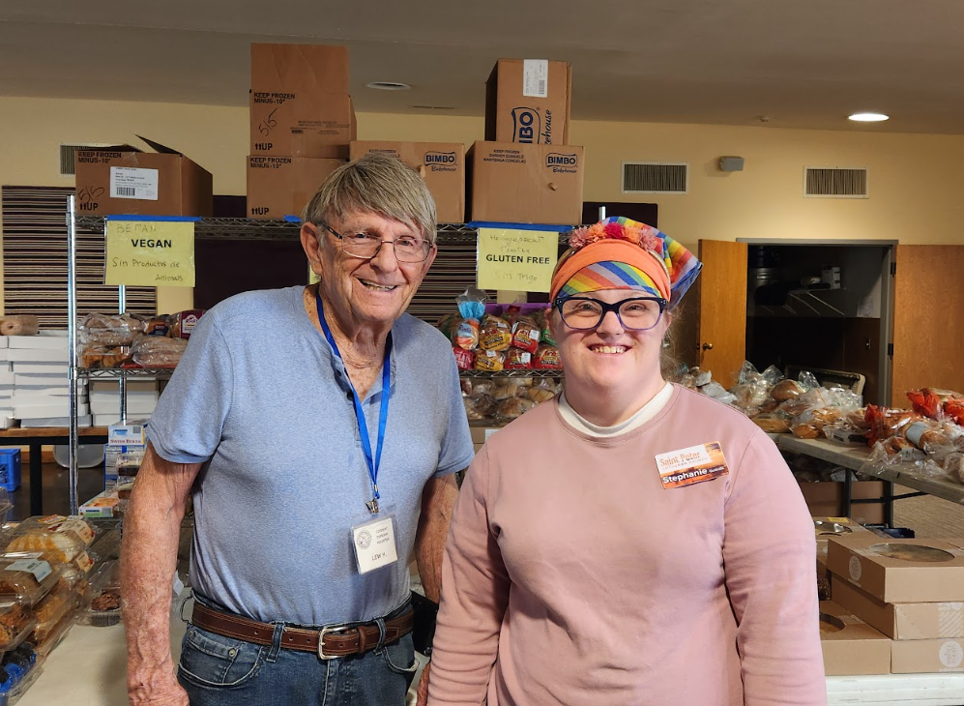
Our volunteers who share miscellaneous items and desserts.

Slide 15
Community Food Drive Partners!
St. Catherine’s Greek Orthodox
Saint Peter Lutheran
UC Health
Colorado Athletic Club
Cherry Creek Vista Subdivision
Stoney Brook Subdivision
Aprio
Reynolds Financial Group
EcoShield Pest Solutions
Digitech Systems
Cventures Inc.
Boy Scout Troop 345
Other Boy Scouts/Cub Scouts
Primrose Preschool DTC
Powell Middle School
Cherry Creek Academy
Walnut Hills Elementary
University Park Elementary
Cherry Hills Christian School
St. Mary’s Catholic School
Bright Horizons Montessori
Whee Preschool

Slide 16
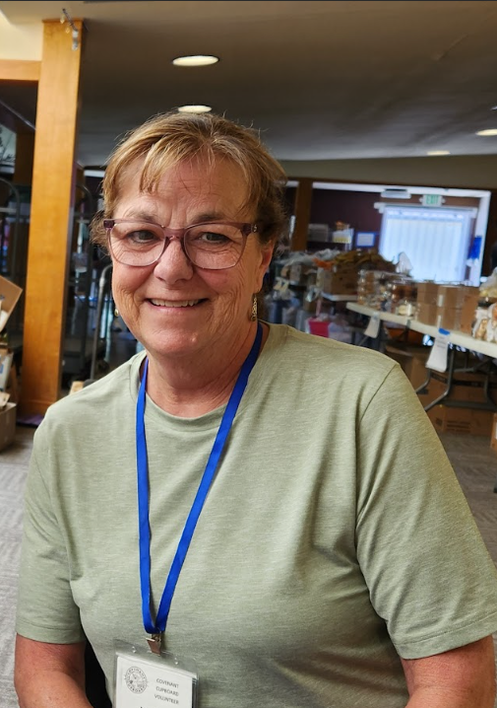
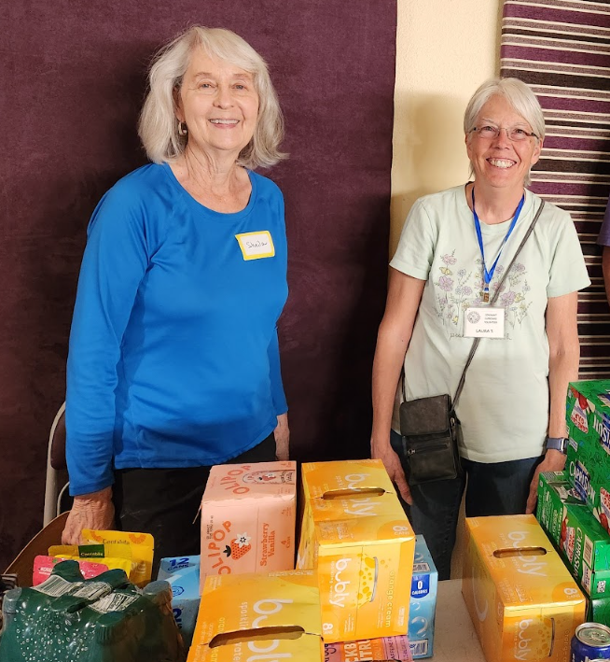
Vegetables? Choose a drink!

Slide 17
Primary Expenses 2025
Food purchased from wholesalers $10,412
Food purchased from Food Bank of Rockies $10,338
Supplies $3,873
Repairs and maintenance $2,162
Rent $13,300
Truck Expenses $5,869
General (phone, software, website, etc) $5,207
Leveraged grants from Food Bank of Rockies, Denver Presbytery, PCOC Endowment, High Plains Diocese, AngloGold Ashanti, and the Tracy Family Foundation for $31,172.
Notes:
Total expenses for year $54,840 ($48,138 in 2022)

Slide 18
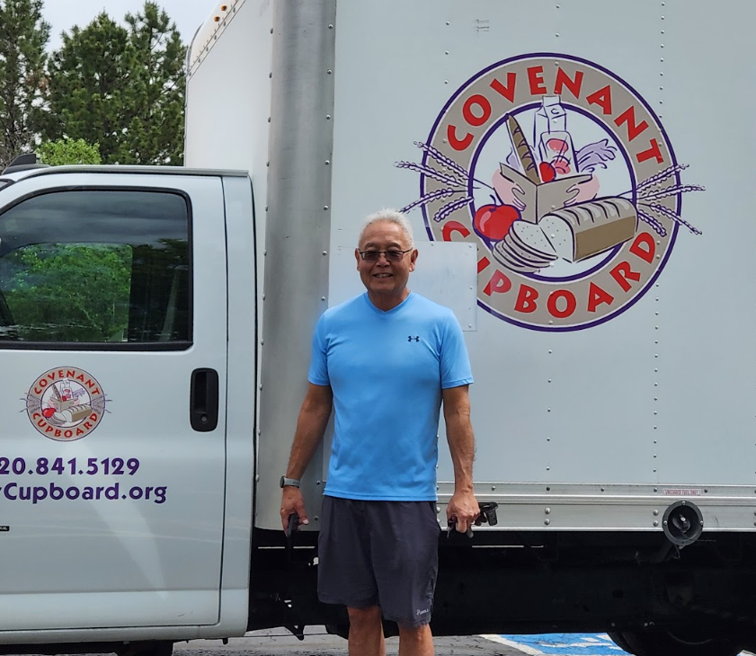
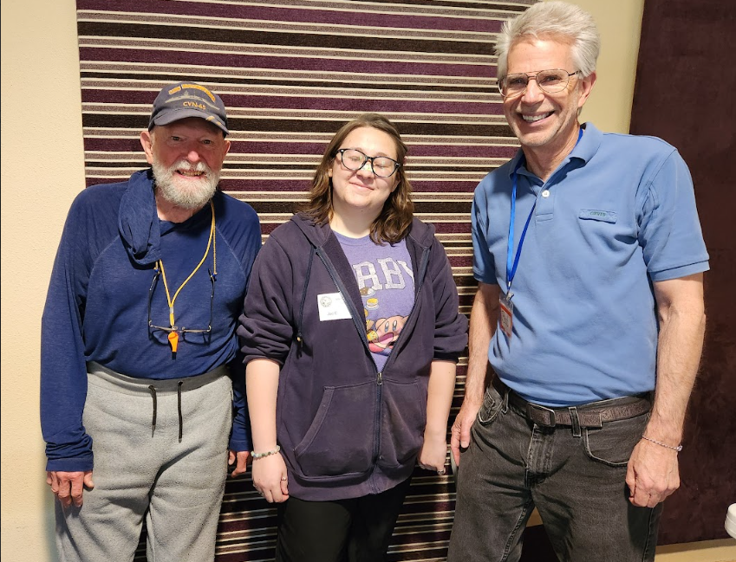
One of our pickup drivers; afternoon volunteers ready to assist guests.

Slide 19
things to be proud of...
31 years of addressing food insecurity in a 100% volunteer operation, using 50+ volunteers every week!
Dental supplies were provided to 2,553 clients and their children, thanks to major donations from Powell Middle School and two dental supply/insurance companies in Pennsylvania.
In partnership with WeeCycle, 30,675 diapers were distributed to 778 children.
rd
1:26 PM Today
Does anyone count volunteers or hours?

Slide 20
More to be proud of...
Thousands of books were provided for children and adults from donations and through a partnership with BookGive.
The Christmas toy distribution held at Saint Peter Lutheran offered toys to 369 children.

Slide 21
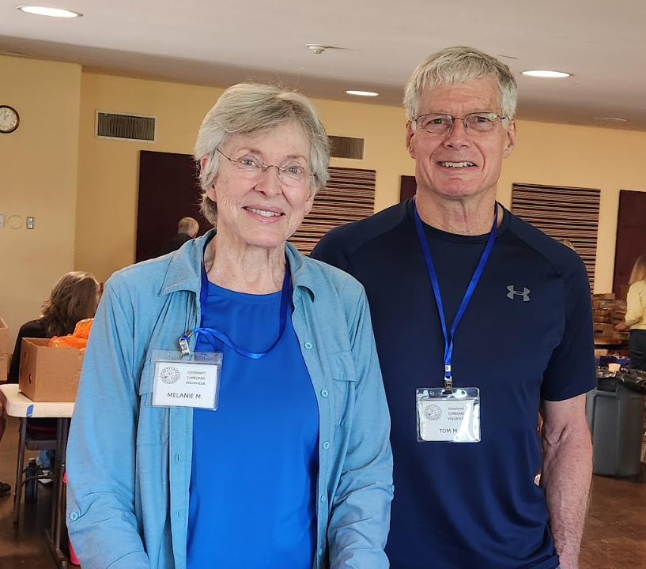
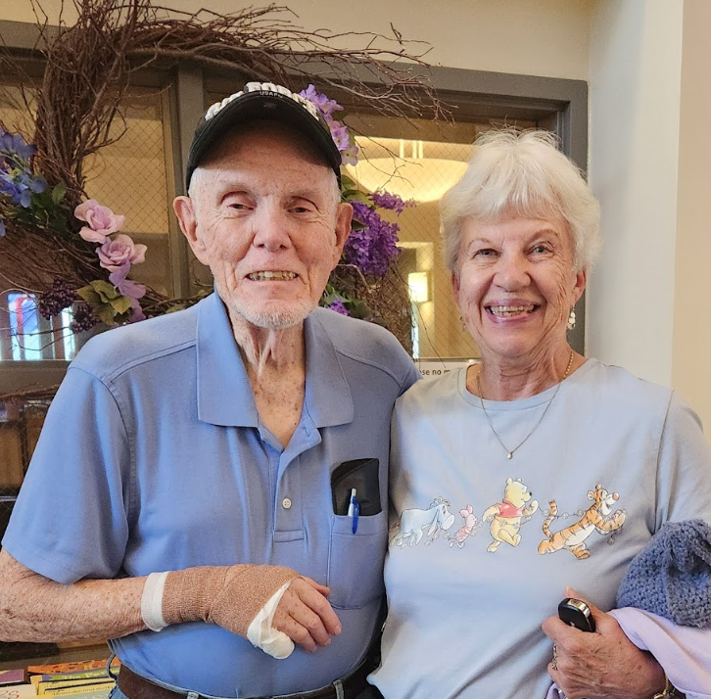
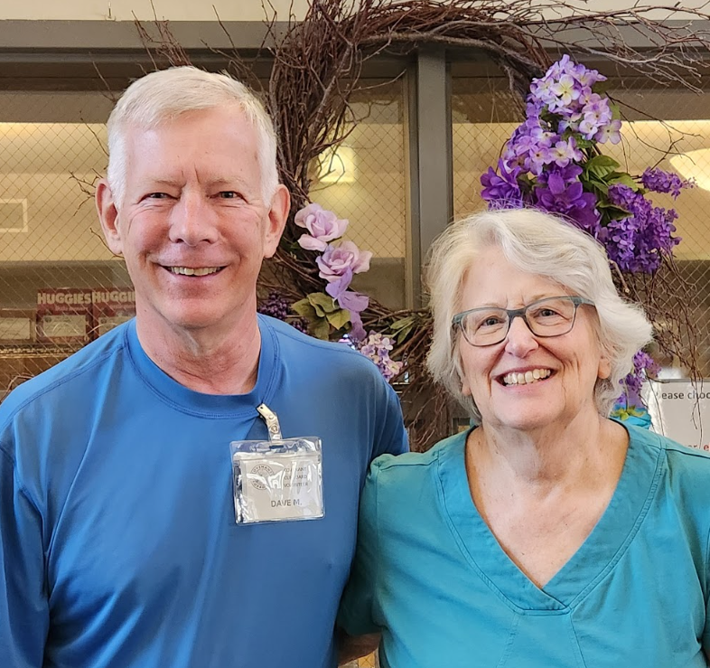
Couples who enjoy volunteering together.

Slide 22
Activities in the works
Replacing our website to improve accessibility and language justice
Recruiting volunteers and back-ups for key positions, realized the importance of this after the passing of a lead volunteer in November 2025
Revising procedures for distribution of Christmas toys

Slide 23
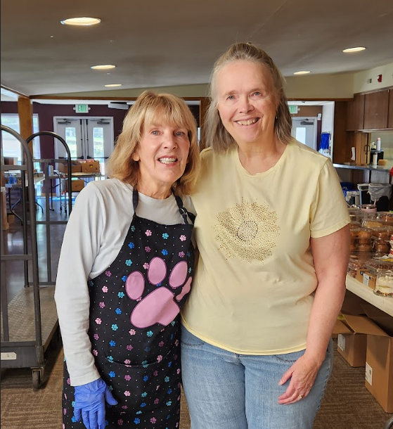
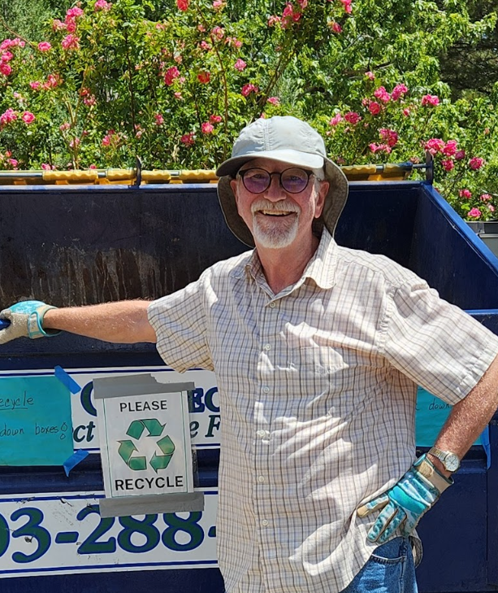
Ready for another fun Friday afternoon of serving our neighbors!

Slide 24

We appreciate our generous volunteers and supporters!
Together, we continue to make a difference.
Thank you High Plains Region!

