Slide 1
The Colorado Asset Map
A Guide for the Complete Beginner
The Diocese of Colorado

Slide 2
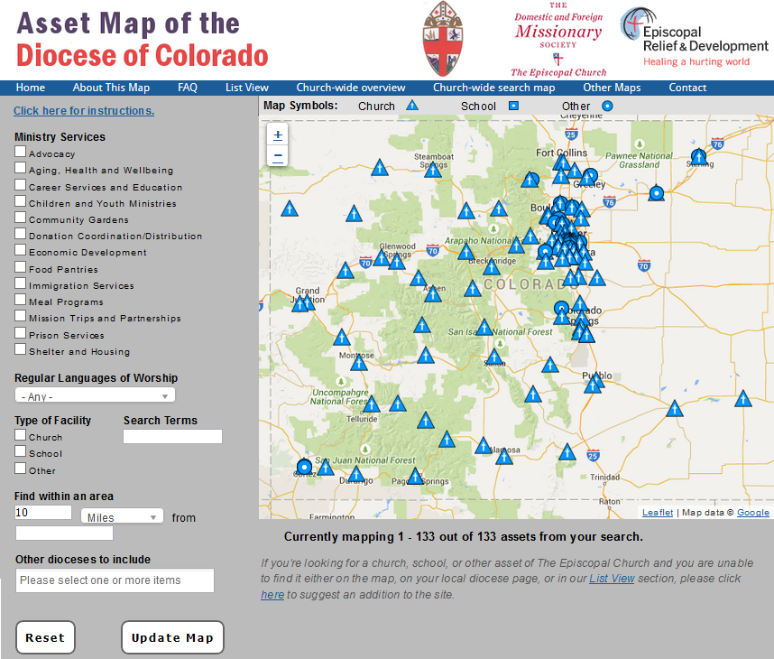
Step 1: Go to http://edco.episcopalassetmap.org/

Slide 3
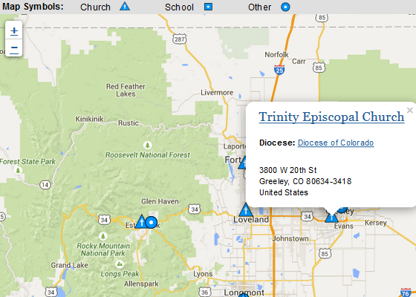
Step 2: Find your Pin
Zoom in using + and – control in lower right corner of map
Click on your pin

Slide 4
Step 3: Click on the name of your church
At the top of the dialog box

Slide 5
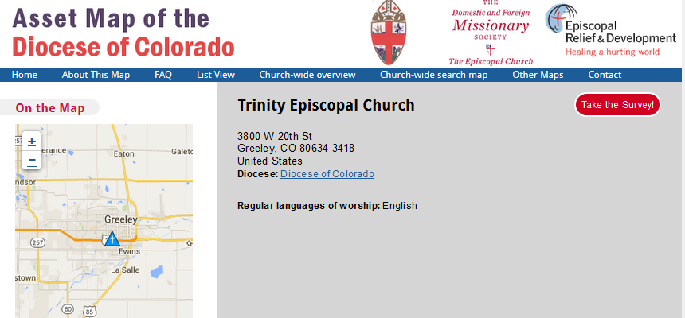
Step 4: This bring up your current Profile

Slide 6
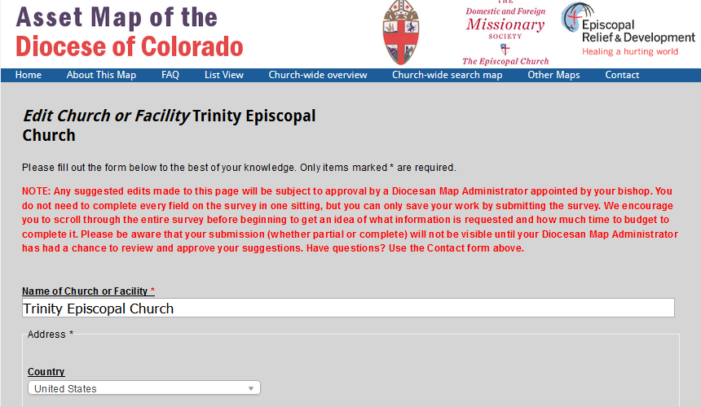
Step 5: Click on the red Take the Survey button
This allows you to edit the Profile information

Slide 7
Step 6: Complete as much of your Profile as you can
Fill in the little arithmetic problem
But it’s not hard – you can probably cut and paste most text from your church’s web site
When you are done go to the bottom of the Profile form…

Slide 8
Step 7: Save your Profile
Fill in the arithmetic box
Click SUBMIT

Slide 9
Step 8: Your work is done!
Your new Profile will not yet be shown on the map, but….
….once it has been approved, it will appear.
This takes 1-2 working days, so….
…wait a day or two and go back to Steps 1-3 and look at your new Profile.
If you didn’t fully complete the Profile, you can go back to it any time.
And the same goes if you need to change any information – just go back to Step 1 and go through the editing process.

Slide 10
Some tips
People may look at your Profile when they are visiting the area or are shopping for a new church
So take advantage of this tool and make your Profile attractive, simple and informative.
Put yourself in the shoes of someone who doesn’t know your church – what do they want to know?
Use pictures!

Slide 11
Questions?
Call or email:
Hill Grimmett, Disaster Recovery Coordinator
HGrimmett@ColoradoDiocese.org
(970) 231-1197
or your Regional Disaster Warden (see following page)

Slide 12
Regional Disaster Wardens
Front Range Region Hill Grimmett. St Luke’s, Fort Collins
hgrimmett@coloradodiocese.org 970-231-1197
High Plains Region Mason Whitney, St Gabriel’s, Cherry Hills Village
masoncwhitney@gmail.com <phone>
Sangre de Christo The Rev. Mary Hendricks, St Andrew’s Episcopal and
Region Holy Cross Lutheran Church, La Junta
marydh@aya.yale.edu 308-340-8996
Northwestern Region TBD
Southwestern Region TBD

